Slide 1
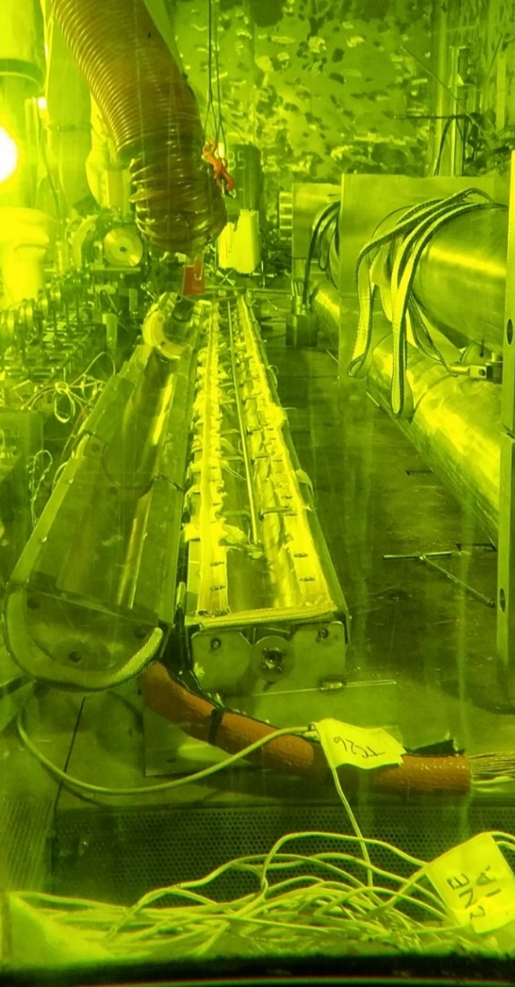
A specially designed heat treatment oven was used to simulate temperatures of dry storage vacuum drying on three sister rods: 1 M5, 1 ZIRLO, and 1 Zirc-4
The oven has 7 zones using individual insulated heating blankets and is capable of multiple temperature profiles
Each of the 3 selected sister rods was heat treated using a flat axial profile at 400 °C with a ≤5 °C/hr cooldown rate
Each rod heat treatment included approximately 38 h heatup + 8 h at temperature + 100 h cooldown
The metallographic and mechanical test results from the heat-treated rods will be compared with the data from baseline rods to determine if vacuum drying imposes any changes on the cladding
ORNL’s 7-zone heat treatment oven located in the Irradiated Fuels Examination Laboratory can heat treat full length spent fuel rods.
Image provided by R.A. Montgomery; US Dept. of Energy, Oak Ridge National Laboratory
Notes:
The project cask drying temperature was below 300C

