Slide 1
Strategy for the Management and Disposal of Used Nuclear Fuel and High-Level Radioactive Waste
John Wagner
Oak Ridge National Laboratory
Nuclear Fuels Storage and Transportation Planning Project
U.S. Department of Energy
10th Meeting of the U.S.-Argentina Joint Standing Committee on Nuclear Energy Cooperation
Oak Ridge, Tennessee
August 2013
Notes:
A-3-5 Radioactive Waste Management – Blue Ribbon Commission

Slide 2
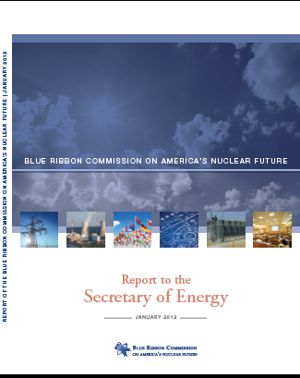
Blue Ribbon Commission
Recommendations
A new, consent-based approach to siting future nuclear waste management facilities.
A new organization dedicated solely to implementing the waste management program and empowered with the authority and resources to succeed.
Access to the funds nuclear utility ratepayers are providing for the purpose of nuclear waste management.
Prompt efforts to develop one or more geologic disposal facilities.
Prompt efforts to develop one or more consolidated storage facilities.
Prompt efforts to prepare for the eventual large-scale transport of spent nuclear fuel and high-level waste to consolidated storage and disposal facilities when such facilities become available.
Support for continued U.S. innovation in nuclear energy technology and for workforce development.
Active U.S. leadership in international efforts to address safety, waste management, non-proliferation, and security concerns.

Slide 3
Summary of the Administration’s
UNF and HLW Strategy
Statement of Administration policy regarding the importance of addressing the disposition of used nuclear fuel and high-level radioactive waste
Response to the final report and recommendations made by the Blue Ribbon Commission on America’s Nuclear Future
Initial basis for discussions among the Administration, Congress, and other stakeholders
10-year program of work that:
  Sites, designs, licenses, constructs, and begins operations of a pilot interim storage facility
  Advances toward the siting and licensing of a larger interim storage facility
  Makes demonstrable progress on the siting and characterization of geologic repository sites

Slide 4
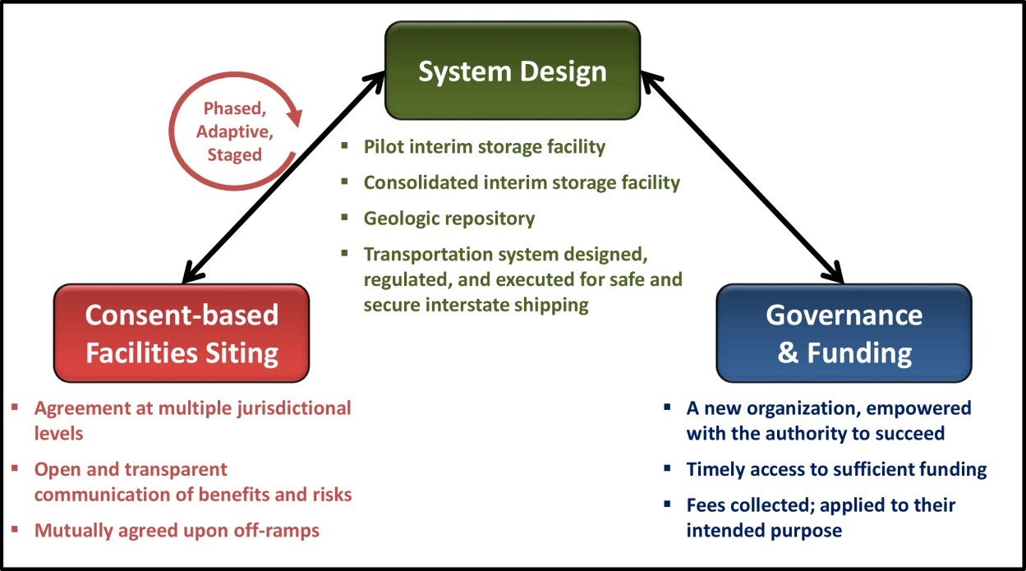
Key Strategy Elements

Slide 5
Implementation:
Interim Storage Facilities
Facilities sited using consent-based process and licensed by the Nuclear Regulatory Commission
Pilot-scale interim storage facility
  Focused on servicing shut-down reactors
  Operational in 2021
Consolidated interim storage facility
  Larger capacity to provide system flexibility
  Operational in 2025

Slide 6
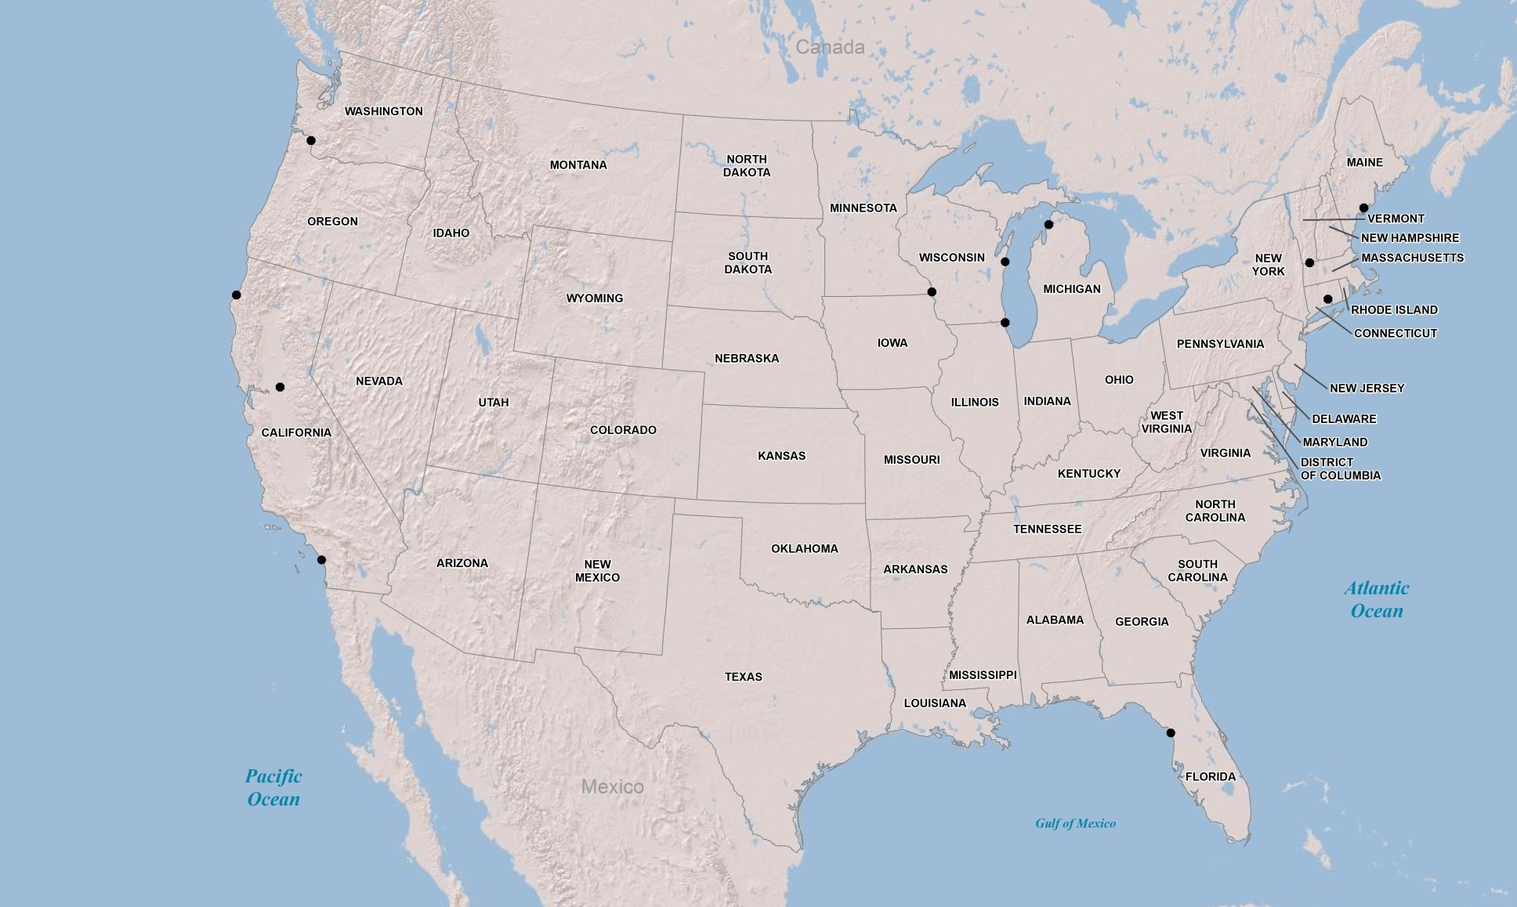
Locations of Shut-down Reactor Sites
Trojan- UNF 34; GTCC 0
Maine Yankee- UNF 60; GTCC 4
Kewaunee- UNF 45; GTCC 2 (Estimated)
Big Rock Point- UNF 7; GTCC 1
Yankee Rowe- UNF 15; GTCC 1
Humboldt Bay- UNF 5; GTCC 1
La Crosse-
UNF 5; GTCC 0
Rancho Seco- UNF 21; GTCC 1
Zion- UNF 61; GTCC 4
CT Yankee-
UNF 40; GTCC 3
San Onofre - UNF 164; GTCC 5 (Estimated)
Crystal River- UNF 42; GTCC 2 (Estimated)
Key
UNF – used nuclear fuel canisters
GTCC – canisters of greater than class C waste
Notes:
UNF and GTCC canisters for Crystal River, Kewaunee, and San Onofre estimated.
Kewaunee UNF includes 8 canisters already stored at ISFSI.
San Onofre UNF and GTCC includes 17 UNF/1 GTCC canisters from SONGS-1 already stored at ISFSI, and 33 UNF canisters from SONGS-2 and -3 already stored at ISFSI. San Onofre does not include 270 assemblies stored at Morris.
Zion revised to include 4 canisters of GTCC.

Slide 7
Implementation:
Disposal and Transportation
Geologic Repository
  Sited using consent-based process by 2026
  Designed and licensed by 2042
  Operational in 2048
Transportation
  Build on experience in industry and with Waste Isolation Pilot Plant
  Capability to service facilities safely and securely

Slide 8
Legislation Needed for Implementation
Active engagement in a broad, national, consent-based process to site storage and disposal facilities
Siting, design, licensing, and commencement of operations at a pilot-scale storage facility
Significant progress on siting and licensing of a larger consolidated interim storage facility
Development of transportation capabilities to begin movement of fuel from shut-down reactors
Reformation of the funding arrangements
Establishment of a new organization to run this program

Slide 9
Storage and Transportation
Near-Term Priorities

Slide 10
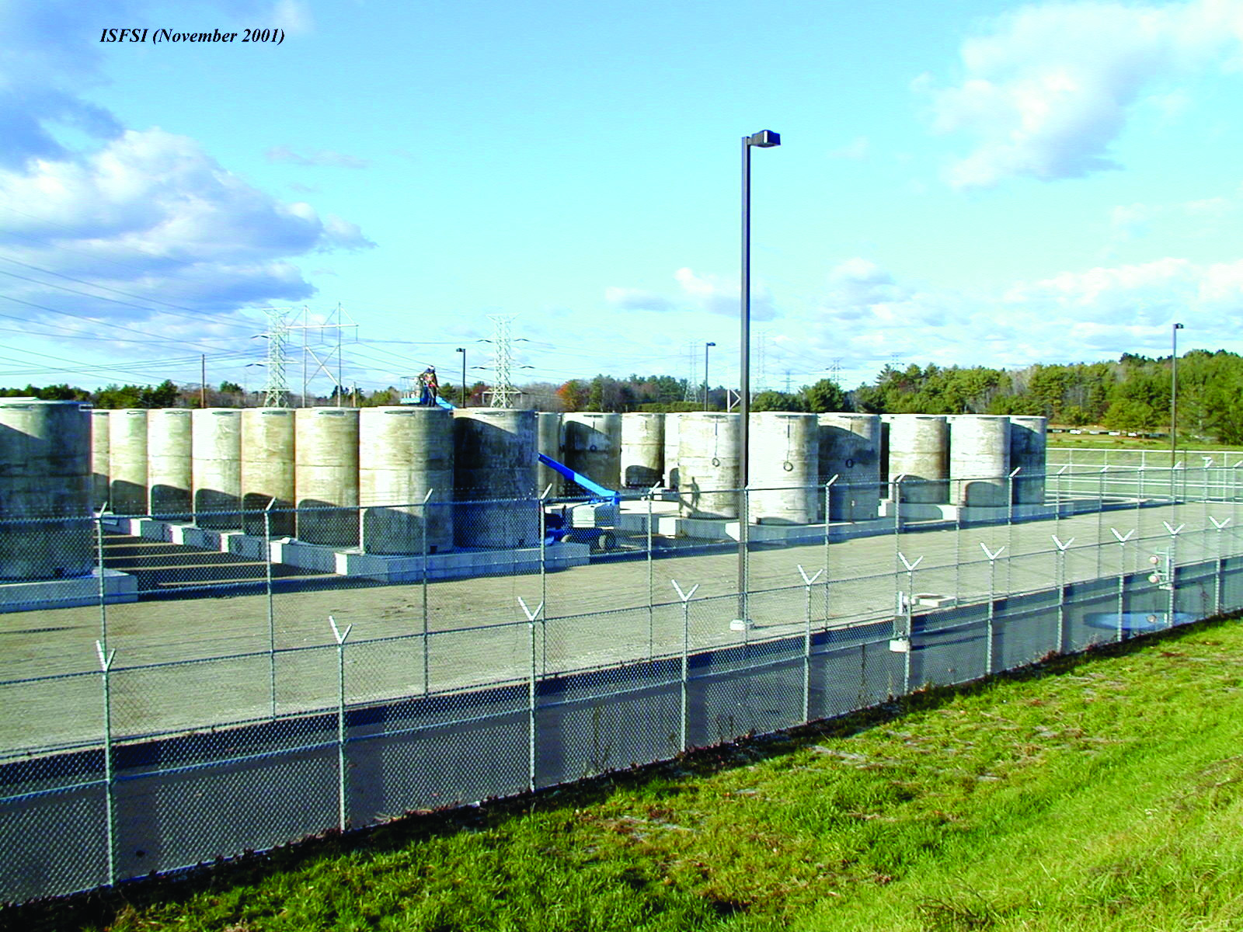
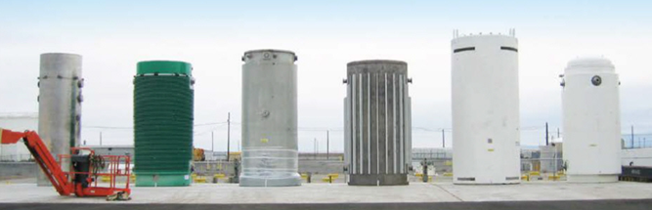
Near-Term Storage Activities
Objective:
Begin laying the groundwork for implementing consolidated storage
  Evaluation of design concepts for consolidated storage
  Conduct system analyses on operational strategies
  Evaluate system benefits of standardized packaging

Slide 11
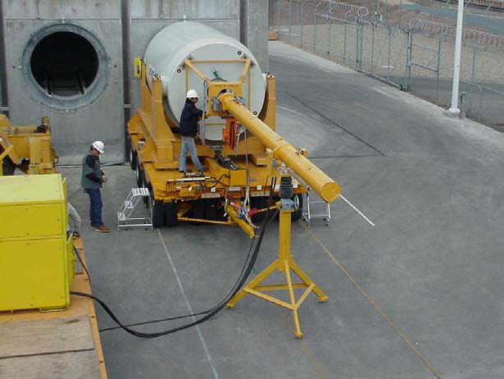
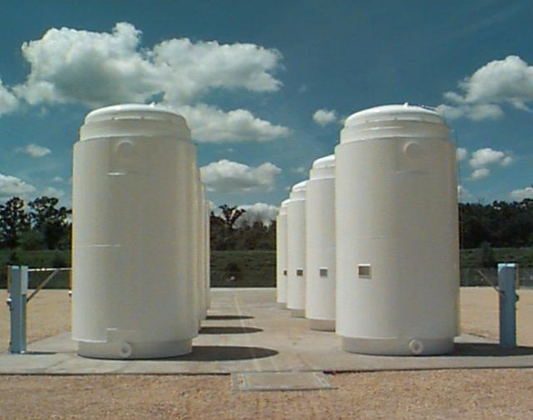
Key Activities: Storage
Completed task on design concepts
Providing system studies for conceptual design and to support future siting activities
Evaluating costs and impacts of opening non-disposable storage canisters
BRC recommendation:
“Perform systems analyses and design studies needed to develop a conceptual design for a spent fuel storage facility”
11
Notes:
See 4 re: key activities

Slide 12
Key Activities: Transportation
Objective:
Ensure the implementation of a staged, adaptive, collaborative transportation process for UNF and HLW
  Evaluate alternatives for a large-scale transportation program
  Address the need for shipping stranded fuel from shut-down sites to a consolidated interim storage facility
    Identify preliminary routes for shipments from shut-down sites
    Evaluate the inventory, transportation interface, and shipping infrastructure needs of used nuclear fuel at shut-down reactor sites
  Evaluate NWPA 180(c) policy regarding financial and technical assistance
  Evaluate large-scale transportation needs (e.g., cask, rail cars, support, and security)

Slide 13
Storage and Transportation
Long-Term Priorities

Slide 14
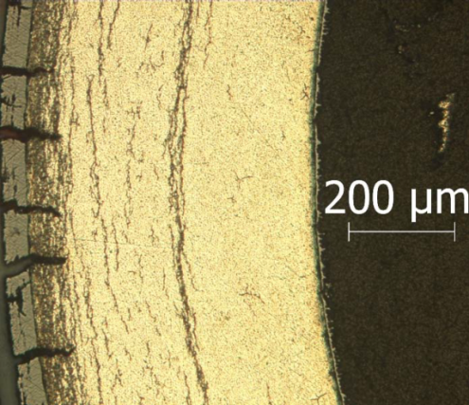
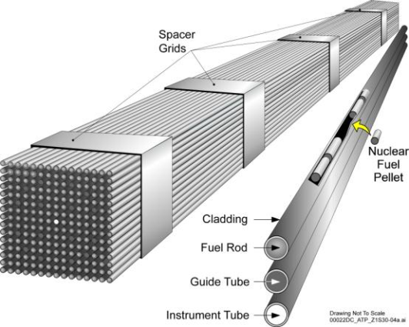
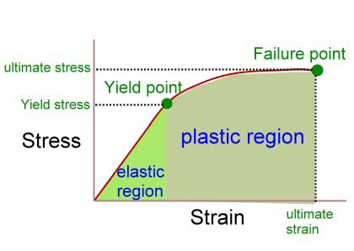
Storage and Transportation R&D
Objective: Prepare for the eventual large-scale transport of spent nuclear fuel and high-level waste
Develop the technical basis for:
  Extended storage of used nuclear fuel
  Fuel retrievability and transportation after extended storage

Slide 15
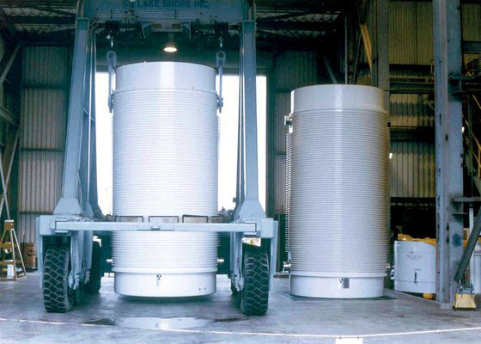
Storage and Transportation
Extended Storage R&D
Better understand potential degradation mechanisms in long-term dry cask storage including:
Complete the identification of data gaps to support extended dry storage
Continue material testing to support modeling and simulation of used fuel aging
Participate with industry and others on full-scale cask storage demonstration of high burnup used fuel

Slide 16
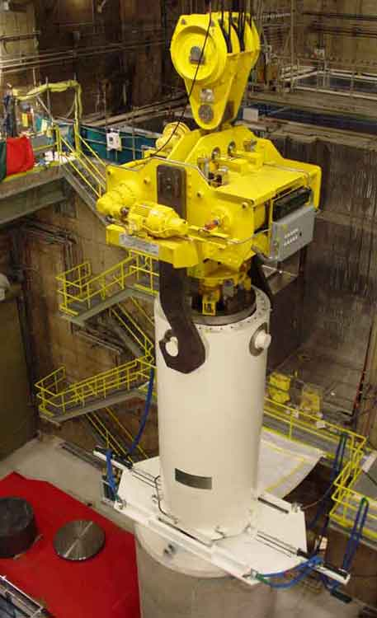
Extended Storage R&D
Demonstration Goals
R&D Goals: To provide a platform to store used high-burnup fuel with the capability to monitor and inspect, for the purpose of confirming our understanding of material degradation processes in storage environments
DOE collaboration with Industry
  Loading a commercial storage cask with high-burnup fuel in a utility storage pool
    Well understood fuel
    Cask outfitted with additional instrumentation for monitoring
  Drying of the cask contents using prototypic process
  Cask will be housed at the utility’s dry cask storage site
    Continuously monitored and externally inspected until the first internal inspection at ~10 years
  Site/Facility to open the cask to be determined

Slide 17
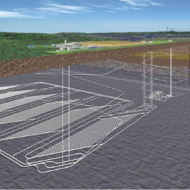
R&D Disposal
Objectives:
Provide a sound technical basis for the assertion that the U.S. has multiple viable disposal options
Increase confidence in the robustness of generic disposal concepts
Evaluate the BRC recommendation for developing a near-term plan for taking the borehole disposal concept to the point of a demonstration

Slide 18
Disposal R&D
International Collaboration
Formal collaborative R&D arrangements with ongoing programs in Europe and Asia
Mont Terri: Underground research laboratory in clay (Switzerland)
Grimsel: Colloid Formation and Migration Project in granite (Switzerland)
DECOVALEX: (Development of Coupled Models and their Validation against Experiments)
KAERI Underground Research Tunnel: Borehole Geophysics (South Korea)
SKB: Task Forces on Groundwater Flow and Engineered Barriers at Äspö Hard Rock Laboratory (Sweden)
BMWi: Data exchange for salt repositories at Gorleben and WIPP (Germany)
ANDRA: Natural and Engineered Barriers in clay and shale (France)
Major current or soon-to-be started experiments

Slide 19
Summary
DOE is actively developing used nuclear fuel management strategies and technologies
  Acknowledgement by Administration of the importance of used nuclear fuel disposition
  Implementation to site interim storage and repository facilities
  Near-term and long-term activities being conducted and planned
Please visit the Office of Nuclear Energy website for further program activities and information
http://energy.gov/ne/

