Slide 1
A History of Standardized, Multipurpose Canister Systems
Joshua Jarrell jarrelljj@ornl.gov
Oak Ridge National Laboratory
Riley Cumberland, Rob Howard,
Jeff Williams
Waste Management 2015
March 17, 2015
Phoenix, AZ

Slide 2
It should be noted that this is a technical report that does not take into account the contractual limitations under the Standard Contract (10 CFR 961). Under the provisions of the Standard Contract, DOE does not consider spent fuel in canisters to be an acceptable waste form, absent a mutually agreed to contract modification.

Slide 3
Overview
Introduction
  Definitions
  Standardized canister systems
1980s: Early concepts
1990s: The Multi-Purpose Canister
2000s: The Transportation, Aging and Disposal Canister
Present status
Summary

Slide 4
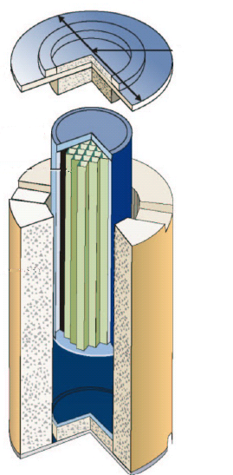
Clear definitions are essential for efficient communication
Canister
  A thin walled container that provides containment for spent nuclear fuel
Overpack
  A thick walled container that provides shielding and physical protection for a canister
Canister-based system
  The combination of a canister and its overpack(s)
Cask
  An integrated thick walled container that shields, protects, and provides containment for spent nuclear fuel
Canister
Overpack
CASTOR V Cask

Slide 5
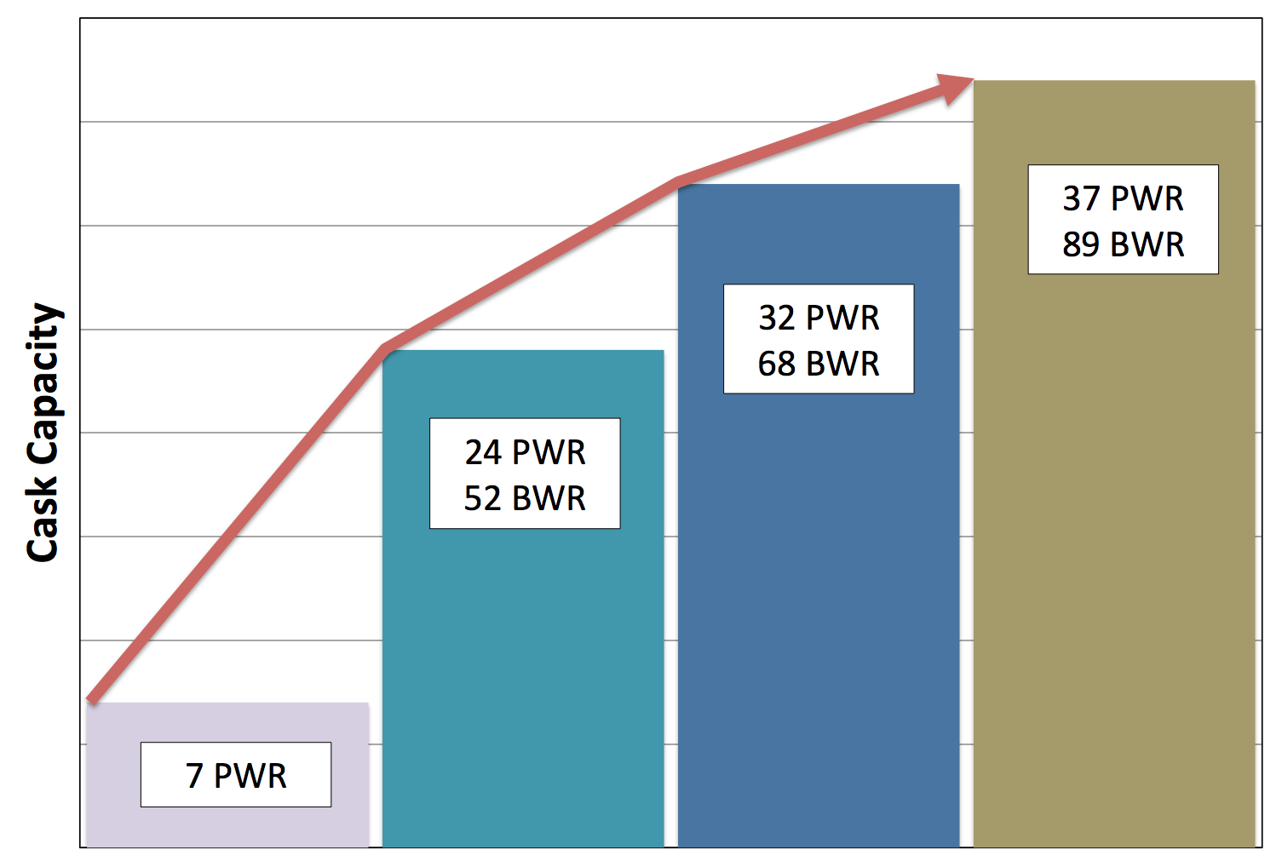
Repository-compatible canister systems can potentially simplify the waste management system
No integrated waste management system
  Utilities have moved to larger canisters to optimize on their storage needs
  Large canisters may not be disposable
  If large canisters are not disposable, they will need to be repackaged
    Increase costs, dose, and operations
A standardized triple-purpose canister system could avoid these issues
  Designed with disposal in mind (along with storage and transportation)
  Most likely smaller than current canisters
  Minimize repackaging

Slide 6
Interest in canister systems emerged in the 1980s
It became clear that fuel might remain at reactors for the foreseeable future
Spent fuel pools were expected to reach capacity
As part of the Nuclear Waste Policy Act of 1982, as-amended, DOE was instructed to work with industry to develop dry storage solutions
During this time, the first commercial dry storage systems were developed
Notes:
US CONGESS, “Nuclear Waste Policy Act of 1982,” Title 2, Section 218, 42 USC 10198, (1982).
Sec. 218. (a) Demonstration and cooperative programs. The Secretary [of Energy] shall establish a
demonstration program, in cooperation with the private sector, for the dry storage of
spent nuclear fuel at civilian nuclear power reactor sites, with the objective of
establishing one or more technologies that the Commission may, by rule, approve for use
at the sites of civilian nuclear power reactors without, to the maximum extent practicable,
the need for additional site-specific approvals by the Commission. Not later than 1 year
after the date of the enactment of this Act [enacted Jan. 7, 1983], the Secretary shall
select at least 1, but not more than 3, sites evaluated under section 214 [42 U.S.C. 10194]
at such power reactors. In selecting such site or sites, the Secretary shall give preference
to civilian nuclear power reactors that will soon have a shortage of interim storage
capacity for spent nuclear fuel. Subject to reaching agreement as provided in subsection
(b), the Secretary shall undertake activities to assist such power reactors with
demonstration projects at such sites, which may use one of the following types of
alternate storage technologies; spent nuclear fuel storage casks, caissons, or silos. The
Secretary shall also undertake a cooperative program with civilian nuclear power reactors
to encourage the development of the technology for spent nuclear fuel rod consolidation
in existing power reactor water storage basins.

Slide 7
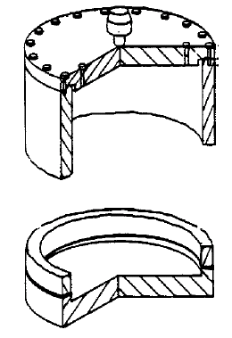
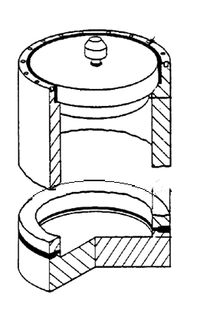
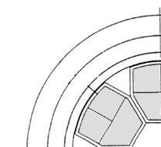
A wide variety of concepts were explored in the 1980s
1985: “Thin” Wall Universal Waste Package
  Bolted closure lids
  Consolidated fuel expected
  Tuff package sealed with overpack
  Closure lid replaced with welded lid on salt package
1986: Non-circular canisters were considered to save space in overpacks
  0.188” (4.8mm) thick walls
  3P/6B capacity (intact)
  Cam lock inner lid
  Welded outer lid to cover penetrations in inner lid
  Boral plates for criticality control
5cm
11cm
Tuff Package
6P/14B consolidated
11.5 ton loaded
Salt Package
8P/24B consolidated
20 ton loaded
General Atomics universal truck canisters in rail overpack (¼ view)
Notes:
“Thin” Wall Universal Waste Package for tuff repository found in:
J. H. SALING, C. R. BOLMGREN, C.R. “Phase 1 Study of Metallic Cask Systems for Spent Fuel Management from Reactor to Repository.” Westinghouse Electric Corporation Report No. WTSD-TML-085 Draft, September (1985).
Non-circular canister concept found in:
R. P. MORISSETTE, P. E. SCHNERINGER, R. K. LANE, R. L. MOORE, K. A. YOUNG, “Commercial Radioactive Waste Management System Feasibility with the Universal Canister Concept,” GA-A--1830-Vol.1, GA Technologies, Jan (1986).

Slide 8
  In the mid 1990s focus developed with the Multi-Purpose Canister project
Westinghouse selected to design and license the Multi-Purpose Canister (storage, transportation, disposal)
2 sizes
  125 ton on crane hook - 21P/44B
  75 ton on crane hook - 12P/24B
Designed for up to 4.3% enriched 45 GWD/MTU
  Boral neutron absorbers
  Flux trap criticality control for 12P design
Concept included horizontal transfer to down-ended vertical storage overpack
Program began in 1993
  Halted in 1996
Flux Trap
¼ view of 12 PWR Canister
Notes:
--Picture of 12P design From TRW, “Mined Geologic Disposal System Advanced Conceptual Design Report: Volume III of IV Engineered Barrier Segment/Waste Package,” B00000000-01717-5705-00027, Rev 0, Las Vegas, Nevada, USA, Mar (1996).

Slide 9
24 BWR Multi-Purpose Canister in disposal overpack
Length | 17.5 ft (5.335 m)
Diameter | 4.15 ft (1.265 m)
Empty Weight | 24.7 ton (22.5 metric ton)
Loaded Weight | 33.5 ton (30.4 metric ton)
Notes:
Shield plug and lid structure not shown for inner barrier. The inner barrier lid consists of an shield plug, an inner lid with a vent and a drain port, and an outer lid.
Taken from Vol III of Mined Geologic Disposal System Advanced Conceptual Design Report. March 1996. TRW Environmental Safety Systems Inc. B00000000-01717-5705-00027 Rev 00.

Slide 10
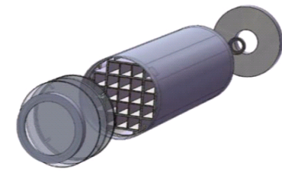
The Multi-Purpose Canister concept re-emerged as the Transportation, Aging and Disposal Canister in the 2000s
AREVA and NAC were selected to design, license and demonstrate two transportation, aging, and disposal canister systems
21P/44B capacity
  Smaller than many commercial storage systems for repository compatibility
Vertical or horizontal storage capability
Areva TN21P TAD Canister
NAC system based on NAC Universal Multi-purpose Canister System
  Single lid canister
  Aluminum heat transfer plates oriented perpendicular to the canister axis
AREVA system based on a NUHOMS canister system
  Aluminum heat transfer plates oriented parallel to axis and integrated in the basket assembly
Notes:
Image from Areva TN presentation at INMM Spent Fuel Management 2014

Slide 11
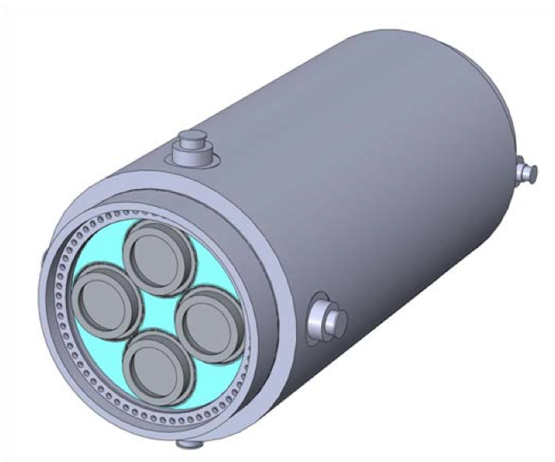
In the past 3 years, the standardized canister concept has been revisited
The BRC recommendation
  “to promote the better integration of storage into the waste management system, including standardization of dry cask storage systems”
EnergySolutions and AREVA Federal Services LLC were contracted to perform feasibility studies
  Both recommended licensing three canister sizes to provide flexibility until repository characteristics are known
Current work
  Development of generic design concepts for small canister systems
  Evaluation of operational impacts at the utility sites
  Development of a standardized canister performance specification

Slide 12
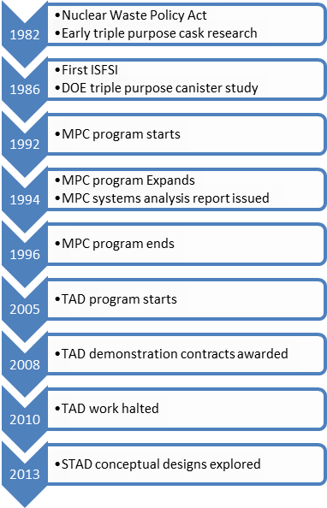
In summary, standardized, multi-purpose systems have evolved over the past three decades
A standardized, disposable canister system has the potential to simplify the waste management system
Early design concepts were developed in the 1980s
The Multi-Purpose Canister project produced standardized canister designs in more detail
The Transportation, Aging and Disposal Canister programs attempted again to standardize canister systems
Today, options are being re-evaluated to develop an appropriate canister to integrate the waste management system

