Slide 1
Nuclear Fuels Storage and Transportation Planning Project Strategic Crosscutting Activities (15180)
Josh Jarrell
NFST Strategic Crosscuts Control Account Manager
Oak Ridge National Laboratory
WM2015 Conference
Phoenix, AZ
March 18, 2015
Mark Nutt (ANL), John Wagner, Matt Feldman, Rob Howard (ORNL), Joe Carter (SRNL)

Slide 2
It should be noted that this is a technical report that does not take into account the contractual limitations under the Standard Contract (10 CFR 961). Under the provisions of the Standard Contract, DOE does not consider spent fuel in canisters to be an acceptable waste form, absent a mutually agreed to contract modification.

Slide 3
The Strategic Crosscut element supports NFST objectives
Provides consistent, traceable data and analysis input as well as automated SNF characterization capabilities (UNF-ST&DARDS)
Uses current system analysis tools to evaluate different options in the nuclear waste management system, including standardization as a means to integrate the system
Develops modern tools to support systems analysis and option comparison
  Dynamic simulation modeling for alternative implementation strategies
  Modern system-level (logistical) software
  Decision analysis and support software and procedures
Provides access to SNF documents and data (curie.ornl.gov)
General project integration support

Slide 4
Commercial SNF in storage continues to increase by ~2,000 MTHM annually

Slide 5

NFST was established in FY 2013 to plan for interim storage and transportation
Mission
  Lay the groundwork for implementing interim storage, including associated transportation, per the Administration’s Strategy for the Management and Disposal of Used Nuclear Fuel and High-Level Radioactive Waste
Purpose
  Make progress on this important national issue
Activities
  Align with Blue Ribbon Commission for America’s Nuclear Future (BRC) recommendations
  Lay ground work for implementing the Strategy
    Within existing Nuclear Waste Policy Act (NWPA)
    Consistent with budget direction and authorization

Slide 6
NFST is satisfying near-term objectives to lay the groundwork for Strategy implementation
Prepare for implementation of a pilot interim storage facility (ISF) with initial focus on receiving SNF from the shutdown reactor sites
Make progress on long lead-time, destination-independent aspects of the transportation infrastructure, such as certification of railcars
Develop and evaluate options for decision-makers on the design of an integrated waste management system
Establish a unified and integrated SNF database and analysis system to characterize the input to the waste management system
Develop generic information materials on storage and transportation of SNF to support stakeholder and public interactions

Slide 7
NFST is organized into four key elements
Consent-Based Siting
Siting process design
Site evaluation and selection*
Site acquisition*
Storage
Design
Construction*
Operations*
NEPA
Regulatory
Strategic Crosscuts
Project management
Systems analyses
Data/document access
Standardization/integration
Communication products
Characterization & Assessment
Transportation
Institutional
Operational
Hardware
* Indicates areas that are not currently active

Slide 8
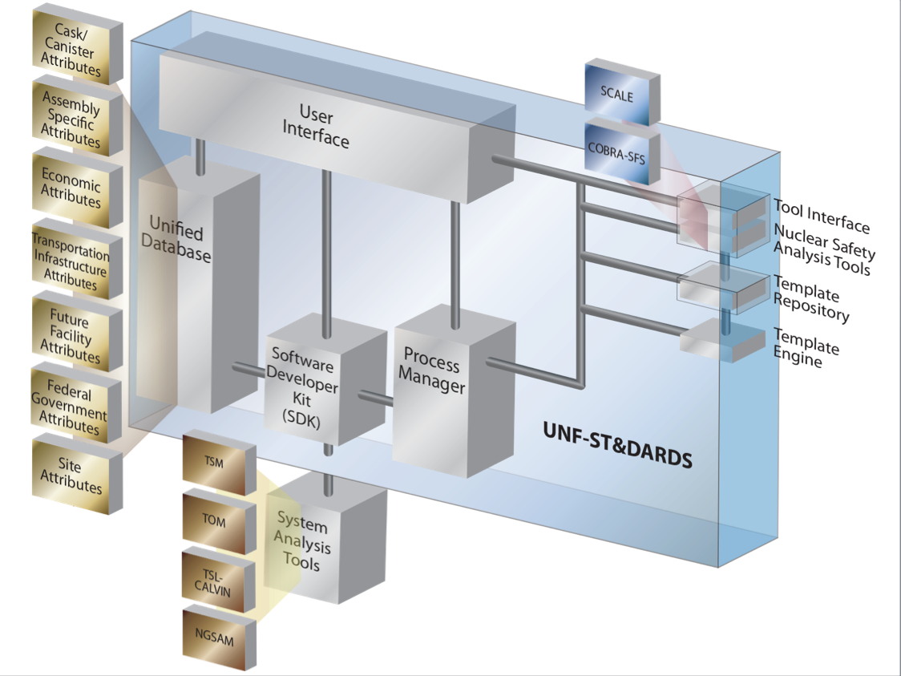
A consistent, verified, centralized SNF characteristics database was established and is being expanded
Objectives are to:
  Characterize the input to the waste management system
  Provide a credible, controlled data source for key information
  Assess issues and uncertainties related to the extended storage and transportability of loaded canisters
  Support safety confidence and R&D prioritization
  Provide a foundational data and analysis capability
UNF-ST&DARDS currently includes:
  Fuel assembly discharge information
  Fuel assembly design data
  Reactor-specific operation data
  Cask design and loading data
  Infrastructure and logistics-related data to support systems analyses

Slide 9
NFST is identifying and evaluating options for a future integrated waste management system
Execution Strategy Analysis (ESA): a dynamic simulation modeling capability for use in the analysis of alternative implementation strategies and plans
  Provides an approach and tool for ongoing performance assessment of the evolving project plan/strategy that takes into account
    Strategic assumptions
    Risks and uncertainties
    Linkages between program/project elements
  Capability helps
    Identify alternative implementation strategies
    Understand consequences of changing funding structure and priorities
    Understand impacts of technical and
    non-technical risks
    Improve the ability to reduce programmatic risks
Example Illustration of a Draft ESA Success Precedence Diagram

Slide 10
NFST is identifying and evaluating options for a future integrated waste management system
Integrated Waste Management System Architecture Analyses support the future deployment of a comprehensive system for managing SNF and DOE-managed SNF and HLW
  Emphasis on providing flexibility
  Evaluating system impact of continued waste management practices
    Loading large dual-purpose dry storage casks
  Identifying and evaluating alternative strategies and approaches for managing SNF to determine potential benefits
    including those pertaining to cost and flexibility

Slide 11
NFST is evaluating standardization as a method to integrate the waste management system
Conducting a quantitative assessment and comparison of relevant options, potential benefits, and impacts associated with deviating from the current industry practice of loading large
dual-purpose canisters (DPCs)
  Opportunities include standardized storage systems, transportation overpacks, cask-handling equipment, and reusable bare fuel casks
  Sought nuclear industry input relative to the feasibility, issues, and benefits of standardization
Near-term activities underway include:
  Developing generic design concepts for small canister systems
  Evaluating the operational impacts at the utility sites with goal of identifying innovative design and/or operational solutions to alleviate impacts
  Developing a performance specification for selected system components of standardized, canister-based systems

Slide 12
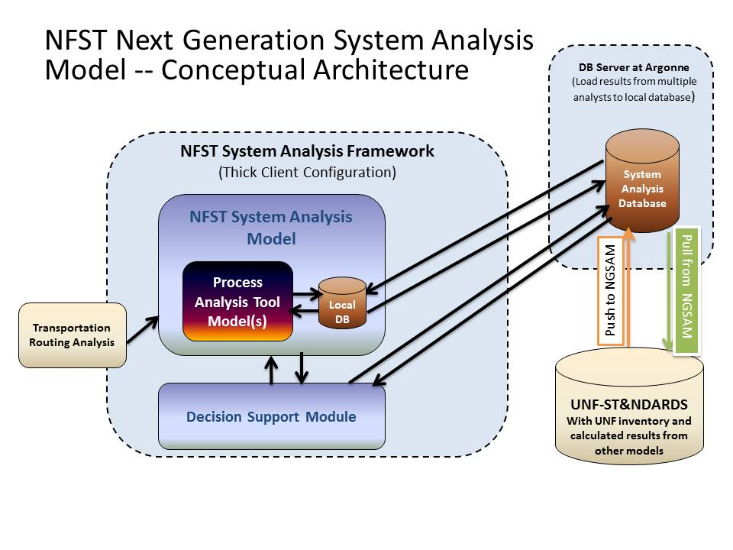
NFST is developing a modern, flexible system analysis tool
Next Generation System Analysis Model (NGSAM): Readily sustainable and maintainable in the future
  Flexible for use for a wide range of scenarios
  Takes advantage of advanced simulation techniques, such as agent-based simulation
  Leverages existing logistics and transportation simulation models
    Allows increased simulation fidelity and detailed output
  Links with the UNF-ST&DARDS system currently under development

Slide 13
NFST is using established decision support methods to provide a comparison of system options
Decision Support Framework: Utilizing accepted decision analysis techniques to identify and evaluate information needed to support future decisions
  Developing prototype value models that consider a range of perspectives
    based on historical experience and information
  Tools will serve as benchmarks for iterative improvement and focus as details of objectives, value preferences, alternative scenarios and other elements emerge
    Important to build knowledge and trust in the decision support methods and procedures early in the decision process
    Prototype value models will also serve to provide a framework for socialization and confidence building
Functional and Operational Requirements: Establishing system-level functional and operational requirements for the entire SNF management system

Slide 14


The CURIE website was developed to support document and data access for SNF-related work
Centralized Used Fuel Resource for Information Exchange (CURIE) – curie.ornl.gov
Provide ready access to data, reports, and other work products
  Collects and maintains historical and current information products
  Maintains reactor- and site-specific information
  Contains the BRC-recommended Siting Experience Database
  Provides both public and permissions-based information sharing

Slide 15
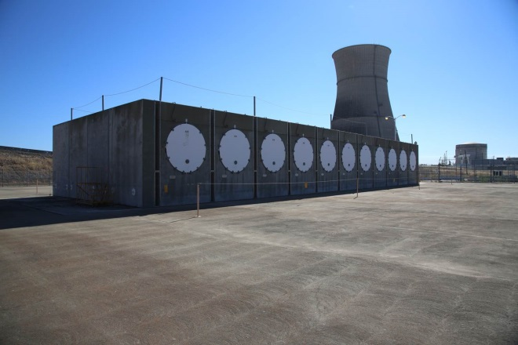
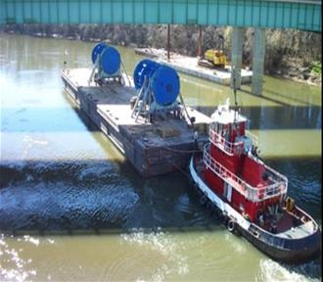
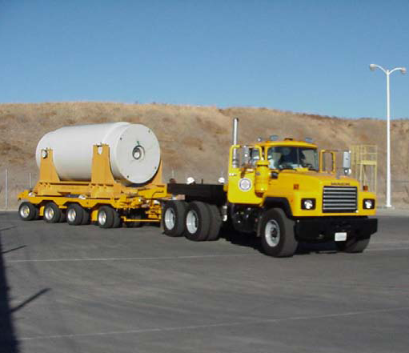
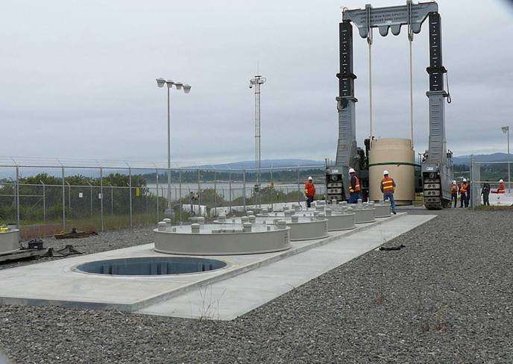
Concluding Remarks
Activities being performed in the NFST strategic crosscut element support the storage, transportation, and consent-based siting objectives of the NFST
The over-arching goal is to develop options for decision-makers on the design of an integrated waste management system

