Slide 1
Standardized Transportation, Aging, and Disposal (STAD) Canister Design Josh Jarrell, Ph.D. R&D Staff, Used Fuel Systems Group, ORNL Strategic Crosscuts Control Account Manager, NFST Nuclear Waste Technical Review Board June 24, 2015 Golden, Co

Slide 2
Disclaimer
It should be noted that this is a technical report that does not take into account the contractual limitations under the Standard Contract (10 CFR Part 961). Under the provisions of the Standard Contract, DOE does not consider spent fuel in canisters to be an acceptable waste form, absent a mutually agreed to contract modification.
This presentation reflects research and development efforts to explore technical concepts which could support future decision making by DOE. No inferences should be drawn from this presentation regarding future actions by DOE.

Slide 3
Outline
Motivation
Responses to NWTRB questions
STAD canister concept
Description
Differences from earlier standardized concepts
Potential timelines
Operational impacts of smaller canisters at reactors
Repackaging impacts
Concluding remarks
Questions/Answers

Slide 4
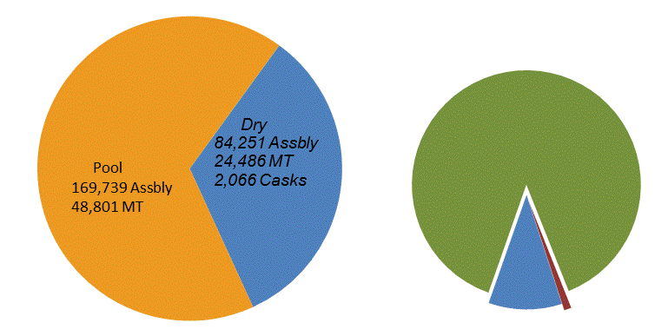
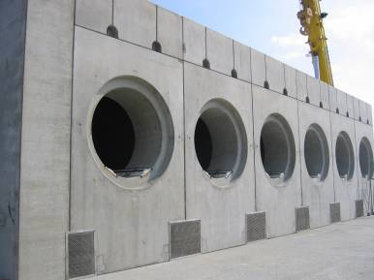
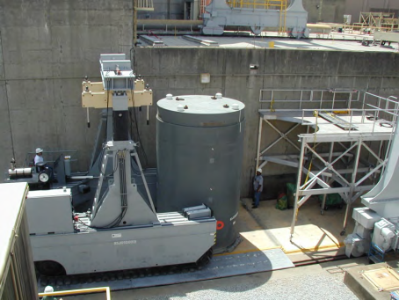
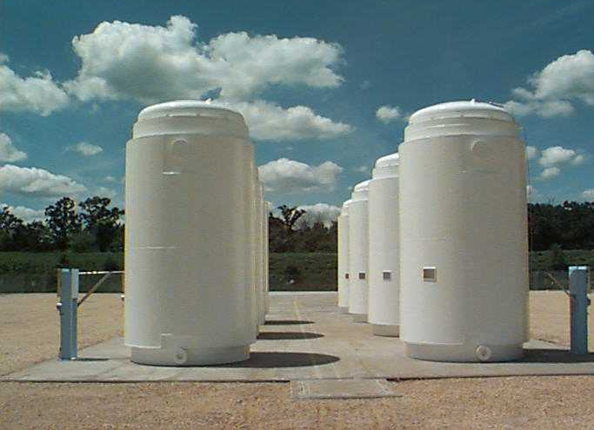
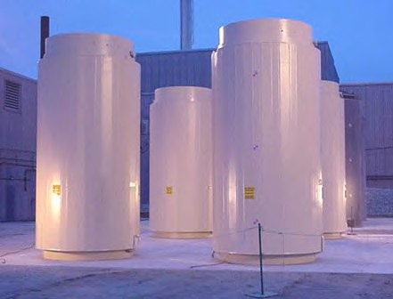
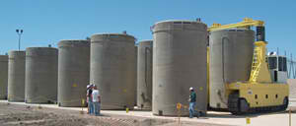
Commercial Dry Storage Inventory is Diverse and Growing
Inventory as of April 7, 2015
1,865 Welded Metal Canisters In Vented Concrete Overpacks
- 74,627 Assemblies
- 88.6% of Dry
- Transnuclear (37%)
- Holtec (41%)
- NAC (20%)
12 Welded Metal Canisters
in Transport Overpacks
- 866 Assemblies
- 1.0% of Dry
Majority of dry inventory is in large welded canisters
Trend toward higher capacity canisters
189 Bare Fuel Casks
- 8,758 Assemblies
- 10.4% of Dry
Transnuclear TN-32
Holtec Hi-Star 100

Slide 5
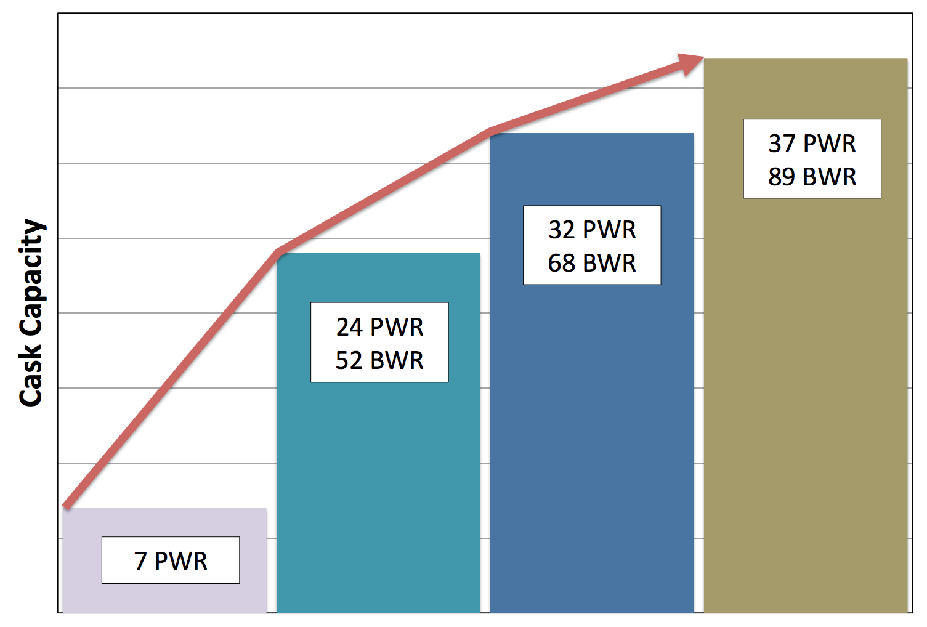
Repository concept-compatible canister systems can potentially simplify the waste management system
There is a lack of integration between storage, transportation, and disposal in the waste management system
Utilities have moved to larger canisters to optimize on their storage needs
Large canisters may or may not be disposable
If large canisters are not directly disposable, they will need to be repackaged
Potential to increase costs, dose, and handling operations
A standardized triple-purpose canister system could avoid these issues
Would be designed with disposal in mind (along with storage and transportation)
Most likely smaller than current canisters
Minimize repackaging

Slide 6
Numerous “Standardization” activities are ongoing in NFST
Standardized Canister System Assessment (presented at Fall 2013 NWTRB Meeting) – Expected Completion FY16
Examining system-wide impacts of integrating standardization options into the waste management system
Expected to inform future policy decisions (i.e., whether to standardize, how to standardize, where to standardize, what to standardize, when to standardize)
Initial evaluation submitted to DOE August 2014
Industry Studies on STAD systems – Completed June 2015
Generic design of small (4 PWR/9 BWR) STAD system (Task Order 18)
Operational impacts and mitigation techniques of loading smaller canisters at reactors (Task Order 21)
STAD Specification Requirements and Rationale – Laboratory Draft completed May 2015
Developing specifications for possible, different-capacity STAD canister systems

Slide 7
Summary of the published NWTRB questions
What are the STAD system concepts and their requirements?
What is the timeline to move forward with the STAD system concepts?
What are the at-reactors impacts of loading the STAD system?
What are the impacts of repackaging?
Reminder:
In order to implement a standardized canister system into the nuclear waste management system, we must have a firm technical basis

Slide 8
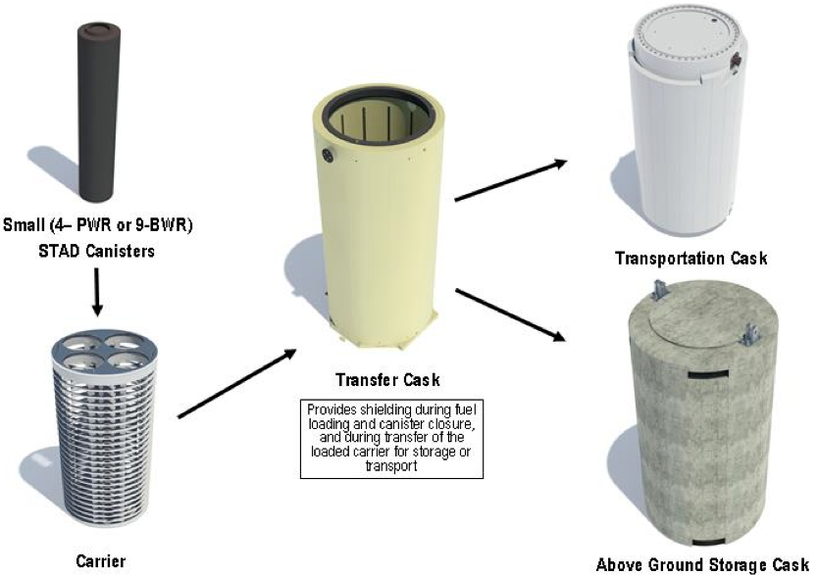
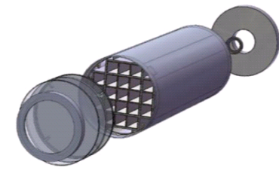
“How does a STAD canister differ from earlier concepts ... and why are the differences required?”
The STAD canister systems would differ from past concepts (specifically the TAD concept) in the following ways
Physical characteristics
Capacities
Handling assumptions
Licensing requirements
Lifetime
These differences are driven by the lack of a known repository geology and design
EnergySolution’s small canister STAD concept
Areva’s TN21P TAD Canister

Slide 9
Key Attributes and Capability Differences of Canister Concepts
Parameter | STAD Canister | TAD Canister
Capacity | Three capacities 4 PWR or 9 BWR 12 PWR or 32 BWR 21 PWR or 44 BWR | One capacity - 21 PWR or 44 BWR
SNF enrichment and burnup | PWR and BWR SNF with enrichment up to 5.0 wt.% U-235 and burnup up to 62.5 GWd/MTU | PWR and BWR SNF with enrichment up to 5.0 wt.% U-235 and burnup up to 80 (PWR) and 75 (BWR) GWd/MTU
SNF inventory | Entire commercial SNF inventory for all designs, length and sizes | Limited to those that can fit within a 212-inch external length TAD canister (excludes STP fuel)
Length | Not specified. Multiple lengths based on SNF characteristics | 186 in. – 212 in.
Diameter | Not specified. Three diameters based on capacity - Nominally 29 in., 52 in., 66 in. | 66.5 in.

Slide 10
Key Safety Functional Requirements Differences
Parameter | STAD | TAD
Structural | No requirements beyond meeting 10 CFR Parts 71 and 72 | Several requirements based on potential structural loads at YMP facilities (both operational and natural phenomena)
Thermal during loading, storage, and transportation | Maintain cladding temperature below 400ºC | Same
Thermal during disposal | Design the canister internal structure to maintain the cladding temperature below 400ºC based on two disposal-related boundary conditions (heat output and canister surface temperature) for each of the three canister sizes | Design the canister internal structure to maintain the cladding temperature below 350ºC

Slide 11
Key Safety Functional Requirements Differences
Parameter | STAD | TAD
Radiation protection and shielding | No requirements beyond meeting 10 CFR Parts 71 and 72 | Several requirements based on Yucca Mountain Repository facilities and planned operations
Criticality, neutron absorber material | Borated stainless steel with 11 mm thickness (based on 10,000 years worth of corrosion at a rate of 250 nm/yr) | Same
Criticality, burnup credit | PWR SNF criticality safety basis must rely on burnup credit | No requirements beyond meeting 10 CFR Parts 71 and 72
Criticality, transportation | Transportation HAC criticality shall be based on moderator exclusion | No requirements beyond meeting 10 CFR Part 71
Storage Confinement | The canister shall constitute the confinement boundary per 10 CFR 72 (dual welded closures) | Risk-informed performance-based requirement to meet specific leak rates limits
Transportation Containment | No requirements beyond meeting 10 CFR Part 71 | Same

Slide 12
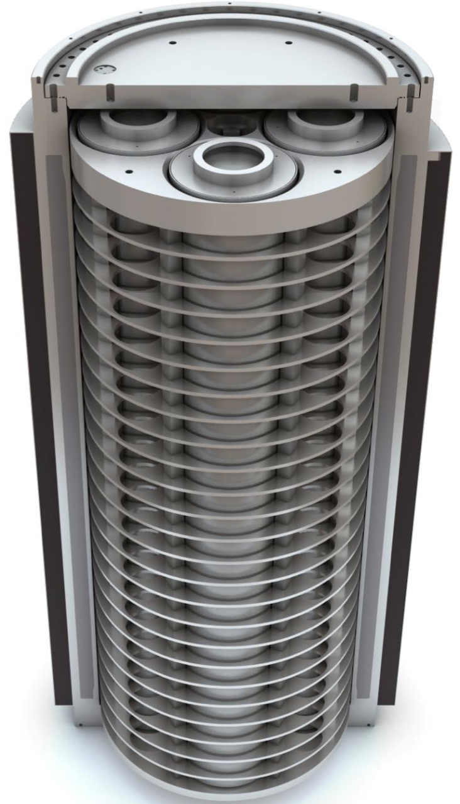
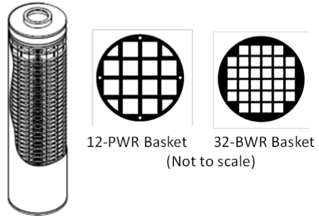
Will DOE pursue other STAD sizes?
Yes, DOE is evaluating a range of STAD sizes in ongoing systems analyses as well as the development of the STAD Performance Specification
2 sizes based on EnergySolutions study recommendations
Small: 4PWR/9BWR
Medium: 12PWR/32BWR
1 size based on AREVA study recommendations
Large: 21P/44BWR
4-PWR Basket, Canister, and Transportation carrier
21-PWR Basket
44-BWR Basket

Slide 13
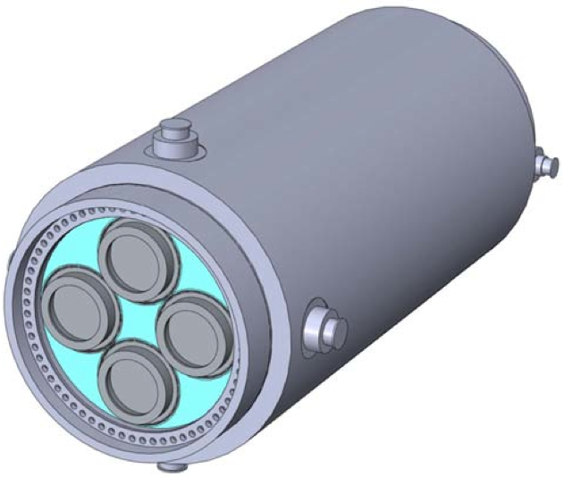
What is DOE’s plan to advance the STAD through licensing before a repository is ready?
DOE is still evaluating implications of selecting a STAD canister system prior to identifying a site-specific repository design (Standardization Assessment)
Initial standardized canister evaluation (completed August 2014)
Another more-fully developed evaluation will be completed in Sept. 2015
DOE may elect to do detailed development as part of a demonstration project (as suggested by AREVA in their feasibility study report in 2013)
This decision will not be tied to the development of a specific repository

Slide 14
“What is DOE’s expected schedule for design, fabrication, and license of the STAD system…?” How does it impact the pilot interim storage facility?
No decision on the use of a STAD system, therefore DOE does not have a schedule for certification and fabrication of the STAD system
Any schedule would be dependent on future decisions related to if, when, and under what conditions STADs would be deployed
If a demonstration project, as suggested by AREVA, were to be initiated, the schedule would be based on factors related to the scope of the demonstration
A STAD canister is NOT needed to support DOE’s strategy to begin operations of a pilot interim storage facility
DOE’s strategy for operations of a pilot interim storage facility is focused on accepting SNF from shutdown sites

Slide 15
“What would be the operational impacts of using small STAD canisters at spent fuel pools at operating reactors?”
Smaller canisters would incur more cost and require longer load times to implement
This is why utilities have moved to larger canisters
However, there are optimizations that could be implemented that would minimize this cost and schedule impact
EnergySolutions’ team including NAC International, Exelon Nuclear Partners, and Booz Allen Hamilton studied a number of aspects
Analyzed loading canisters using current procedures
Researched potential optimizations related to improved methods and parallel operations that could be used to minimize the at-reactor impacts
Provided cost and loading time comparisons
Identified site-specific concerns for loading smaller systems

Slide 16
Smaller canisters are more expensive, though at-reactor process improvements can be significant
Loading time per assembly for PWR canisters as a function of capacity
Loading cost per assembly for PWR canisters as a function of capacity
Capital cost per assembly for PWR canisters as a function of capacity
 | Hours / Assembly |  | Percent Increase vs DPC
 | Baseline | Optimized | Baseline | Optimized
DPC | 3.51
Large STAD | 5.26 | 4.36 | 50% | 24%
Medium STAD | 8.33 | 7 | 137% | 99%
Small STAD (in carrier) | 7.98 | 4.87 | 127% | 39%
 | Loading Costs / Assembly |  | Percent Increase vs DPC
 | Baseline | Optimized | Baseline | Optimized
DPC | $ 3,539
Large STAD | $ 5,716 | $ 4,744 | 62% | 34%
Medium STAD | $ 9,195 | $ 7,710 | 160% | 118%
Small STAD (in carrier) | $ 9,934 | $ 7,643 | 181% | 116%
 | Capital Costs / Assembly | Percent Increase vs DPC
DPC | $ 37,380
Large STAD | $ 43,925 | 18%
Medium STAD | $ 53,816 | 44%
Small STAD (in carrier) | $ 76,706 | 105%

Slide 17
What are the repackaging implications? What facilities are needed and where would they be located?
Repackaging could be complicated:
Increases total fuel-handling operations
Complicates pool operations and increases worker doses if performed at reactor sites
Requires development and deployment of on-site repackaging systems if performed at shut-down reactor sites
Generates additional low-level waste including discarded dry storage canisters
Repackaging could be reduced or eliminated provided either:
Direct disposal of existing dry storage canisters is proven acceptable
Standardized storage, transportation and disposal canisters are developed and deployed
Otherwise, ~206,000 BWR and ~277,000 PWR assemblies may have to be repackaged
If the status quo continues, ~11,000 canisters may need to be opened

Slide 18
Location of repackaging if needed would have system-wide impacts
Repackaging at reactors would be challenging
Operating sites: Impact operations
Shutdown sites: Build new facility or pools
Repackaging at ISF or repository would offer flexibility
Purpose-built facility (minimize dose, maximize throughput)
Repackaging may impact transportation
Probably more canisters to move (if not performed at repository)
Empty canisters, overpacks, and materials generated in repackaging process would have to be managed
Low-level waste on the order of $9500 / assembly
Assume 350 ft³ / canister; 37 assemblies / canister; $1000 LLW / ft³
NOTE this is MORE than the cost to load the assembly in any canister

Slide 19
Conclusion
Implementation options for a possible STAD canister are currently being analyzed
With most recent information, better understanding of local and system-wide impacts of standardization are possible
DOE is keeping multiple options on the table as standardization options are being evaluated
Repackaging would be expensive and challenging
Unless all DPCs are disposable, some repackaging WILL occur
In order to implement a standardized canister system into the nuclear waste management system, we must have a firm technical basis
At this time, DOE has not made a decision as to whether to proceed with a STAD canister system

