Slide 1
Community Involvement – An Engineering and Project Management Perspective on How to Use the Ongoing Social Science Research
Rob Howard
Nuclear Fuel Storage and Transportation Planning Project
Deputy National Technical Director
howardrl1@ornl.gov
NEI Used Fuel Management Conference
Orlando, FL
May, 6, 2015
Notes:
Social Scientists such as Hank Jenkins-Smith from the University of Oklahoma have suggested that the structured evaluation of beliefs and preferences measured in annual survey and social media data streams can assist program managers in making nuclear facility siting programs responsive and adaptive to the evolution of nuclear narratives. This presentation will provide an engineering and project management perspective on how ongoing social science research can be used. Topics to be covered include the iterative process for including stakeholder preferences in waste management system functions and requirements and project plans through the development of design concepts, alternatives analyses, trade studies, and project planning and how the technical information can be provided back to stakeholders through communications products for further refinement of preferences.

Slide 2
Caveat Lector
It should be noted that this is a technical presentation that does not take into account the contractual limitations under the Standard Contract (10 CFR 961). Under the provisions of the Standard Contract, DOE does not consider spent fuel in canisters to be an acceptable waste form, absent a mutually agreed to contract modification.

Slide 3
Public involvement in the development of large public works puts the “civil” in civil engineering
“The process by which….an innovative bridge gets transformed from some engineer’s dream to a spectacular structure, is seldom straight forward. It can entail decades of painstakingly slow research and development, followed by weeks of frenzied activity. In addition, each engineering project is touched by the idiosyncrasies' of individual engineers, companies, communities, and marketplaces.” Henry Petroski- Invention by Design: How Engineers get from Thought to Thing.
The design process is both creative and collaborative
The structured evaluation and use of public preferences can assist engineers and project managers in making projects responsive and adaptive over time

Slide 4
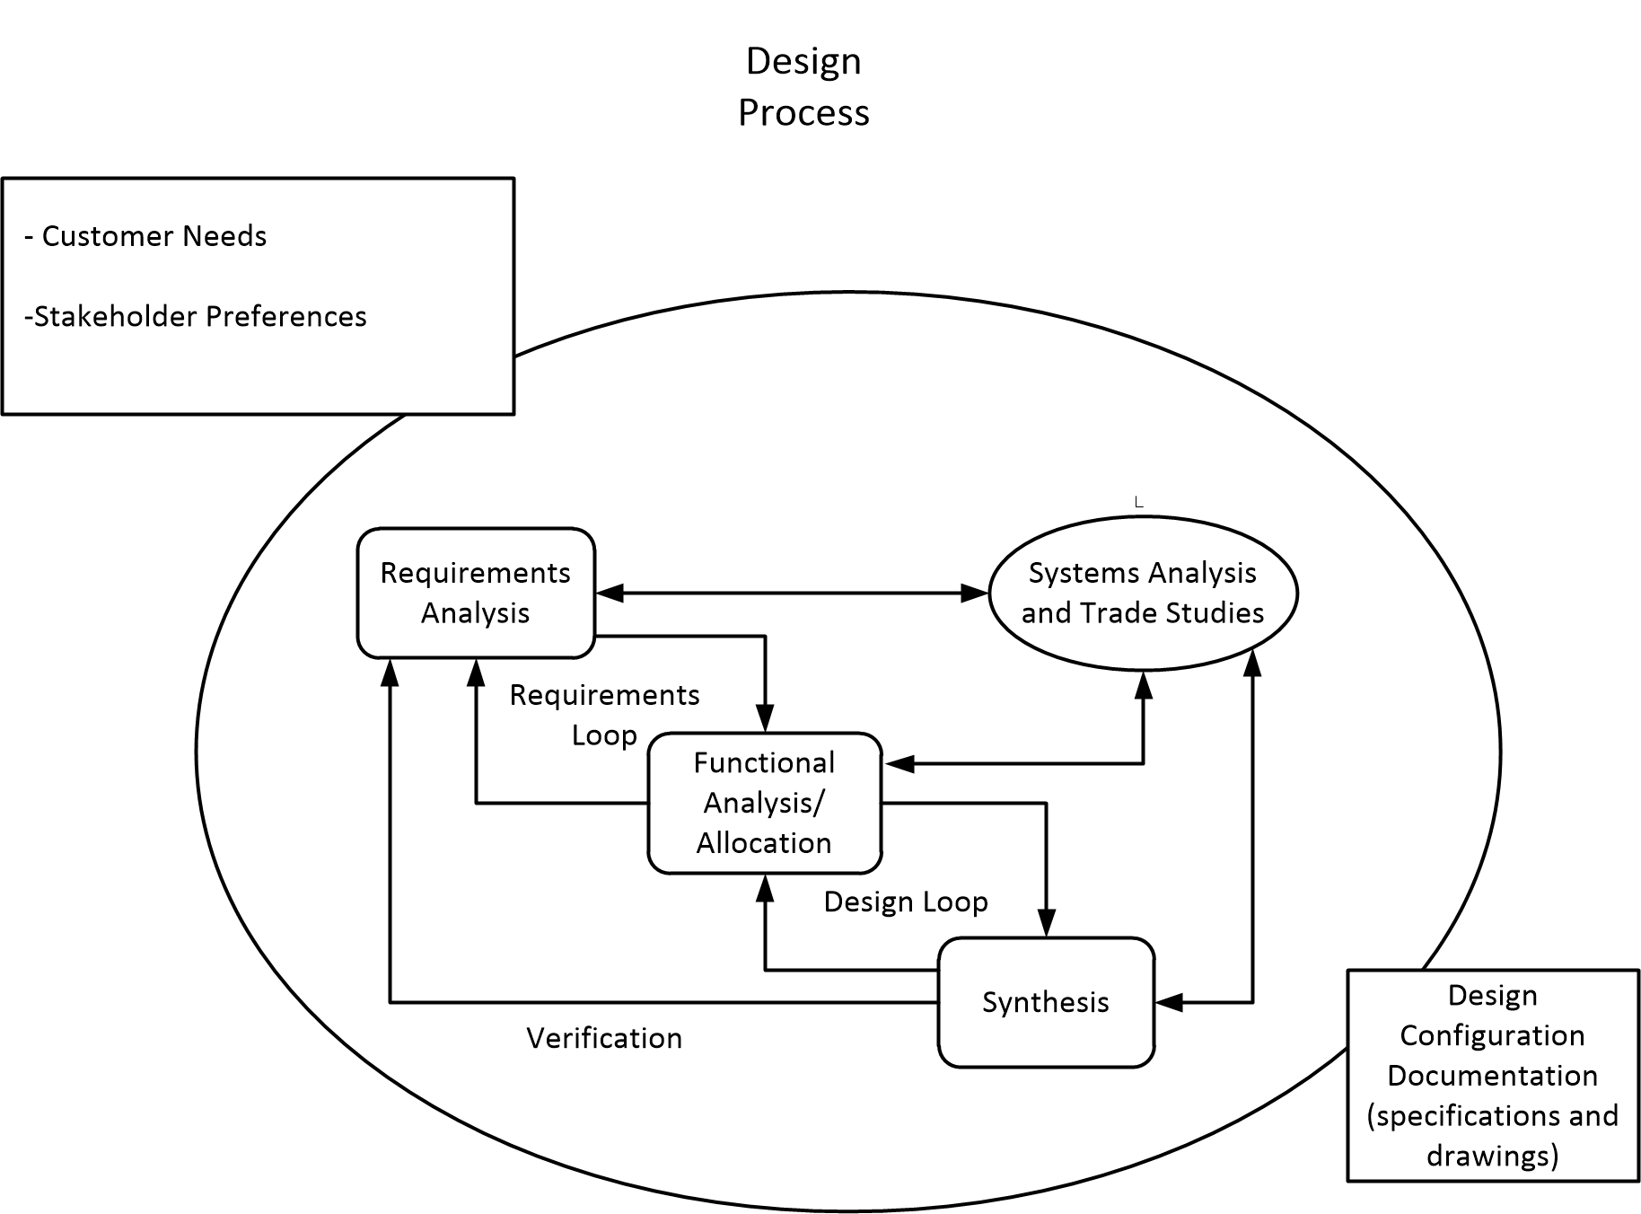
An engineer’s rendition of the system design process (systems engineering)
The process is always iterative and never straight forward for a complex design project

Slide 5
Social science research provides insight on public preferences related to SNF storage
We’ll focus on a 2014 survey by Hank Jenkins-Smith and his colleagues for this discussion

Slide 6
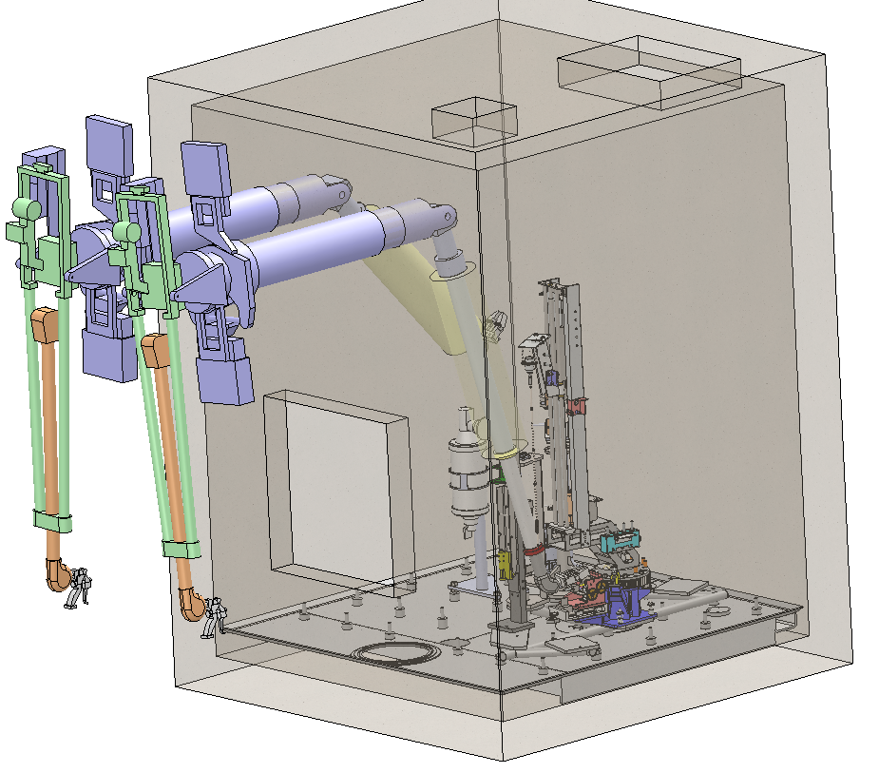
Engineers and Project Managers need to know both what people prefer and why they might prefer a particular option
Wording from the survey provides some insight:
Option 2
Used nuclear fuel would be transported to and stored at an interim storage facility. As a reminder:
An interim storage facility could be designed to repackage used nuclear fuel for long-term storage and disposal in a permanent repository.
An interim storage facility could include a research laboratory to study the characteristics of spent nuclear fuel over time, options for storage and permanent disposition, and alternative methods for managing high-level, long-lived radioactive materials.
Notes:
Laboratory Facility
A Laboratory facility would support the primary missions for UNF and GTCC materials storage at the ISF. In addition, this facility could also be used in support of fuel performance activities for operating reactors. A hot cell facility would provide for the unloading and opening of select canisters, unloading of UNF assemblies, and analyses of the UNF and select canisters.
Key features of the Laboratory facility may include:
A pool to allow for the non-destructive examination (wet) of the UNF prior to transfer of the UNF to another licensed canister
An interim storage pad for performing accelerated aging tests on cask systems
A hot cell to allow for the destructive and non-destructive examination (dry) of UNF from a canister or cask (bare fuel)
Laboratories capable of performing non-destructive examinations and post-irradiation examinations
Computational facilities to model performance of UNF and cask system components
Demonstration capability of repackaging for disposal canisters.
5.2.1.3.2 Packaging Facility
The facility will have the capability to open all the DSC and package the fuel into disposal containers. Since the repository requirements are not determined, design alternatives will consider various disposal container sizes . Likewise the fuel blending capability need to meet any final repository disposal canister thermal limits is now known, the facility design will examine alternatives for lag storage. The facility will be capable of loading these disposal containers in transportation overpacks and loading onto rail cars for transfer to the repository. The design concepts should be modular to allow for a phased deployment of this capability, and may be located at the ISF or the repository.

Slide 7
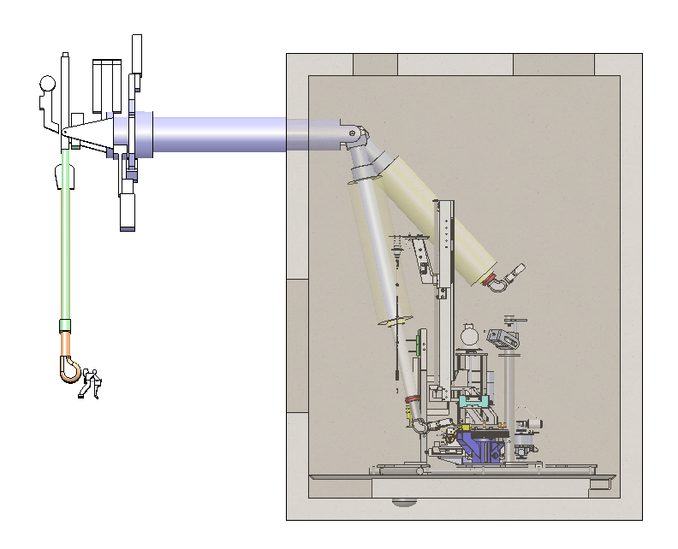
The functional requirements for a research lab can be broadly interpreted based on the survey
“study the characteristics of spent nuclear fuel over time,”
Could imply hot cells and equipment
May involve a different regulatory regime than the storage facility (Part 70 vs Part 72)
options for storage and permanent disposition,
Could range from computer modeling to field testing
alternative methods for managing high-level, long-lived radioactive materials
Wide open
Additional feedback and clarification mechanisms are needed to develop specific preferences for a research lab. Details on preferences are likely to be community specific.

Slide 8
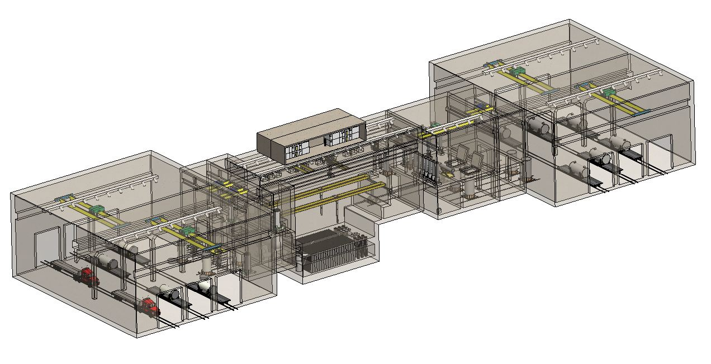
Repackaging requires substantial planning and facilities: community preferences will evolve
Common understanding of :
When is the facility needed?
How will the facility be designed and deployed?
Options for managing LLW streams
All of these issues will impact:
Scope of NEPA analyses
Land requirements
Licensing approach
Repackaging facility concept design evolution should involve iterative communication between engineers and communities

Slide 9
How can engineers and project managers get clarity on public preferences?
Each community gets to choose how it wants to engage
Project managers need to adapt to multiple engagement methods
One size doesn’t fit all
2-way, 3-way, 4-way intersection

Slide 10
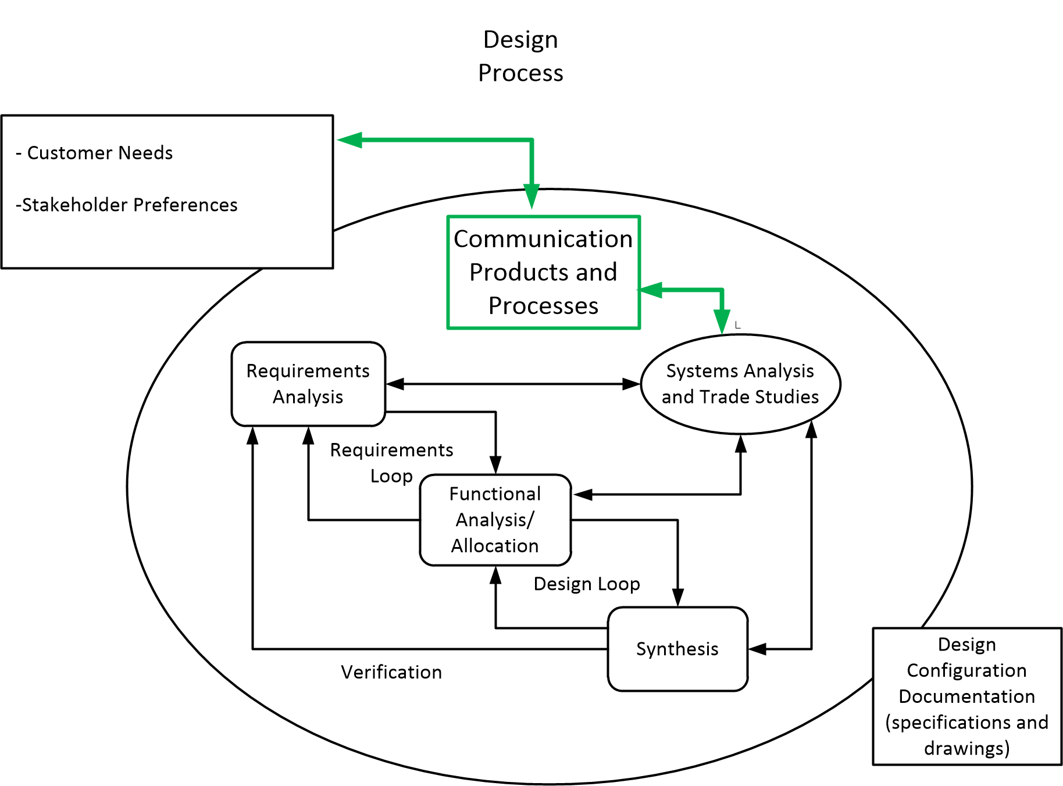
Revised rendition of the design process
Communications products and processes need to be developed and customized to facilitate the evolution of mutually acceptable designs
Communities need to articulate preferences, needs and tradeoffs
Designers need to articulate what they are doing and why
Continuous dialogue is important
Notes:
There are multiple communication packages needed at different stages of the process.
Past design concepts for facilities and structures and information about the nature of the operations, focused on health, safety and environmental conditions is a good place to start for developing communications packages.
Once groups are engaged the communications packages will need to be descriptive of the facility requirements (drawn from the generic conceptual designs and system studies Additional technical information on operations will also need to be developed, including basic information on environmental impacts from construction and operation. It is important for that information to be consolidated and made available for any interested party to review. This data will also feed into the environmental analysis that is performed by DOE and NRC in its licensing process.
To address the different requests and needs for public meetings and literature about the program, DOE will develop a communications effort that would include relevant literature, tracking inquiries; and providing background information for the public, States, Native American Tribes, the Congress and other interested parties. This will require a multi-media approach including a web site and perhaps outreach through social media. Communication will be a full-time responsibility and a significant effort once the public is aware of the likelihood that the project is advancing toward design, construction and operations.

Slide 11
Thoughts
“Making things is an activity as old as civilization, and making ever new things is part of being human. Laypersons and engineers alike are forever encountering new problems, new needs, and new desires that challenge them to invent, to innovate, and to engineer still another thing, another scheme, another dream” Henry Petroski- Pushing the Limits: New Adventures in Engineering

