Slide 1
What to Expect When Readying to Move Spent Nuclear Fuel from Commercial Nuclear Power Plants
Adam H. Levin
AHL Consulting
May 14, 2014

Slide 2
Acronyms
BWR – Boiling Water Reactor
DOE – Department of Energy
DSC – Dry Storage Canister
ISF – Interim Storage Facility
ISFSI – Independent Spent Fuel Storage Installation
PWR – Pressurized Water Reactor
SNF – Spent Nuclear Fuel
2

Slide 3
Table of Contents
The status of spent fuel storage across industry – what’s out there and what is industry likely to turn over to DOE?
Near-term spent fuel management at operating reactor sites – will industry change to meet DOE needs as they develop?
When DOE performs – who’s likely to be on first and how might DOE make it work?
3

Slide 4
Status of Spent Fuel Storage (1)
All spent fuel located in dry storage systems at 15 retired units
Big Rock Point, Haddam Neck, Maine Yankee Yankee Rowe, Rancho Seco, Trojan, Humboldt Bay, LaCrosse, Zion (2015), San Onofre (not official - 2019), Kewaunee (2020) and Crystal River 3 (2019)
Fourteen of 15 units will not have operating spent fuel pools available after 2020
Unable to execute repackaging operations at these ISFSIs once spent fuel moved to dry storage
Crystal River 3 will maintain spent fuel pool in a recoverable configuration, if required later
4

Slide 5
Status of Spent Fuel Storage (2)
Two additional retirements announced: Vermont Yankee (2014) and Oyster Creek (2019)
Currently 11 dry storage systems with greater-than-Class C low-level radioactive waste (excluding SONGS 2/3, Kewaunee, Crystal River and Zion)
5

Slide 6
Status of Spent Fuel Storage (3)
Dry cask storage systems at operating sites
1917 DSCs containing used fuel (as of 5/1/14)
Estimated 2900 DSCs in 2020 [EPRI 2012]
Almost all are “large” DSCs (24 or more PWR assemblies, 52 or more BWR assemblies), most likely to be transported large distances by rail
EPRI estimates all currently operating plants will need dry cask storage by 2025 [EPRI 2012]
6

Slide 7
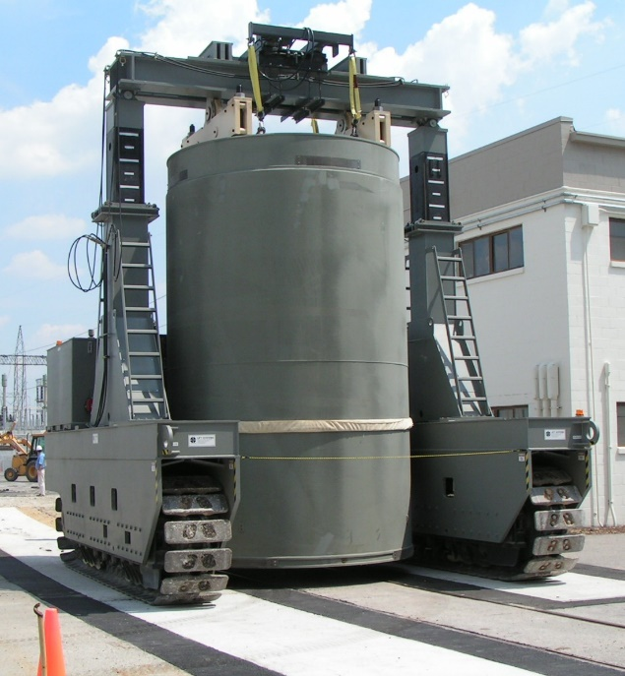
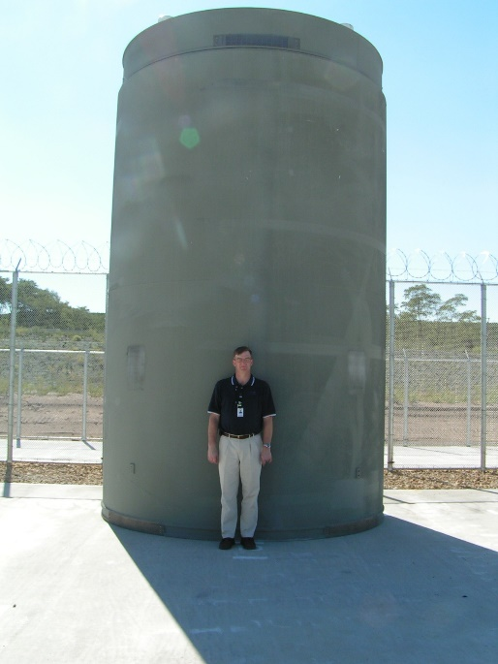
Near-Term Industry Practices (1)
In the absence of NRC regulatory or DOE program guidance, nuclear power plant operators will continue to load large dry cask storage systems.
7

Slide 8
Near-Term Industry Practices (2)
Dose / safety considerations
Minimize radiation exposure
Reduce the number of heavy lifts
Plant operations
Minimize spent fuel pool overhead crane use
Radiation protection and security requirements
Cost considerations
Additional support staffing
Cask loading costs ($300k - $400k)
Public Service and Public Utility Commissions
8

Slide 9
Near-Term Industry Practices (3)
Given the Administration’s position on Yucca Mountain, industry executives have little confidence that DOE will be able to make real progress in the near-term
Specifications for transportation requirements
Specifications for storage systems compatible with DOE disposal facility
When DOE begins acceptance of SNF, they will be faced with accepting currently-licensed large storage systems from industry
9

Slide 10
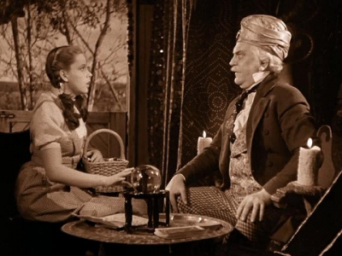
What Does The Future Hold?
The following slides present my speculative view of how spent nuclear fuel might be removed from existing reactor sites to DOE interim storage / disposal facilities
10

Slide 11
BRC Recommendation & DOE Response
Blue Ribbon Commission
Construct a central interim storage facility to accept spent fuel
Move promptly to site a geologic repository
DOE-NE developing program to construct a Pilot Interim Storage Facility (ISF) and Larger ISF
Pilot ISF operational by 2021
Large ISF operational by 2025
Disposal facility operational by 2048
11

Slide 12
A Path Forward (1)
Unless the federal government finds a way to restart efforts to site a repository quickly, the DOE program may never have to take spent fuel from an operating site
Nuclear operators will be more comfortable with shipping SNF once the plant has retired
The national SNF management program efficiency may be improved as a result
Certain changes may need to be made to the currently-existing program framework – Acceptance Priority Ranking
12

Slide 13
A Path Forward (2)
DOE’s early concept for a Pilot ISF is operations beginning in 2021, accepting initially 500 DSCs
DOE Pilot ISF will focus on shutdown units
Excluding Vermont Yankee and Oyster Creek, there will be 472 large DSC’s at ISFSI’s at the retired units – at completion of the current projects
With the retirement of Vermont Yankee and Oyster Creek, approximately 600 large casks will be available
DOE will have sufficient inventory to operate Pilot ISF, and then some
13

Slide 14
A Path Forward (3)
Large ISF for approximately 2,000 DSCs can come on line in 2025, finish currently retired units (including Vermont Yankee and Oyster Creek)
Begin taking fuel from upcoming retirements beginning with Dresden Unit 2 in 2029
There may be a short period with some fuel between 2026 and 2028, where fuel may be removed from operating units near retirement
After 2028, currently-scheduled plant retirements should supply sufficient inventory for Large ISF
14

Slide 15
Observations (1)
DOE needs to start transportation licensing and designing of ancillary equipment now
DOE should accept large DSCs at both facilities
Repackaging into smaller systems for disposal should be planned for at the Large ISF – not at utility sites
Introduce flexibility in disposal system design at the Large ISF
Acceptance order per the DOE Standard Contract is inefficient to the overall SNF management system
15

Slide 16
Observations (2)
Waiting to transfer spent fuel from retired units allows licensees to focus on shipping activities
Minimize number of shipments allowing five or more DSCs to be transported at one time
Improved opportunities for integrated training of plant staff and first responders
16

Slide 17
Conclusions
The interface between at-reactor storage and transportation remains nebulous
Commercial operators want to ship large DSCs, and may have no choice otherwise
DOE not settled on whether or this is acceptable to a national spent fuel management program
Utilities will continue to do what best fits their business interests – driven by safety and cost
DOE working hard to determine, given reality, what can/needs to be done to move the program forward
17

