Slide 1
Oak Ridge National Laboratory Response to DOE call for photos
January 25, 2016
APROVED FOR PUBLIC RELEASE
Notes:
This document has been reviewed and is determined to be
APPROVED FOR PUBLIC RELEASE.
Name/Title: Leesa Laymance / ORNL TIO
Date: 1/25/2016

Slide 2
This document has been reviewed and is determined to be
APPROVED FOR PUBLIC RELEASE.
Name/Title: Leesa Laymance / ORNL TIO
Date: 1/25/2016
Please use the following credit line for all photos
“Courtesy of Oak Ridge National Laboratory, U.S. Dept. of Energy.”

Slide 3
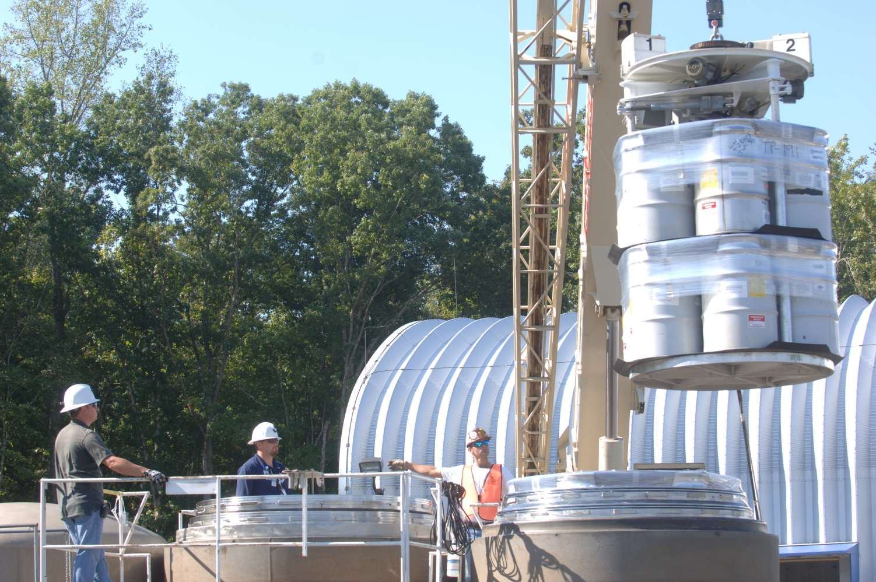
Transuranic Waste Packaging Center
Loading of a TRUPACT II Type B transportation package being prepared to ship Oak Ridge Contact Handled (CH) transuranic waste to the Waste Isolation Pilot Plant (WIPP) for disposal.
Notes:
This document has been reviewed and is determined to be
APPROVED FOR PUBLIC RELEASE.
Name/Title: Leesa Laymance / ORNL TIO
Date: 1/25/2016

Slide 4
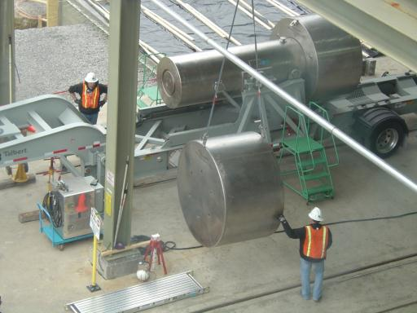
Transuranic Waste Packaging Center
Loaded RH-72B Type B transportation package being prepared to ship Oak Ridge Remote Handled (RH) transuranic waste to the Waste Isolation Pilot Plant (WIPP) for disposal.
Notes:
This document has been reviewed and is determined to be
APPROVED FOR PUBLIC RELEASE.
Name/Title: Leesa Laymance / ORNL TIO
Date: 1/25/2016

Slide 5
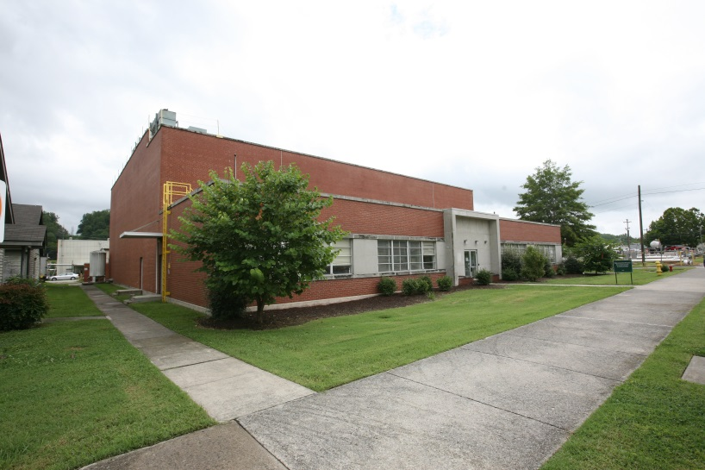
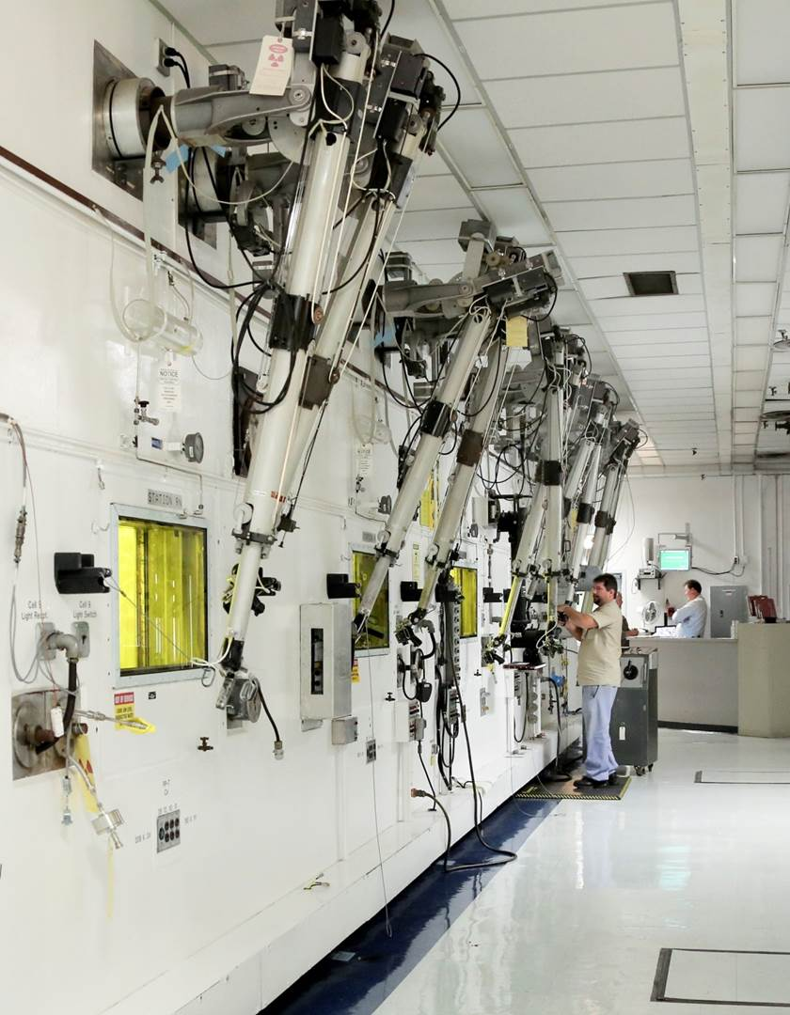
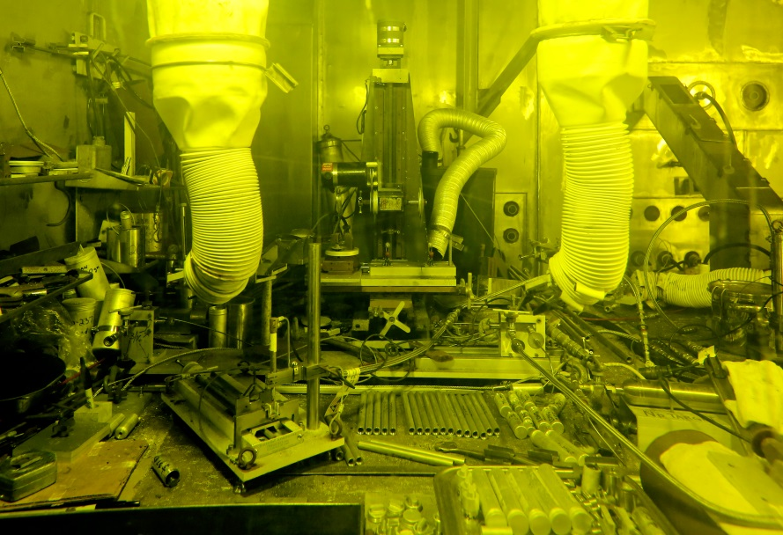
Irradiated Fuel Examination Laboratory
Exterior photo of ORNL’s Irradiated Fuel Examination Laboratory (2009-P02111)
Hot cells inside the Irradiated Fuel Examination Laboratory (2014-P05913)
Photo of manipulators inside hot cell ORNL’s Irradiated Fuel Examination Laboratory (2014-P05908)
Notes:
This document has been reviewed and is determined to be
APPROVED FOR PUBLIC RELEASE.
Name/Title: Leesa Laymance / ORNL TIO
Date: 1/25/2016

Slide 6
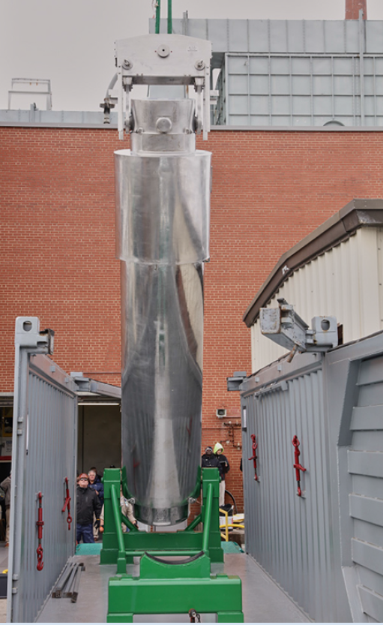
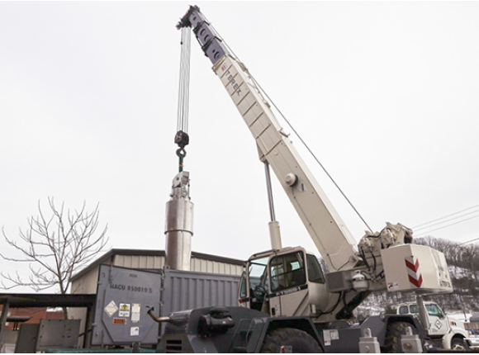
Spent fuel storage cask movement
Transferring the cask into the ORNL Irradiated Fuel Examination Laboratory for post-irradiation experiments of the spent fuel rods, related to irradiation and aging
(2016-P00289)
(2016-P00287)
Notes:
This document has been reviewed and is determined to be
APPROVED FOR PUBLIC RELEASE.
Name/Title: Leesa Laymance / ORNL TIO
Date: 1/25/2016

Slide 7
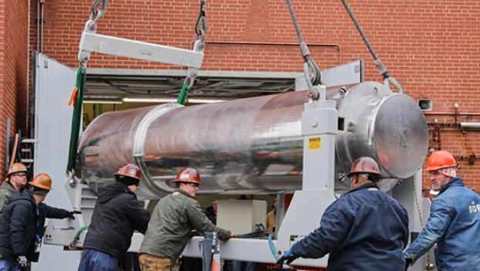
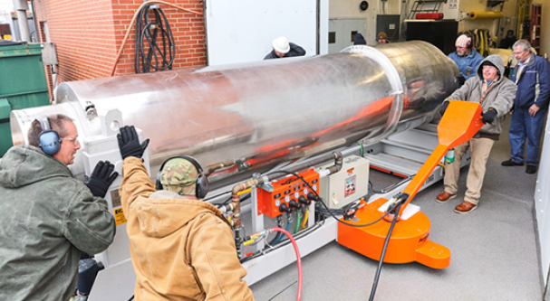
Spent fuel storage cask movement
Transferring the cask into the Irradiated Fuel Examination Laboratory for post-irradiation experiments of the spent fuel rods, related to irradiation and aging
(2016-P00292)
(2016-P00293)
Notes:
This document has been reviewed and is determined to be
APPROVED FOR PUBLIC RELEASE.
Name/Title: Leesa Laymance / ORNL TIO
Date: 1/25/2016

Slide 8
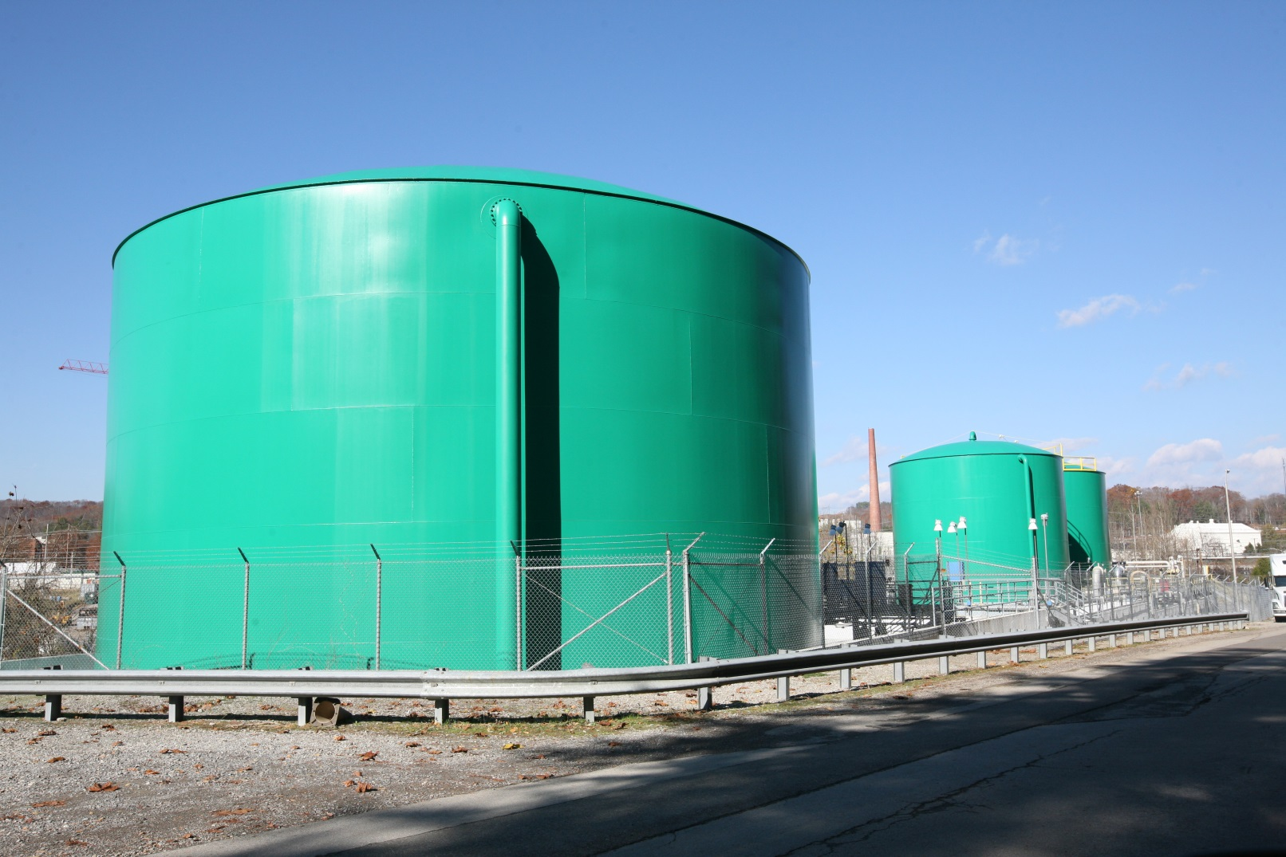
Waste Storage
Bethel Valley Waste Collection Tanks at ORNL (2010-P05548)
Notes:
This document has been reviewed and is determined to be
APPROVED FOR PUBLIC RELEASE.
Name/Title: Leesa Laymance / ORNL TIO
Date: 1/25/2016

