Slide 1
Flexible Integrated Modular Nuclear Fuel Canister System
Presenter: Mark Reeves
Principal Investigators: John Scaglione, John Wagner
Commercialization Manager: Doug Speight

Slide 2
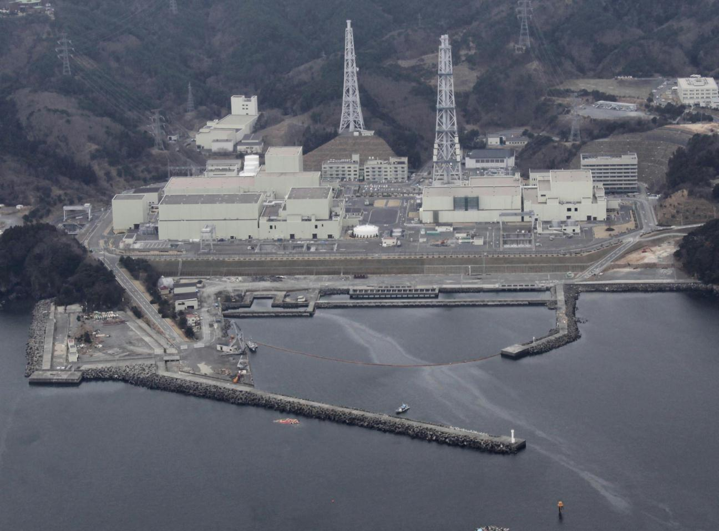
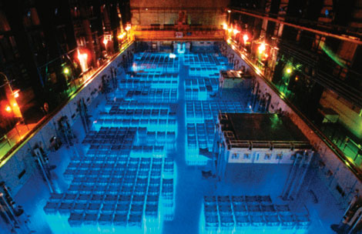
The Pain in the Marketplace (before)

Slide 3
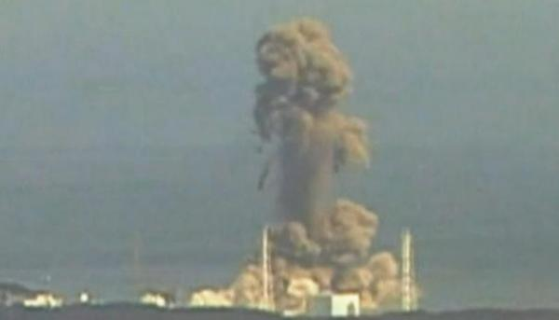
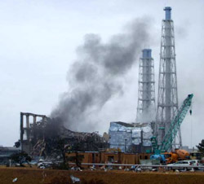
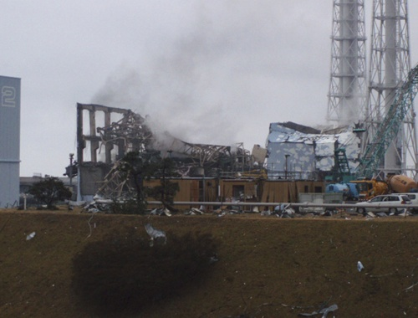
The Pain in the Marketplace (after)

Slide 4
The Pain in the Marketplace
With the demise of Yucca Mountain, the United States has no plan for used nuclear fuel disposal
Most or all other nuclear countries are in a similar situation
Globally, 190,000 metric tons of high level radioactive waste is in temporary storage
Approximately 10,500 additional metric tons of spent fuel are generated each year
By 2020, the total needing disposal will be 445,000 metric tons (and more nuclear plants are planned)

Slide 5
The Pain in the Marketplace (cont’d.)
Worldwide, about 90% of spent fuel is in vulnerable cooling ponds (think Fukushima)
Remainder generally stored in dry casks
None of the existing dry casks will be acceptable for any available future disposal options
Salt formation disposal
Clay/shale
Granite formation disposal
Deep borehole disposal
All future disposal options will require modular casks (combined storage, transport, and disposal) to avoid the financial, operational, and radiological liabilities associated with repackaging

Slide 6
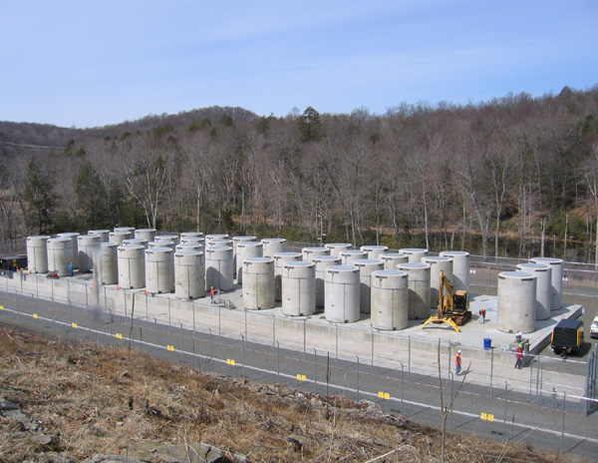
Who’s Feeling the Pain?
The United States government, particularly the Department of Energy (which has regulatory responsibility)
Commercial utilities operating nuclear power reactors, both domestically and abroad
Governments of foreign nuclear countries (where, like Japan, the government/commercial enterprises are inseparable)

Slide 7
Peering Into the Crystal Ball…
Someday, there will be ultimate disposal options for spent nuclear fuel
Present-day storage casks will not meet requirements
Lack flexibility
Will not be physically compatible (size, management of thermal load) with any future disposal option
The exact nature of future disposal options/systems is not known, but some safe assumptions can be made

Slide 8
The Needed Pain Remedy
A new cask system that meets all requirements but does not require repackaging bare fuel
Multi-modal use and flexibility in all operations
Regardless of ultimate disposal option chosen
Can serve current cask functions as well as function in future scenarios (current cask designs will be obsolete in the future and their loads will have to be removed and repackaged)
Unique design features
Handle individual canisters separately or collectively
Allow storage and transportation of high burnup fuel
Reduce disposal licensing burden
Works within existing framework at utilities for dry cask storage
Permits removal and re-processing of fuel assemblies, if desired

Slide 9
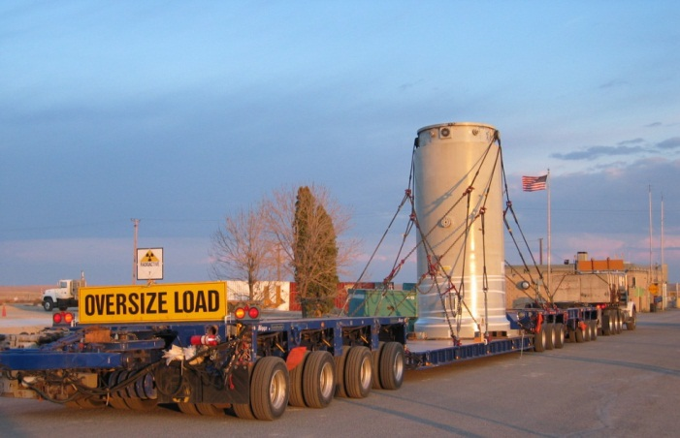
ORNL’s Pain Remedy
Small canister provides flexible disposal options
Flexible Integrated Modular Nuclear Fuel Storage, Transportation, and Disposal Canister System (FIrST)
Multi-modal use and flexibility in all operations while working within existing utility framework
Unique design features to accommodate future, current, and past proposed disposal concepts
Small canisters in larger canister for storage and transportation

Slide 10
FIrST
Multiple sealed canisters within larger reusable container
Assemblies in SS tubes (FBT)
Neutron Absorber (B-SS)
Al thermal shunts or some additional heat transfer ability
Disc structural support system with heat transfer needs incorporated.
Secondary retrieval mechanism
Modular canisters can be stored in large, up-right concrete overpacks, horizontal storage similar to Nuhoms, or potentially in-earth/building storage, with suitable seismic constraints
B-SS plates slide between tubes
FBT bottom meets existing damage fuel canister mesh requirements for containment
Notes:
Indicate this is PWR concept, but BWR one would be available also (need some calculations to vet the design)

Slide 11
Advantages of ORNL Remedy
Retrievability during/after storage
Sealed inner canister should suffice
Secondary retrieval option is to open modular canister and remove fuel assembly as intact assembly if intact
Tertiary retrieval mechanism would be for damaged fuel through FBT removal with assembly components contained inside FBT (special grapple)
Maintain integrity after transportation
Sealed inner canister should suffice for all disposal options
Sealed inner canister should remove 45 GWd/MTU burnup threshold
Tertiary storage retrieval mechanism should work for reprocessing plant
Physical size and thermal limits
Sealed inner canister can be used for clay/shale or salt concepts
FBT removal used for deep borehole concept
Reduced life-cycle costs because no repackaging of bare fuel
FIRST system can meet all used fuel disposition concepts envisioned for the future

Slide 12
Intellectual Property Status
One Invention Disclosure to date—UT-Battelle ID 2603, “Flexible, Integrated Modular Used Nuclear Fuel Storage, Transportation, and Disposal Canister System” (FIrST)
U.S. provisional patent application filed July 20, 2011
Foreign patent protection still possible
Future inventions will flow as development proceeds; ~$750K in funding in hand now to advance design

Slide 13
Potential Market Value of ORNL Remedy
1,900 existing casks will have to be replaced
Casking of current pond-stored wastes will require 17,100 more casks
Additional metric tonnage of spent fuel generated by 2020 will require 25,500 casks
Current Holtec casks (not viable for future storage options; will need to be replaced) cost $1MM each.

Slide 14
Potential Market Value of ORNL Remedy (cont’d.)
Presuming a profit margin of 20% and a cost of $1.5MM each for modular casks, the world market for casks by 2020 would result in $66.75B in revenues and $13.35B in profits

Slide 15
Potential Market Value of ORNL Remedy (cont’d.)
The yearly waste generation total would thus support $1.575B yearly in revenues and $315MM yearly in profits
Market Share Yearly Revenues Yearly Profits
100% $1,575MM $315MM
50% $787.5MM $157.5MM
20% $315MM $63MM
Does not take into account backlogs of existing wastes!

Slide 16
The Promising Path to Market
The spent fuel disposal dilemma must and will be solved
Regulatory decisions will be made; disposal options will be chosen
Future disposal options will require a modular, multipurpose cask (does not exist in the marketplace now)
The opportunity is now to influence policy decisions by helping to create—and making available—a compelling technology

Slide 17
The Promising Path to Market (cont’d.)
Commercial firms who are partners in technology development will have first adopter opportunity
Likely to be significant U.S. government funding available to implement technology
First adopter exploitation of U.S. opportunities in partnership with U.S. government will allow subsequent penetration of commercial and foreign markets

Slide 18
Potential Barriers Along the Path to Market
Regulatory Obstacles
Ultimate disposal option(s) have to be chosen and regulations written regarding cask specifications
Political will to make hard choices has been scarce (see Yucca Mountain)
Technological Obstacles
Not as significant as regulatory obstacles
Cask design needs to be fleshed out
Prototypes need to be built and tested
Risk takers will be rewarded handsomely; not for the faint of heart!
Will require
Patience
Aggressive engagement with regulators and policymakers
Persistence
Investment

Slide 19
The Commercial Partnership Opportunity
Research partnership with ORNL (CRADA)
Technology development and prototyping
Leveraging of private and government funds (funding to support ORNL efforts already beginning to flow)
Provides a ‘seat at the table’ to influence licensing/regulatory conversations regarding disposal options
Option or license existing technology at outset of partnership
Be a part of further development of the technology under CRADA, which can be licensed as needed (CRADA provides option protection)
Use the compelling nature of the technology to drive adoption/mandate by regulatory authorities
First adopter opportunities

Slide 20
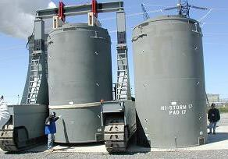
Contact Information
Doug Speight
865.241.6564
dspeight@ornl.gov
John Scaglione
865.574.9284
scaglionejm@ornl.gov
John Wagner
865.241.3570
wagnerjc@ornl.gov

