Slide 1
Used Nuclear Fuel-Storage, Transportation & Disposal Analysis Resource and Data System (UNF-ST&DARDS)
J. M. Scaglione et al.
Oak Ridge National Laboratory
Scaglionejm@ornl.gov
WM Symposia 2014
March 2 – March 6, 2014
Phoenix, Arizona
Session 078, Abstract 14657

Slide 2






Acknowledgement
Oak Ridge National Laboratory
Pacific Northwest National Laboratory
Savannah River National Laboratory
Nuclear Energy Institute
Duke Energy
Tennessee Valley Authority
The Yankee Companies
  Yankee Atomic
  Maine Yankee
  Connecticut Yankee

Slide 3
  Waste management system decision making must be informed with the best information available
Informed decision making requires a variety of analytic tools and relevant data
Necessity for central, controlled information storage location “unified database”
  Data needs are diverse
  Publicly available information is not always consistent
  Tracking down correct information is time consuming
  People leave the industry and knowledge transfer is incomplete
Data integration and analysis automation are required for generating reliable used nuclear fuel (UNF) characteristics as a function of time
The UNF-Storage, Transportation & Disposal Analysis Resource and Data System (UNF-ST&DARDS) integrates data and analysis capabilities with broad applicability

Slide 4
Presentation overview
Waste management system planning is complex
Inherent margin has potential to offset uncertainties
Data integration and analysis automation
Performance of cask-specific evaluations
Automated analysis process pipeline
Graphical user interface
Summary

Slide 5
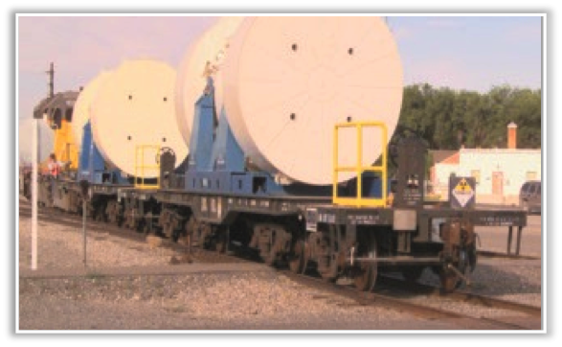
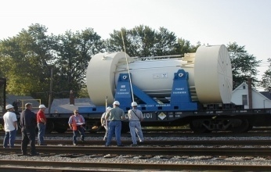
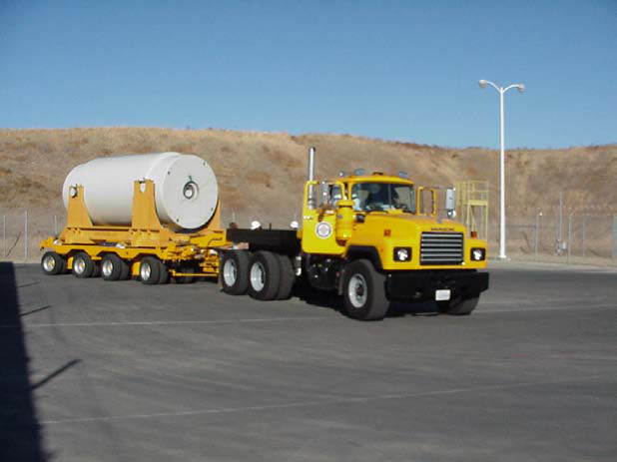
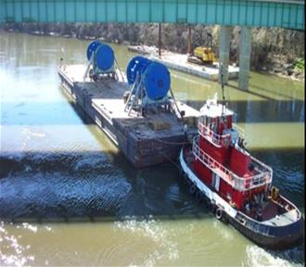
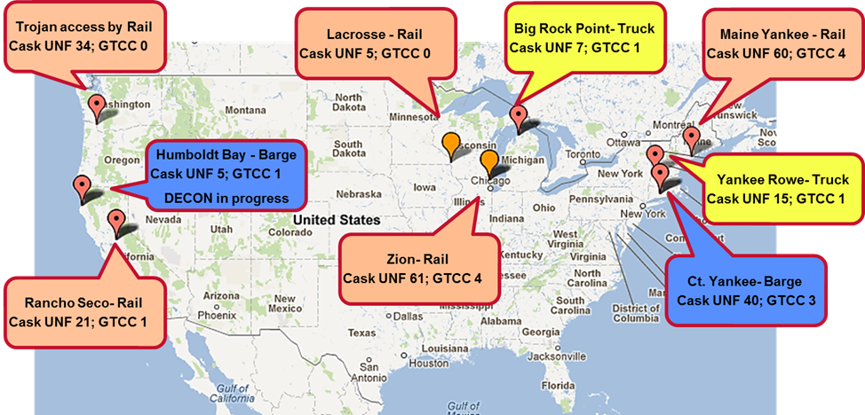
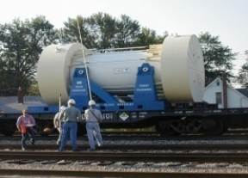
Planning for large-scale transportation of 1000’s of UNF casks is complex
The UNF may be stored, transported, and handled multiple times before disposal
  number of reactor sites involved
  variety of dry storage systems in use
  different approaches for transporting
  UNF from the reactor sites
Large number of different fuel
assembly types that have been
and are being used by nuclear
reactors
Uncertainties from materials aging
and changing nuclear and mechanical
characteristics

Slide 6
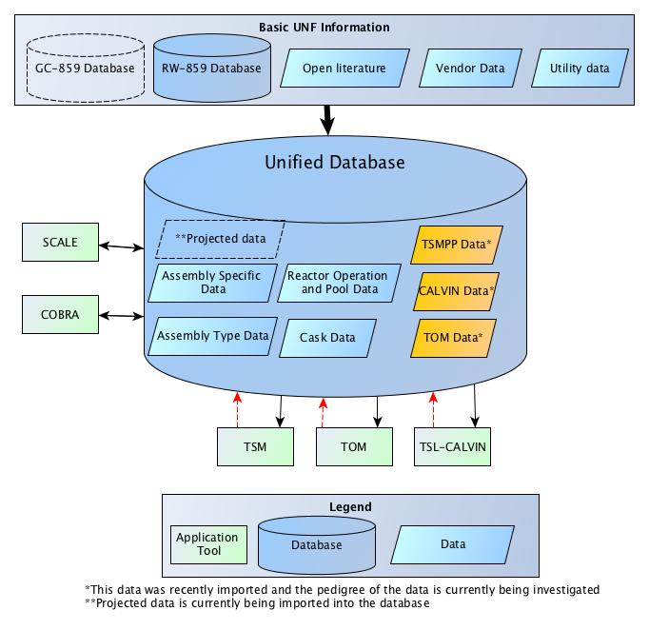
Data integration and analysis automation is required for generating reliable UNF characteristics as a function of time
UNF-ST&DARDS
  Characterizes input to waste
  management system
  Provides credible, controlled
  data source for key information
  Couples database with analysis
  capabilities (inventory, thermal,
  criticality, dose, etc.)
  Assess issues and uncertainties
  related to transportability of
  loaded casks, with initial
  emphasis on shutdown sites
Next Gen. tools

Slide 7
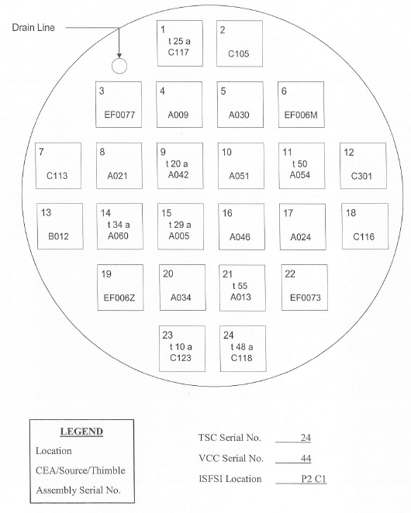
A unique, unprecedented capability within UNF-ST&DARDS is the performance of actual cask-specific evaluations
Understanding current
conditions and practice
versus hypothetical
bounding scenarios
(i.e., realistic margins)
  Enables practical
  approaches to addressing UNF
  issues
  Enables improved operational
  flexibility
  Potentially enable direct
  disposal of existing canisters
  Address questions on used fuel
  issues such as potential for fuel
  failure over time

Slide 8
Cask systems are loaded with inherent uncredited margin that could be used to offset some uncertainties
Example illustration of cask-specific criticality safety margin for site A
  All site A casks have more than 10% Δk_{eff} (75% have greater than 20% Δk_{eff})
Example illustration of cask-specific thermal analyses for site A
  Peak clad temperature margin
  Allows identification of component temperature changes with time

Slide 9
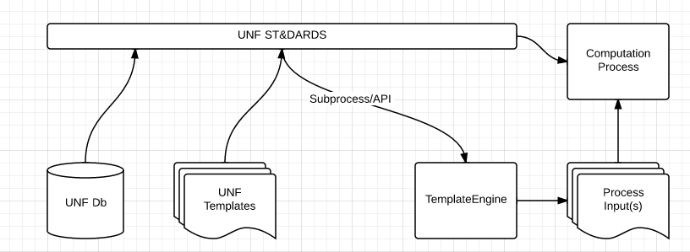
A key database design element that facilitates cask-specific analysis automation is the data relations defined within the database.
UNF-ST&DARDS connects the UNF database parameters to computation module templates
uses the TemplateEngine to expand computational process specific templates into full input(s)
executes the computational module with expanded input
Notes:
TemplateEngine:
Separate input structure from input parameters
Take advantage of repeated input structures
Encourage organization of components into distinct layers

Slide 10
Templates are used to facilitate analysis automation

Slide 11
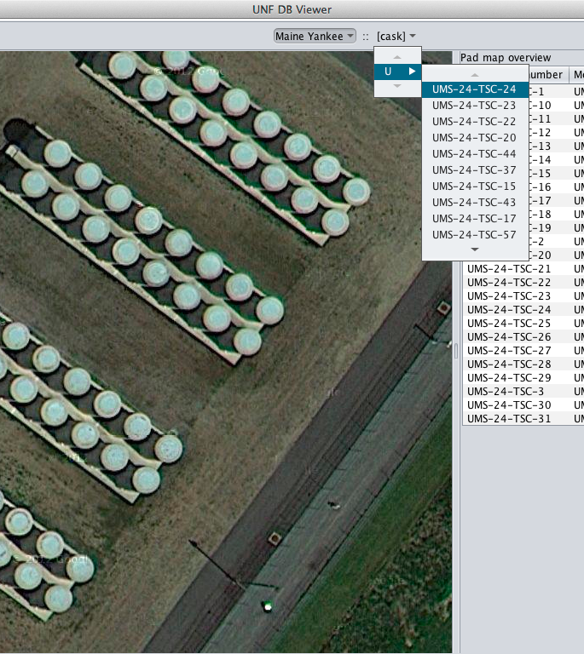
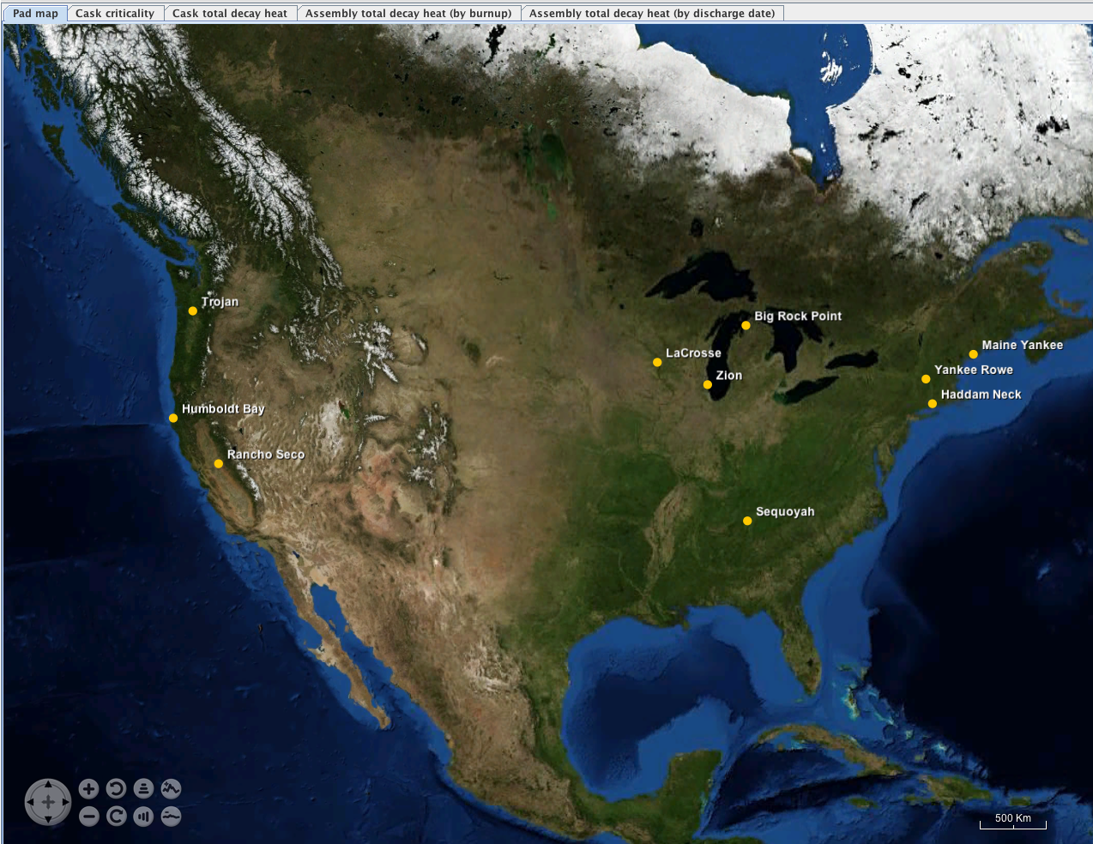
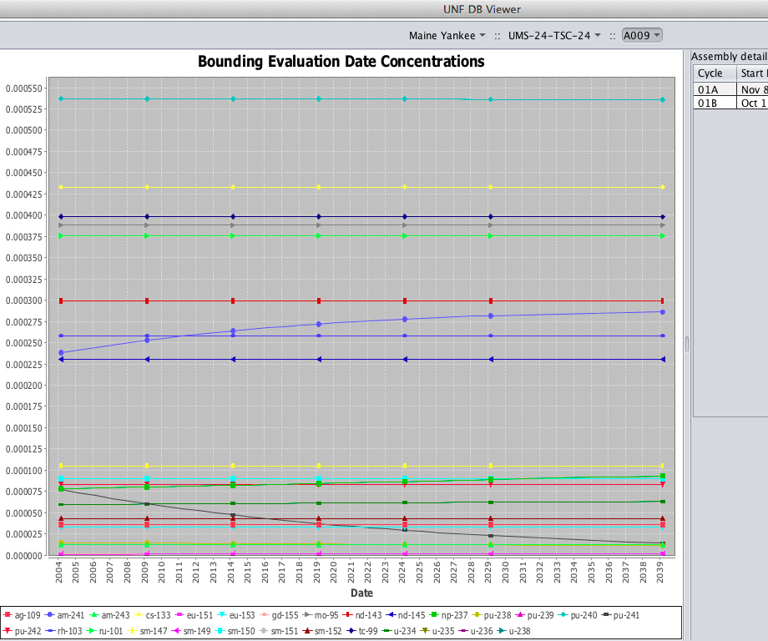
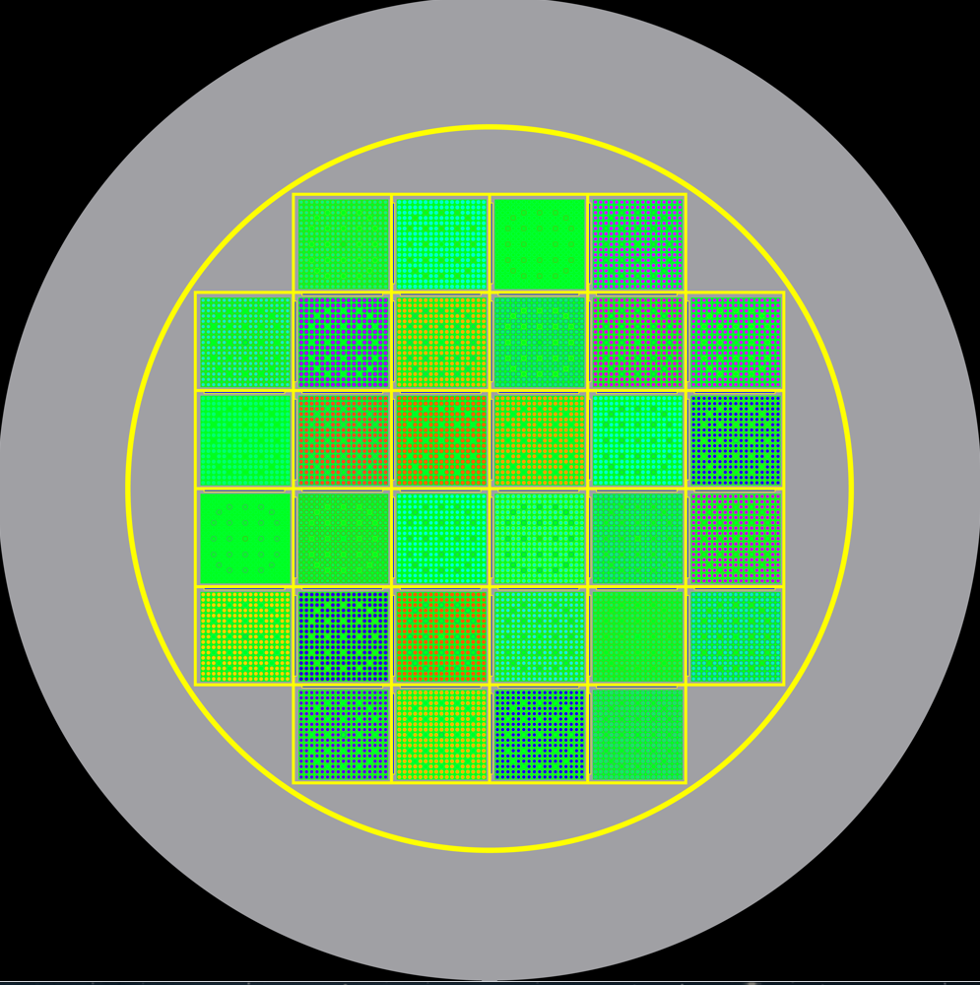
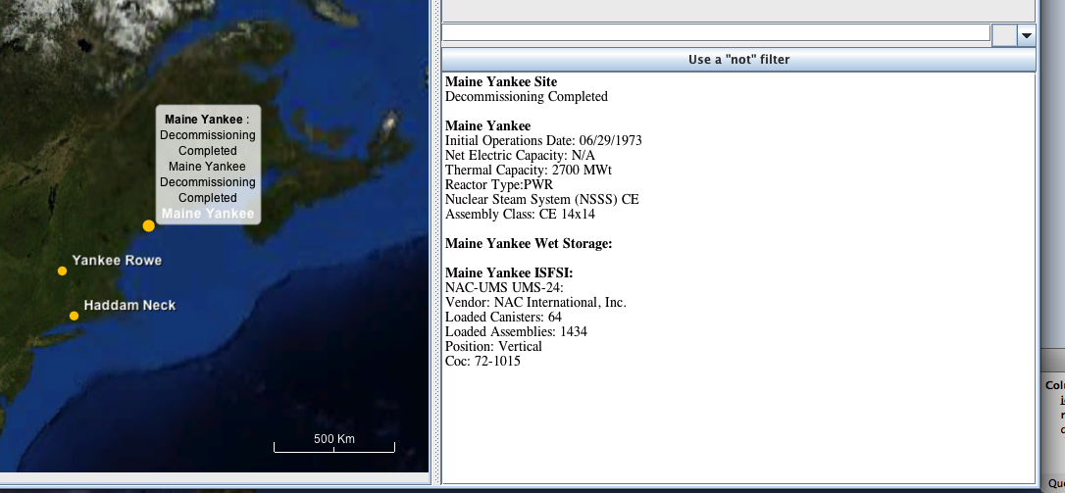
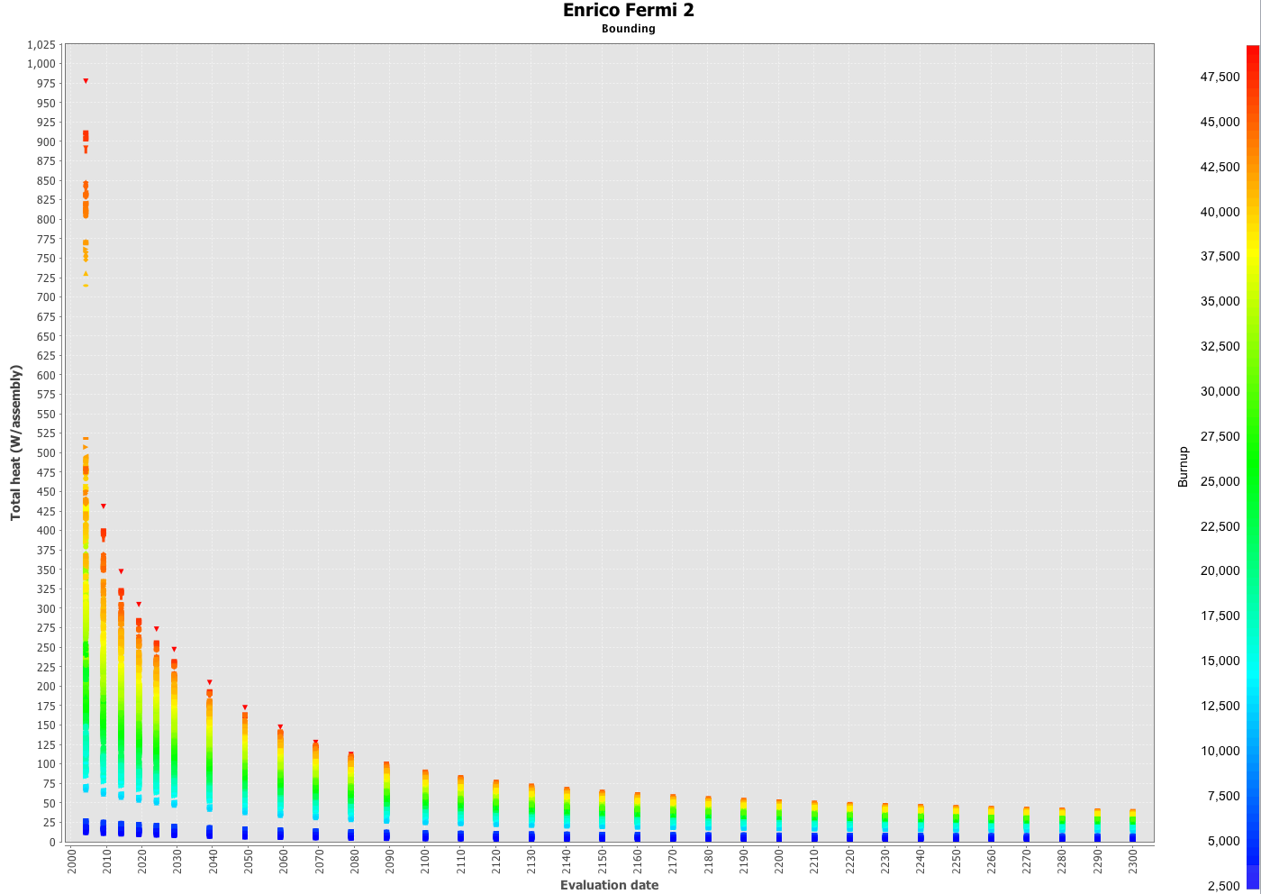
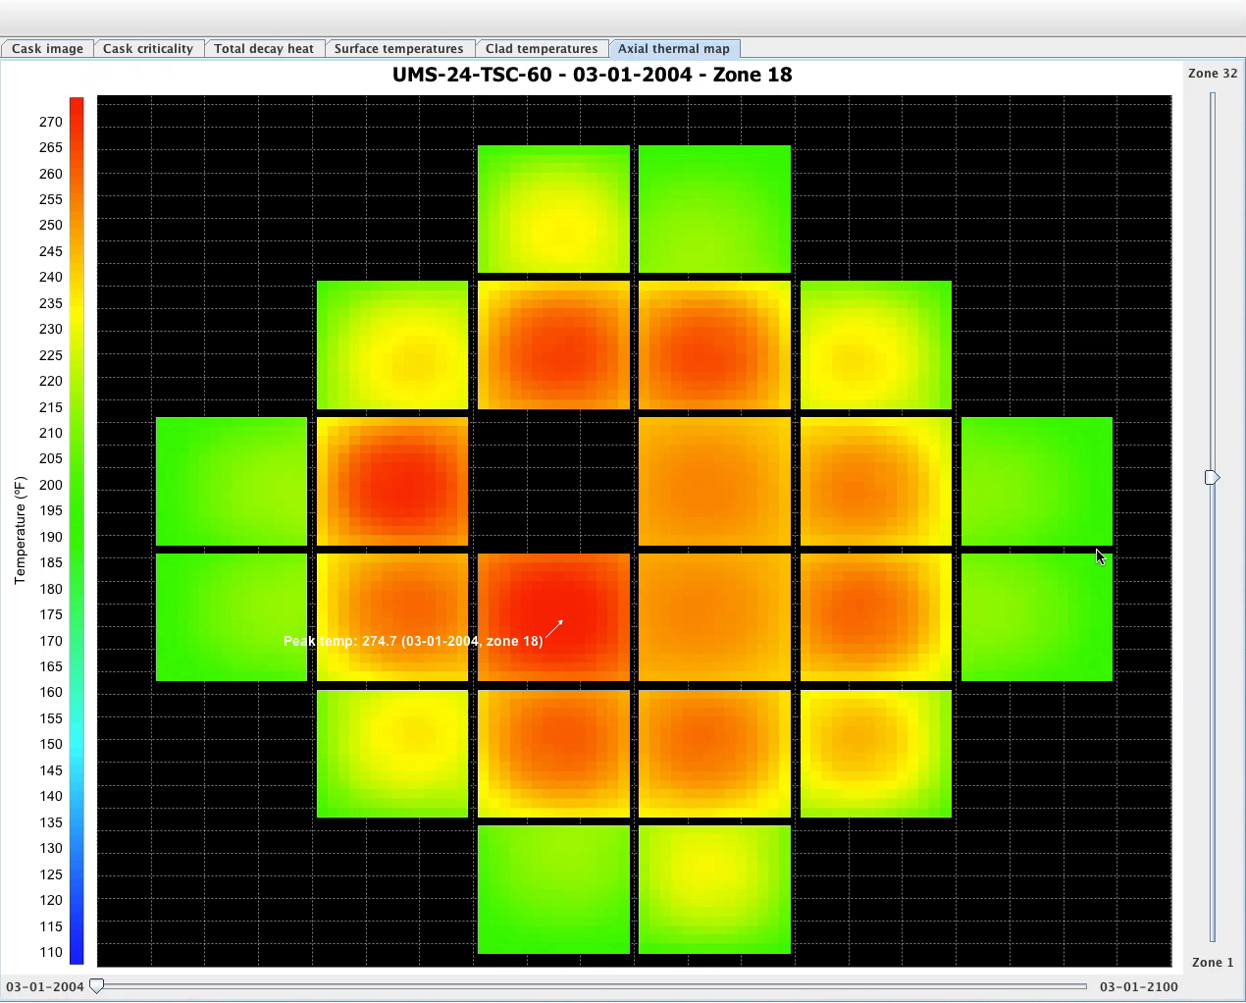
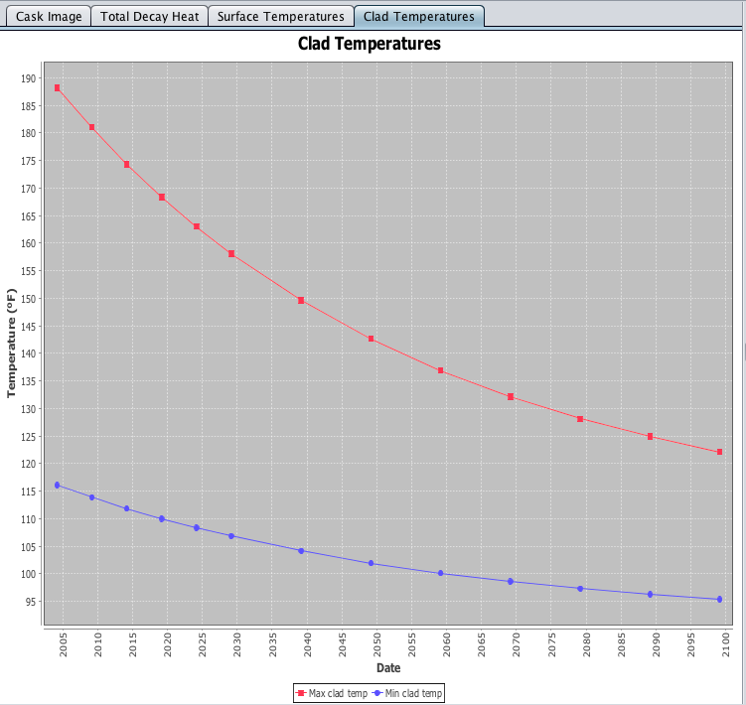
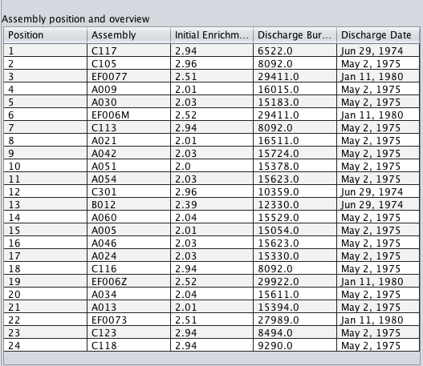
Interactive visualization capabilities facilitate data analysis and results interpretation

Slide 12
UNF-ST&DARDS is a comprehensive national resource providing a wealth of UNF information with broad applicability
Provides a national unified domestic used nuclear fuel (UNF) system database and key analysis capabilities to support Department of Energy (DOE) waste management and fuel cycle related objectives
  consolidation, collection, archival, and distribution of commercial nuclear fuel data
  controlled source of technical data for various waste management system analysis/evaluation tools, as well as fuel cycle systems, safeguards, and security studies
Provides foundation for tracking UNF from reactor power production through ultimate disposition
Enables informed decision making relative to design, safety, and licensing of spent fuel systems and facilities with best available information
Notes:
Emphasize that key data is not colleted or consolidated, and that the mojority of the time when conducting analyses is associated with tracking down the correct data through numerous different sources and building models for analyses. The unified database allows reductions in human error,,a means to make sure others that are doing complimentary analyses use the same infomration about the cask and fuel, and allows focus t obe placed on analyzing results instead of getting the model to run.

