Slide 1
Criticality Safety Assessment for As-loaded Spent Fuel Storage and Transportation Casks Kaushik Banerjee, John M. Scaglione, John C. Wagner, and Robert A. Lefebvre Oak Ridge National Laboratory banerjeek@ornl.gov ORACS Workshop May 19-21, 2015 Albuquerque, NM

Slide 2
Outline
Background
Uncredited criticality safety margin associated with as-loaded criticality analysis and its application
As-loaded criticality analysis results for eight reactor sites
Conclusion

Slide 3
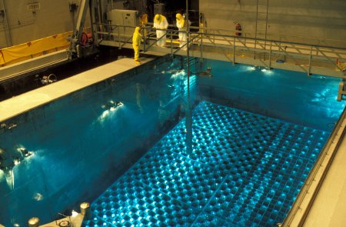
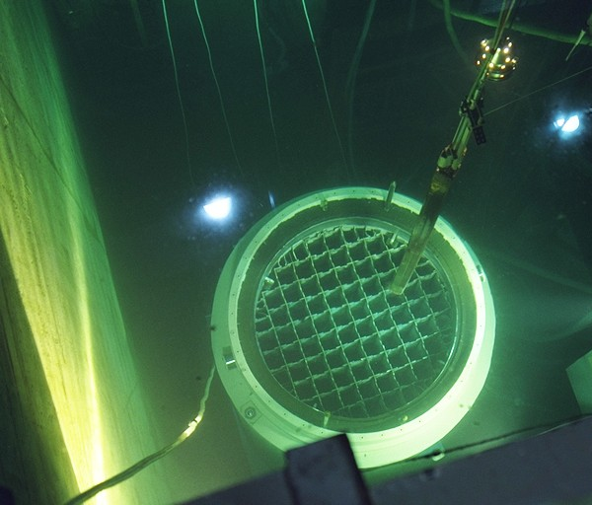
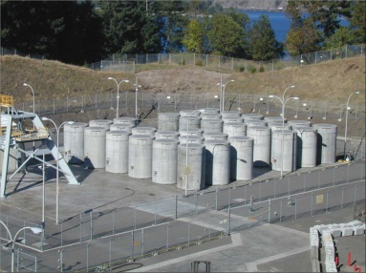
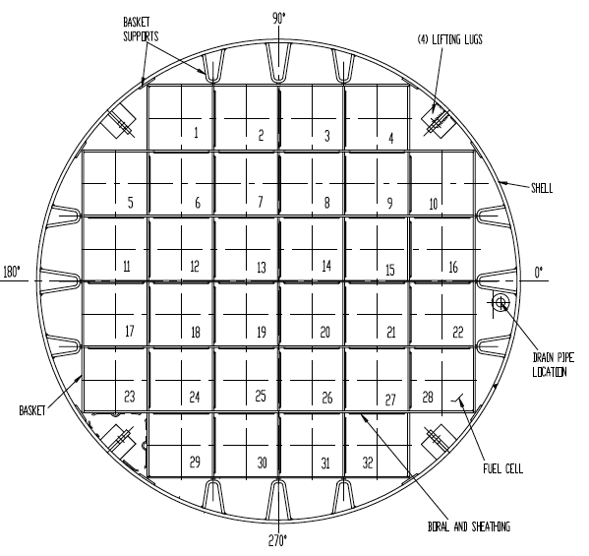
Spent nuclear fuel (SNF) is stored in a basket positioned within a canister/cask
SNF is stored within a basket cell
Flux-trap basket design
Non Flux-trap design
Neutron absorber (such as Boral®) plates are attached to the basket cells
Neutron absorbers are comprised of a chemical form of the neutron absorber nuclide (such as B-10 in B₄C) and a matrix (such as Al or stainless steel)
The canister is placed in different overpacks for storage, and transportation
Dry storage at Trojan
MPC-32

Slide 4
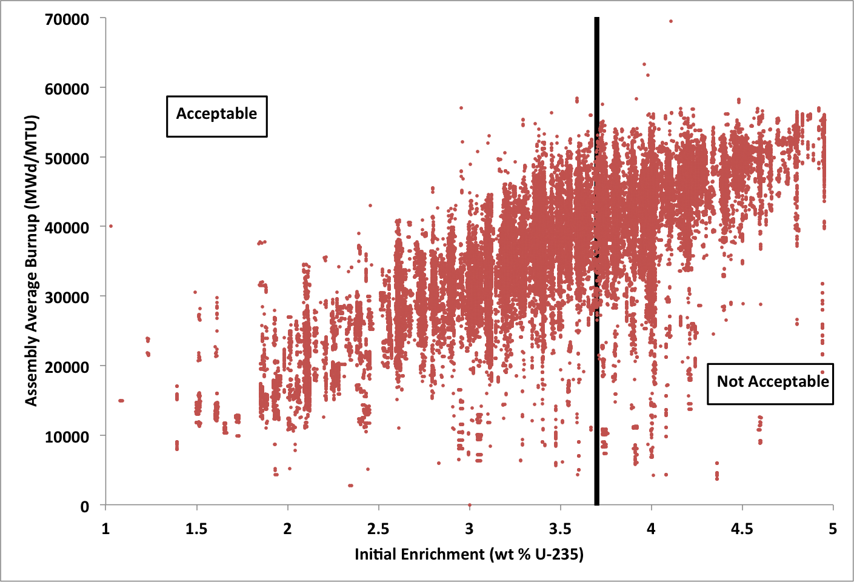
Uncredited criticality margin exists in as-loaded SNF canisters
Bounding fuel characteristics (e.g., fuel type, initial enrichment, and discharge burnup) are applied for licensing applications
In practice discharged SNFs available for loading are diverse (e.g., wide variations in SNF assembly burnup values)
Licensing application
k_{eff} = 0.90
Discharged inventory
As-loaded
k_{eff} = 0.66
3.7
0
0
3.7
0
0
Uncredited margin = 0.90-0.66 = 0.24 Δk_{eff}
3.2
34.0
33
3.2
32.0
33
3.7
0
0
3.7
0
0
3.7
0
0
3.7
0
0
3..2
36.0
33
3.2
36.0
33
3.2
38.0
33
3.2
34.0
33
3.7
0
0
3.7
0
0
3.7
0
0
3.7
0
0
3.7
0
0
3.7
0
0
3.2
32.0
33
3.2
36.0
33
3.2
40.0
33
3.2
39.0
33
3.2
36.0
33
3.2
33.0
33
3.7
0
0
3.7
0
0
3.7
0
0
3.7
0
0
3.7
0
0
3.7
0
0
3.2
33.0
33
3.2
36.0
33
3.2
39.0
33
3.2
40.0
33
3.2
36.0
33
3.2
33.0
33
3.7
0
0
3.7
0
0
3.7
0
0
3.7
0
0
3.2
34.0
33
3.2
38.0
33
3.2
36.0
33
3.2
34.0
33
3.7
0
0
3.7
0
0
3.2
32.0
33
3.2
33.0
33
X
Y
Z
Assembly average initial enrichment (wt%)
Assembly average burnup (GWd/MTU)
Cooling years

Slide 5
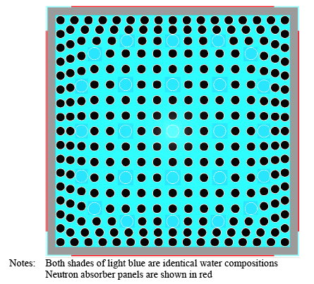
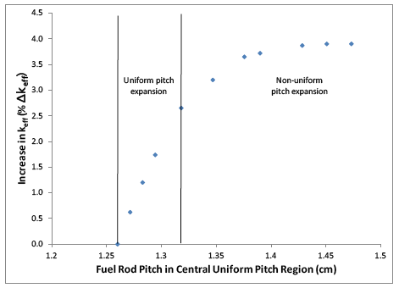
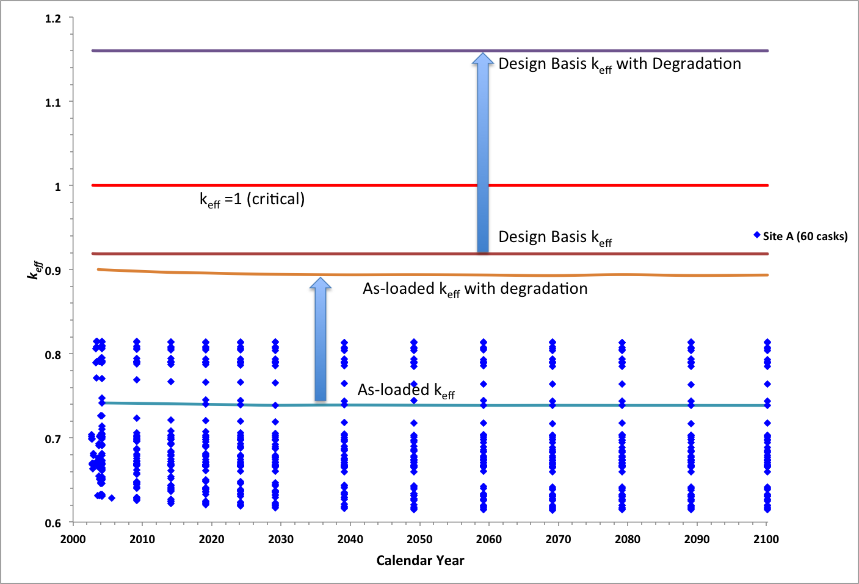
Uncredited criticality margin can be credited to offset system aging related reactivity increases
Potential changes in as-analyzed geometric configuration
Fuel reconfiguration
Effects of neutron absorber degradation

Slide 6
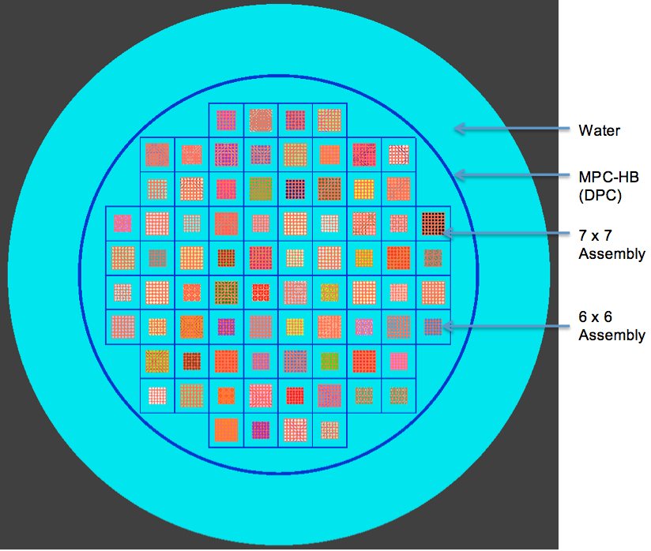
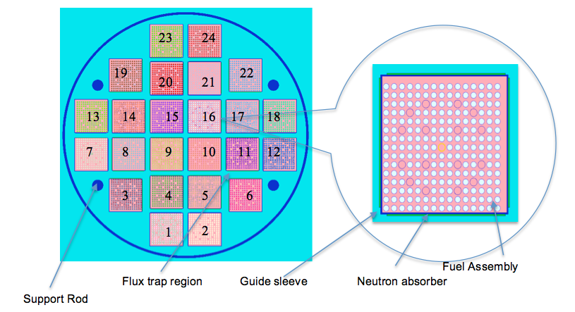
As-loaded criticality calculations were performed for eight reactor sites to quantify uncredited margins
Site E canister
Site C canister
Site A, C, D, and F employ 24-assembly canisters (Flux-trap design)
Site B employs both 24- and 26-assembly canisters (Flux-trap design)
Site G and H employ 32-assembly canisters (Burnup credit canister)
Site E employs 80-assembly (BWR) canisters

Slide 7
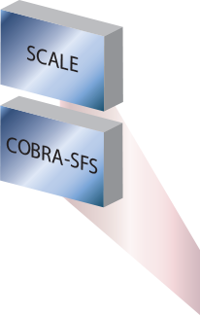
A new tool has been developed to perform as-loaded analyses
Used Nuclear Fuel- Storage, Transportation & Disposal Analysis Resource and Data System (UNF-ST&DARDS) streamlines various waste management related analyses
UNF-ST&DARDS provides a comprehensive database and integrated analysis tools
Data relations facilitate analysis automation
Minimum user interaction assures accuracy

Slide 8
UNF-ST&DARDS uses ORNL’s SCALE code system for criticality calculations
As-loaded analysis for SNF requires the determination of time dependent isotopic number densities - Depletion and Decay calculation
Isotopic composition of the SNF from the depletion step is used to determine the cask neutron multiplication factor (k_{eff}) – Criticality calculation
Depletion and decay calculation of SNF to generate assembly-specific composition:
TRITON sequence and ORIGIN module are used
Isotopic compositions are generated for assembly-specific initial enrichment, burnup and decay times for major fuel class (e.g., C1414C)
Conservative depletion parameters such as constant soluble boron concentration (1000 ppm) are used
Depletion calculations include the presence of burnable poison rod (PWR) and control blade (BWR) throughout the irradiation time

Slide 9
UNF-ST&DARDS uses ORNL’s SCALE code system for criticality calculations
KENO-VI is used to perform cask criticality calculations using cask-specific fuel inventory (loading maps)
continuous energy ENDF/B-VII.0 cross section library
12 actinides and 16 fission product isotopes are credited (NUREG/CR-7108, -7109)
Pressurized water reactor (PWR) axial burnup profiles are used from NUREG/CR-6801 (18 node)
Uniform profile is used for the one boiling water reactor (BWR) site analyzed
Specific fuel types are modeled (e.g., C1414C, C1414A, C1414W)
Conservatism is maintained for the analyses
Bounding assembly models (e.g., fresh design basis assembly) as determined in the FSAR/SAR are applied for irregular assemblies (e.g., assemblies with missing fuel rods, damaged fuel assemblies).

Slide 10
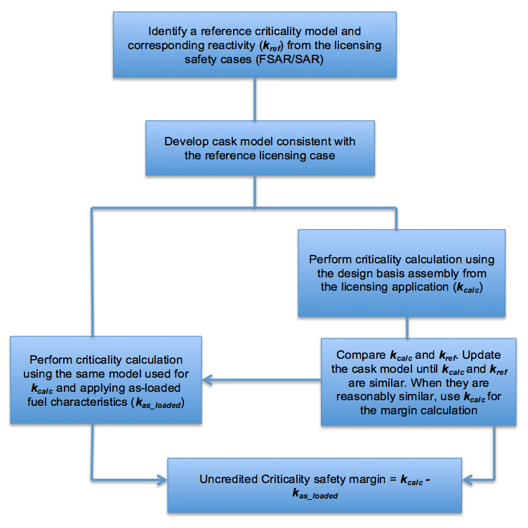
Uncredited criticality safety margin is calculated as

Slide 11
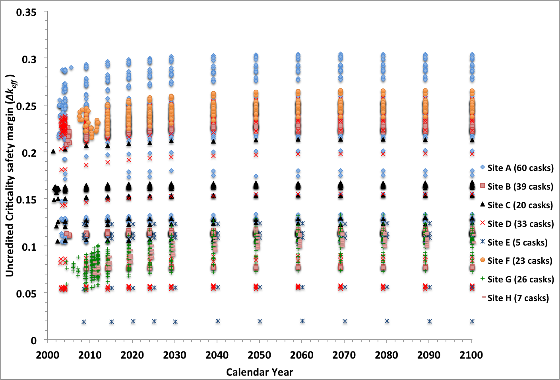
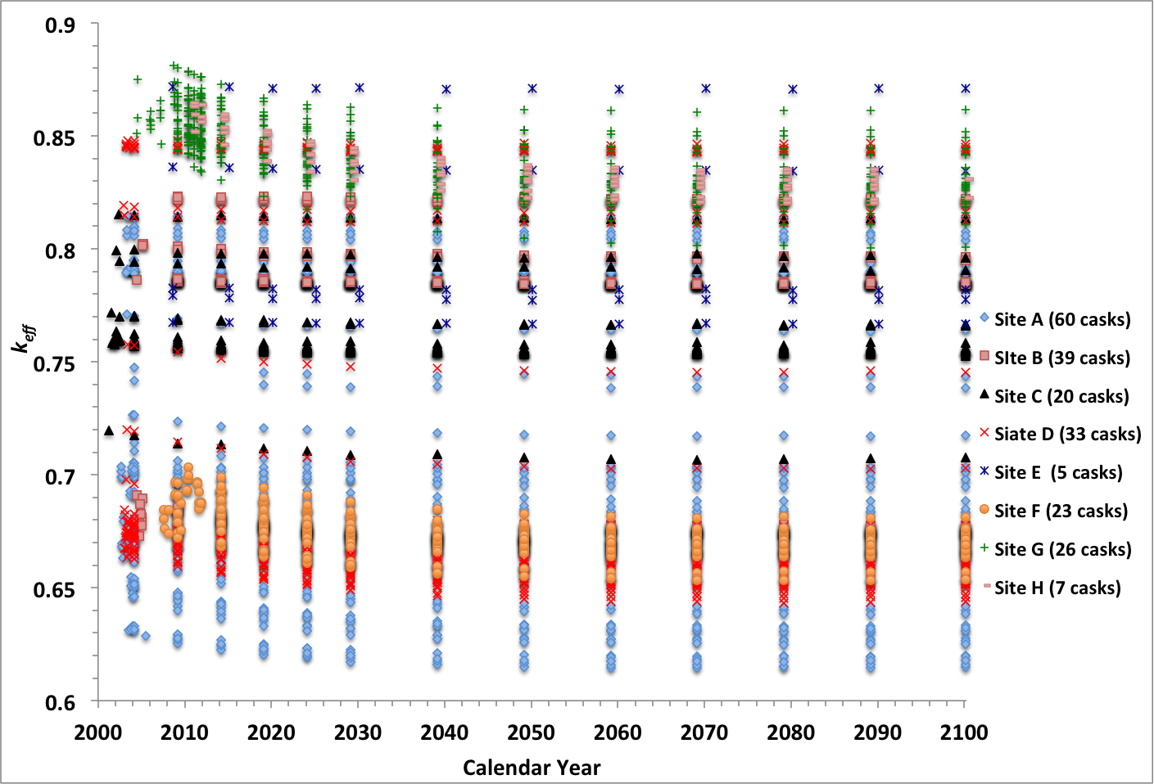
Uncredited criticality margins are quantified for loaded canisters at eight sites using as-loaded configurations
213 loaded casks at eight sites are analyzed
Six canisters types including 24-assembly baskets (flux trap design), 32-assembly basket (burnup credit canisters), and a BWR basket

Slide 12
Uncredited criticality margin could be credited to offset postulated mechanical performance losses as systems age
Canister-specific as-loaded criticality calculations have been performed for eight reactor sites (total 213 as-loaded casks)
It is observed that most of the as-loaded casks have substantial uncredited safety margins ranging from 0.05 to almost 0.30 Δk_{eff}
The uncredited safety margins can be used:
To offset aging related uncertainties
For example, uncredited margin can offset increase in k_{eff} (indicated to be 4%*) from potentially credible fuel failure configurations that could occur during transportation after extended storage
Support direct disposal of currently loaded canisters
As-loaded criticality analysis can also support licensing of the highly reactive SNF inventories (assemblies in the unacceptable region of a loading curve) in a large capacity transportation cask
*W. J. Marshall and J. C. Wagner, Consequences of Fuel Failure on Criticality
Safety of Used Nuclear Fuel, ORNL/TM-2012/325,
Oak Ridge National Laboratory, Oak Ridge, Tenn., September 2012.

