Slide 1
Subcriticality Demonstration Options
for Direct Disposal
of Dual-purpose
Canisters
Kaushik Banerjee, John M. Scaglione, Justin B. Clarity, and Robert Jubin
Oak Ridge National Laboratory
Thomas Severynse
Savannah River National Laboratory
Ernest Hardin
Sandia National Laboratories
Used Fuel Disposition R&D Campaign
Contact: banerjeek@ornl.gov
ORACS Workshop
Albuquerque, NM, 19-21 May, 2015

Slide 2
Acknowledgments
This work was supported by the U.S. DOE, Office of Nuclear Energy,
Fuel Cycle R&D Program, Used Fuel Disposition Campaign
This is a technical presentation that does not take into account contractual limitations under the Standard Contract. Under the provisions of the Standard Contract, DOE does not consider spent fuel in canisters to be an acceptable waste form, absent a mutually agreed to contract modification.
Prepared by Oak Ridge National Laboratory, P.O. Box 2008, Oak Ridge, Tennessee 37831-6285, managed by UT-Battelle, LLC, for the U.S. Department of Energy under contract DE-AC05-00OR22725.
This presentation was prepared as an account of work sponsored by an agency of the United States government. Neither the United States government nor any agency thereof, nor any of their employees, makes any warranty, express or implied, or assumes any legal liability or responsibility for the accuracy, completeness, or usefulness of any information, apparatus, product, or process disclosed, or represents that its use would not infringe privately owned rights. Reference herein to any specific commercial product, process, or service by trade name, trademark, manufacturer, or otherwise, does not necessarily constitute or imply its endorsement, recommendation, or favoring by the United States government or any agency thereof. The views and opinions of authors expressed herein do not necessarily state or reflect those of the United States government or any agency thereof.

Slide 3
Outline
Background
As-loaded criticality analysis for a repository time frame with fresh water and postulated basket degradation
As-loaded criticality analysis for a repository time frame with groundwater (chlorinated) and postulated basket degradation
As-loaded criticality analysis with filler materials
Conclusion

Slide 4
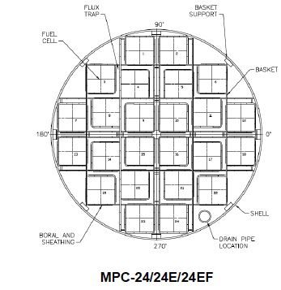
Used nuclear fuel (UNF) is stored in a basket built as a honeycomb of cellular elements positioned within a canister
Fuel basket structure and canister are typically made of stainless steel
Coated carbon steel has also been used
Neutron absorber (such as Boral®) plates are attached to the basket cells
Neutron absorbers are comprised of a chemical form of the neutron absorber nuclide (such as B-10 in B₄C) and a matrix (such as Al or stainless steel) that holds the absorber nuclide
Canisters are typically dual-purpose canisters (DPCs) as they are designed for storage and transportation
The canister is placed in different overpacks for storage, transportation, and disposal (if they are to be disposed of)

Slide 5
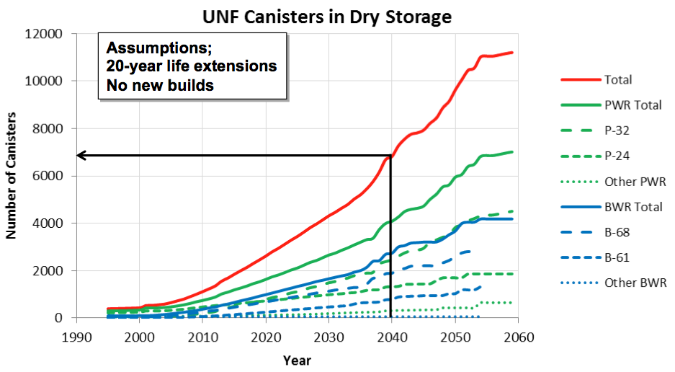
Used nuclear fuel will eventually be disposed of in a geological repository
Current used fuel disposition campaign research is focused on investigating the feasibility of direct disposal of existing canister systems (DPCs)
Why evaluate direct disposal of large DPCs?
Lower cost
Less fuel handling
Less repackaging (facilities, operations, new canister hardware)
Lower worker dose
Less secondary waste (e.g., no separate disposal of existing DPC hulls)
Sometime before 2040 more than half of the commercial UNF in the U.S. will be stored in ~7,000 DPCs at power plants or decommissioned sites.

Slide 6
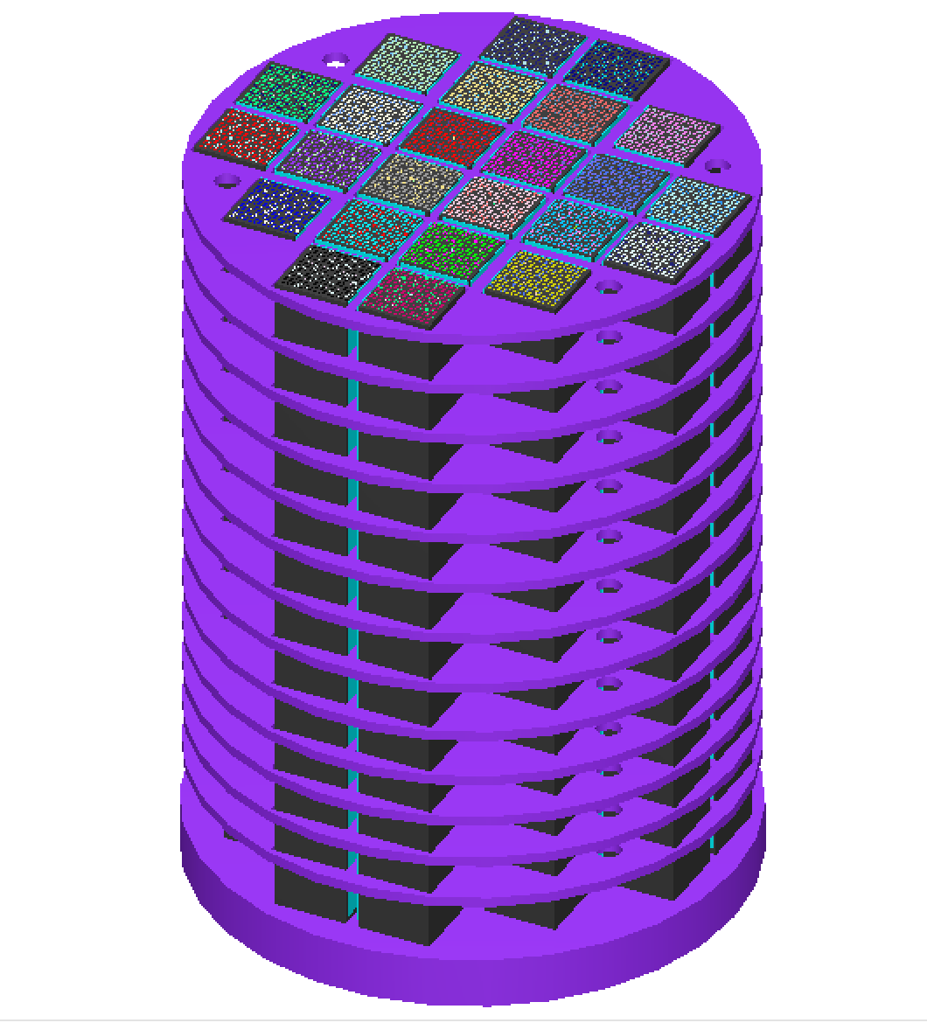
One of the principal challenges to direct disposal of DPCs is the potential for criticality over repository time frames
Groundwater (moderator) infiltration and associated DPC structural degradation (e.g., degradation of neutron absorber panels) need to be considered due to long repository time frames (1000s of years)
Detailed analysis and other engineering options are being explored to demonstrate DPC subcriticality over repository time frames
Inherent uncredited criticality margins in DPCs associated with as-loaded configurations
Neutron absorption of various dissolved aqueous species in groundwater
Mitigation of DPC post-closure criticality by filling the DPC cavity before disposal

Slide 7
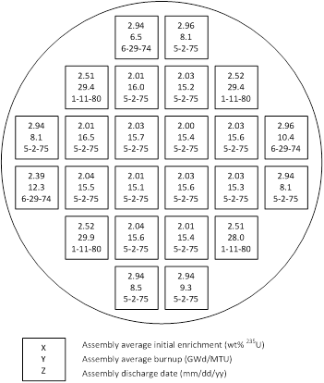
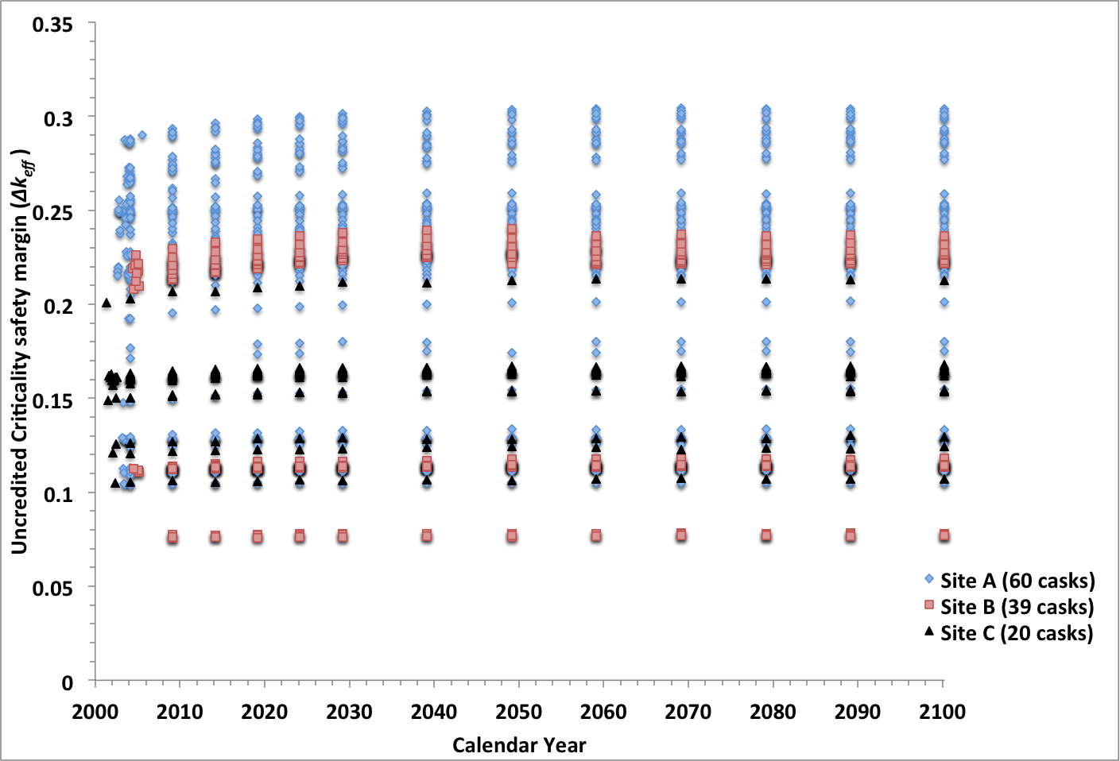
Uncredited criticality margins in DPC can be credited to offset reactivity increase from flooding and material degradation
Storage and transportation Certificates of Compliance are based on established bounding loading specifications using design-basis limits
Because of the diverse UNF inventory, it is not possible to load a DPC with UNF that represent exactly the design-basis limits, thereby providing some amount of unquantified, uncredited safety margin
The uncredited safety margin associated with actual loading is investigated to offset reactivity increases from flooding and associated basket material degradation

Slide 8
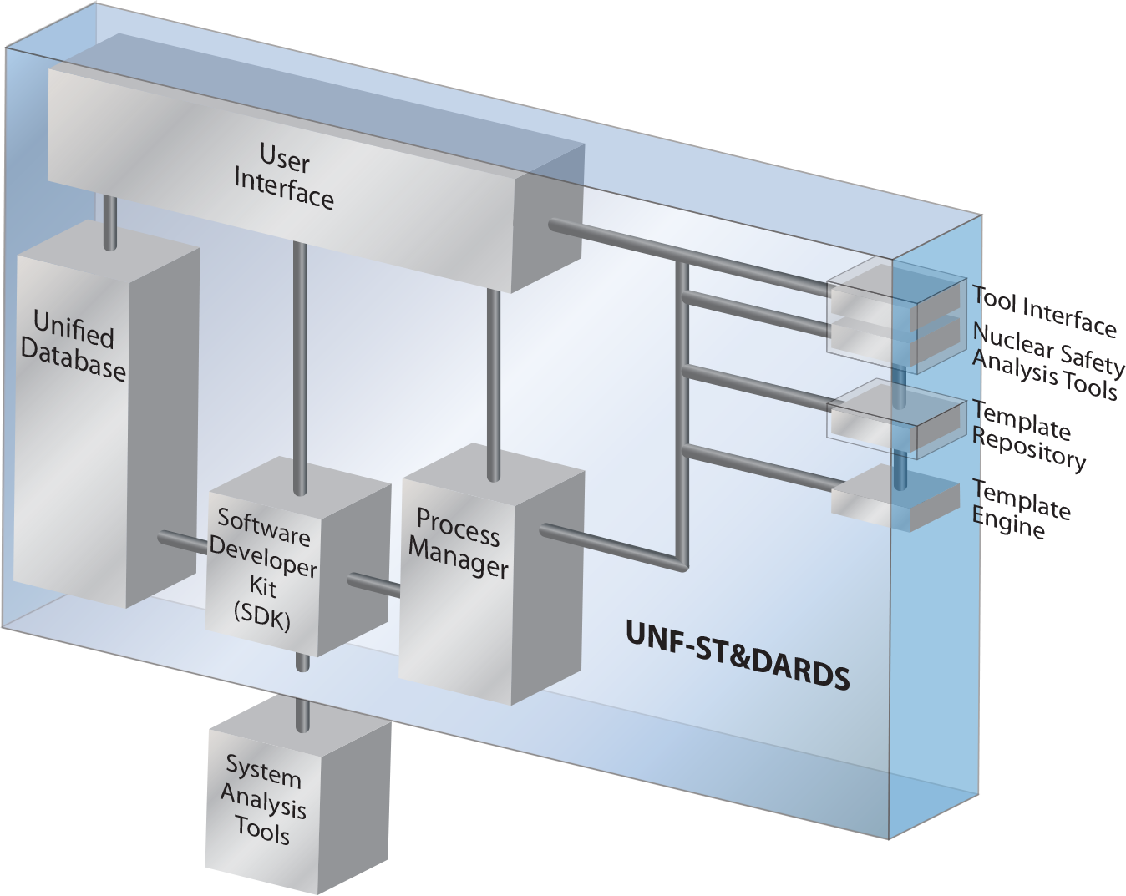
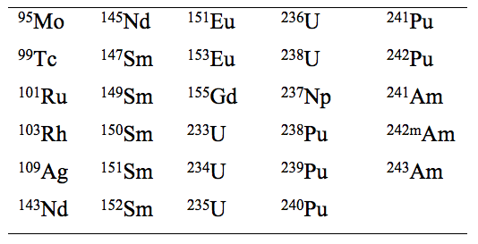
Inherent uncredited criticality margins in DPCs associated with as-loaded configurations are being quantified
Used Nuclear Fuel- Storage, Transportation & Disposal Analysis Resource and Data System (UNF-ST&DARDS) is used for as-loaded analyses
ORNL’s SCALE code is used for criticality analyses
Principal set of isotopes (29) are used for criticality analyses
Pressurized water reactor (PWR) axial burnup profiles are used from NUREG/CR-6801
Uniform profile is used for the one boiling water reactor (BWR) site analyzed
Depletion calculations included the presence of burnable poison rod (PWR) and control blade (BWR) throughout the irradiation time

Slide 9
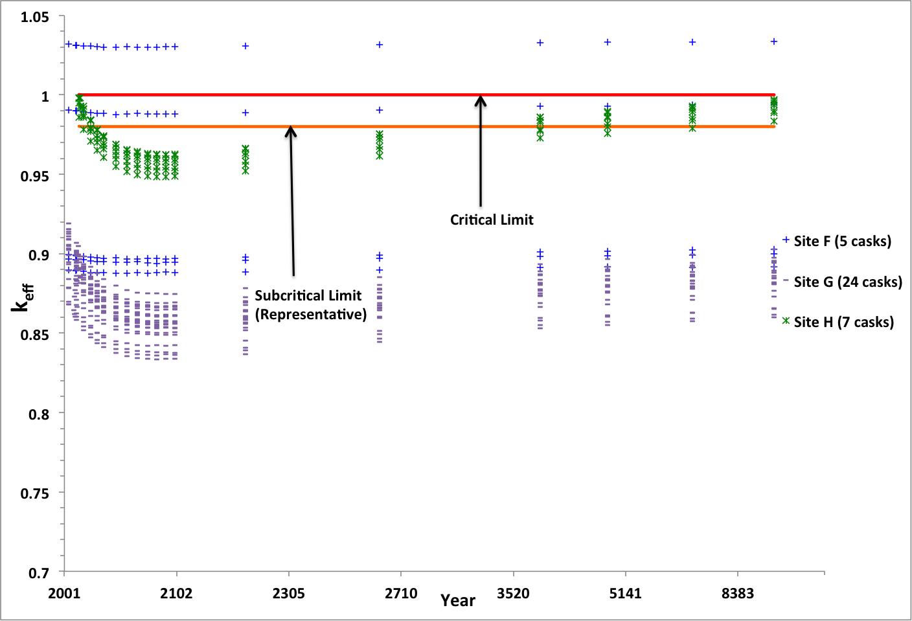
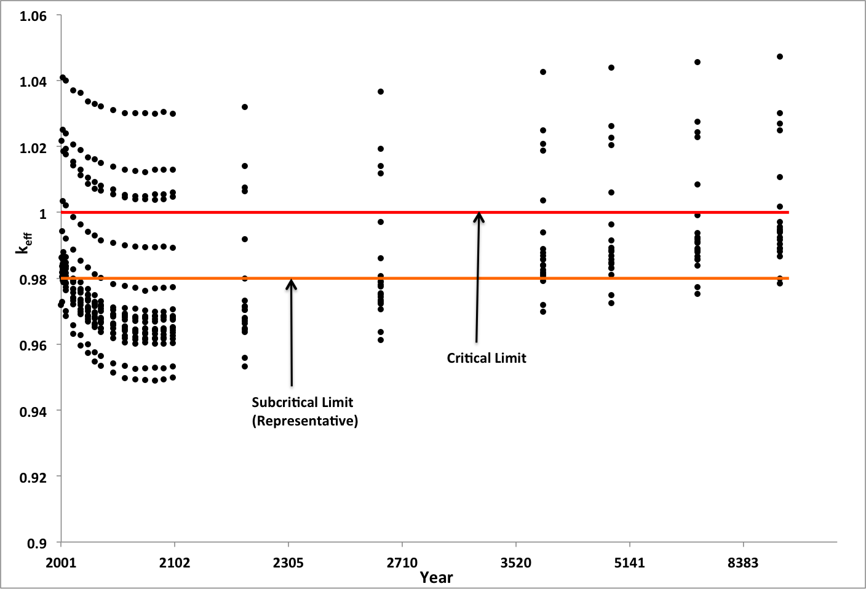
Criticality analyses are performed for loaded DPCs at eight sites using as-loaded configuration
215 loaded DPCs at eight sites are analyzed
Six DPC types including 24-assembly baskets (flux trap design) and 32-assembly basket
One BWR site analyzed
Two degradation scenarios are considered
Loss of neutron absorber panels (seven sites)
loss of carbon steel components and neutron absorber panels (one site)
Representative subcritical limit
k_{eff} <0.98 is used in this study as a representative acceptance criteria for as-loaded calculations
With loss of neutron absorber panels
With loss of neutron absorber panels
With loss of neutron absorber panels
and carbon steel components (Site C)

Slide 10
75% of analyzed DPCs are below the representative subcritical limit with as-loaded analysis (fresh water)
What else can be credited?

Slide 11
Geochemistry of the repository will determine the composition of groundwater
The dissolved aqueous species available in the groundwater widely vary depending on the geochemistry of the repository concepts under considerations (salt, crystalline rock, clay/shale, sedimentary rock, and hard rock)
The following dissolved species are commonly available in varying quantity in the repository concepts under consideration
Ca, Li, Na, Mg, K, Fe, Al, Si, Ba, B, Mn, Sr, Cl, S, Br, N, and F
The quantity of the dissolved species can vary from less than 1 mg/liter (for example, Li in Opalinus clay*) to more that 150,000 mg/liter (for example, Cl in a salt repository**)
*Y. Wang et. al., “Integrated Tool Development for Used Fuel Disposition Natural System Evaluation – Phase I Report,” Prepared for U.S. Department of Energy Used Fuel Disposition, FCRD-UFD-2012-000229 SAND2012-7073P, 2012.
**J. Winterle et. al., “Geological Disposal of High-Level Radioactive Waste in Salt Formation.” Center for Nuclear Waste Regulatory Analyses, San Antonio, Texas, March 2012.

Slide 12
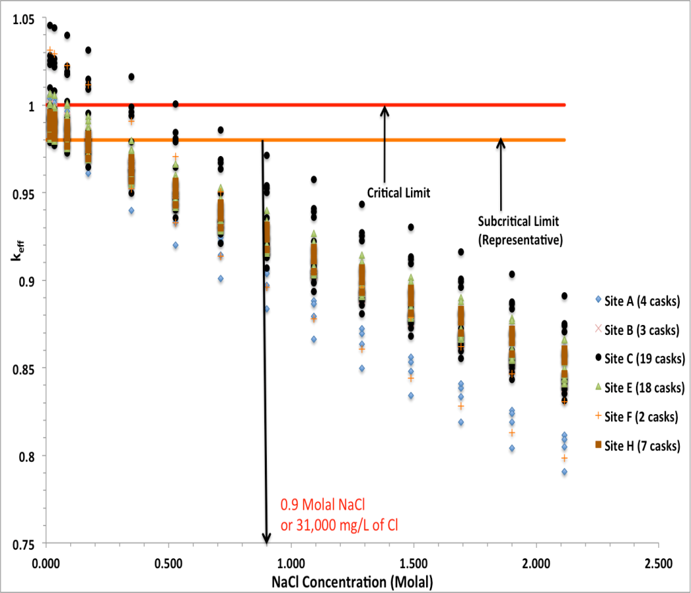
Only Cl is expected to be present in sufficient amounts to suppress reactivity in the geological media under consideration
In addition to salt repository concepts, Cl is also available (in moderate quantity) in clay*, granite* and crystalline rock**
The quantity of Cl varies between the geological media
Literature reviews show that Li and B may also be available in small quantity in some geological media*
Other commonly available dissolved aqueous species may not yield a significant neutron absorption effect, but together may provide a significant moderator displacement effect (not studied here)
*Y. Wang et. al., “Integrated Tool Development for Used Fuel Disposition Natural System Evaluation – Phase I Report,” Prepared for U.S. Department of Energy Used Fuel Disposition, FCRD-UFD-2012-000229 SAND2012-7073P, 2012.
**C.F. Jove Colon et. al. “Disposal Systems Evaluations and Tool Development – Engineered Barrier System (EBS) Evaluation,” Prepared for U.S. Department of Energy Used Fuel Disposition Campaign, SAND2010-8200, 2011.

Slide 13
Filler materials can also be used to prevent flooding of the DPCs during the repository time frames
The moderator displacement aspect of the filler materials is investigated using as-loaded DPCs at Site E (with loss of neutron absorber)
Aluminum is used as a representative filler material that only provides water displacement
Gibbsite (Al(OH)₃), which is a mineral of aluminum and can potentially form from aluminum in the presence of water over the repository performance period, is also considered
58% and 68% volumetric mixtures of filler materials are considered
Filler Material
Water
Water
Filler Material

Slide 14
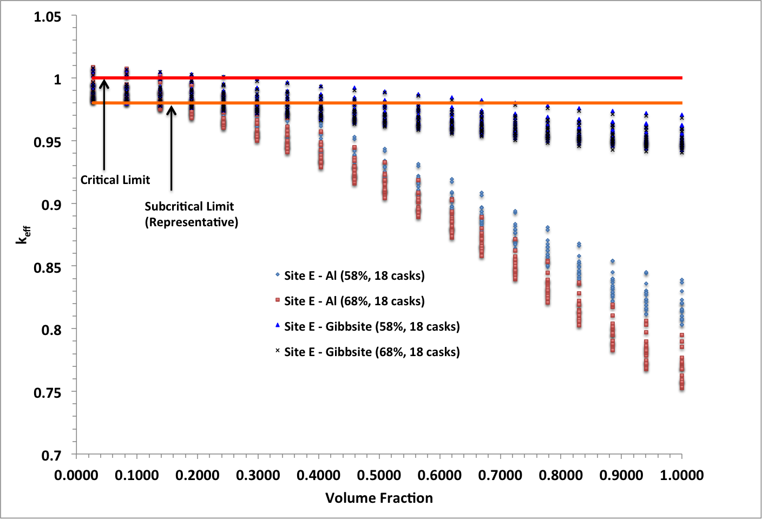
Filler materials should occupy substantial DPC volume to provide criticality control over repository time frames
About 34% volume (58% volumetric mixture) is required to be filled (uniformly) by aluminum slurry to maintain k_{eff} below 0.98 for all the DPCs at Site E in the year of 9999
However, if the aluminum turns into gibbsite (or other similar materials that react with water to form a hydrogenous compound) over the repository time frames, about 72.5% volume would be required to be filled

Slide 15
DPC disposal criticality safety demonstration may require both canister-specific evaluations and credit for neutron absorbers present in the groundwater
Direct Disposal of DPCs has many potential benefits
Criticality is a challenge
If chlorine from the repository environment is in the groundwater, there may be substantial criticality benefits
It may be difficult to benchmark this analysis with current criticality experiments
Using actual as-loaded cask models (instead of design basis models), provides another significant criticality benefit
Preconditioning measures such as adding filler materials to fill the canister void region and displace the moderator could be another option to mitigate post-closure criticality
Additionally, criticality consequence analyses can be used to determine the impact of one or more criticality events on the repository performance

