Slide 1
Consolidated Interim Storage Facility Design Concepts In the
United States
Nuclear Fuels Storage and
Transportation Planning Project
IAEA International Conference on the
Management of Spent Fuel from Nuclear
Power Reactors
Joe T. Carter
Vienna, Austria.
15-19 June, 2015

Slide 2
Outline
US Commercial Fuel Inventory
  Focus on Shutdown Reactor Inventory
Pilot Interim Storage Facility Concepts
  Currently licensed storage systems
  Underground storage concepts
  Vault storage concepts

Slide 3
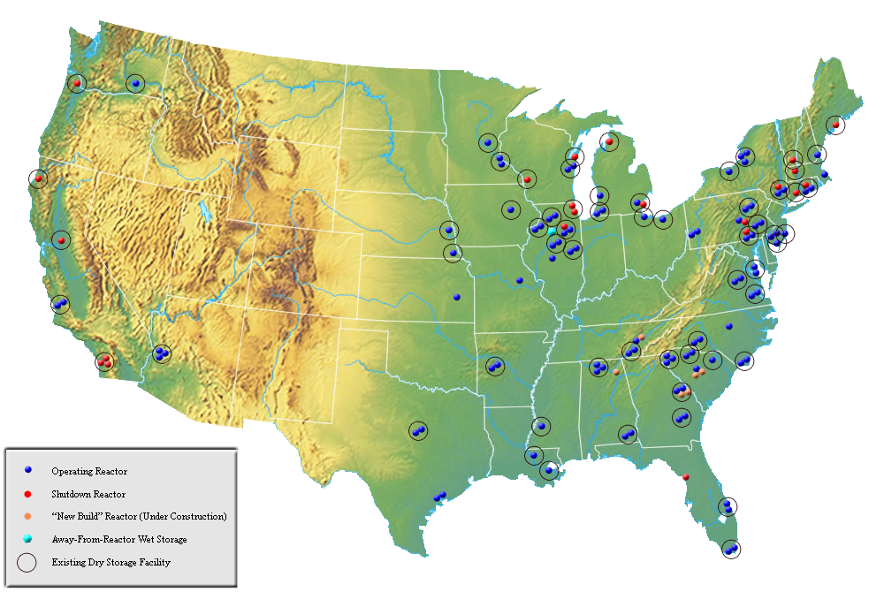
US History of Commercial Power Reactors
130 Nuclear Power Plants Built for Commercial Power Generation
9 Early Prototypes
  No fuel on site
1 Never Operated
1 Disabled
  Fuel moved to DOE
1 Demonstration High Temperature Gas Reactor
19 Ceased Operations
  Fuel on site
  3 reactors on sites with on going nuclear operations
  16 reactors on 13 sites with no other nuclear operations
99 Operating Reactors
6 New Units Under Active Construction
IAEA June 15-19, 2015

Slide 4
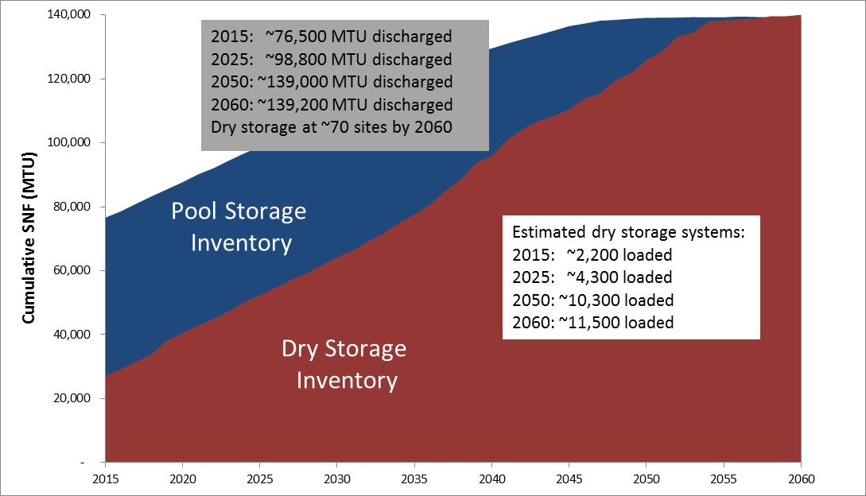
Projected Inventory (Dec 2015 to Dec 2060)
Current Reactors Operate 60 Years, 5 New Builds Operate 40 Years

Slide 5
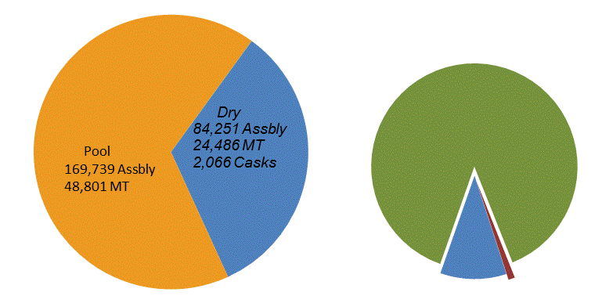
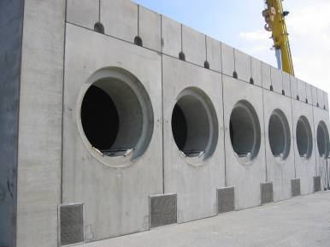
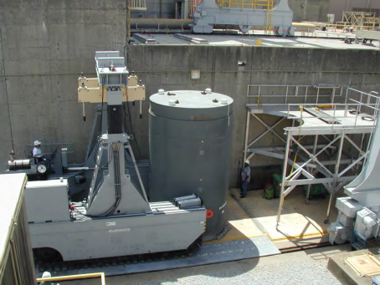
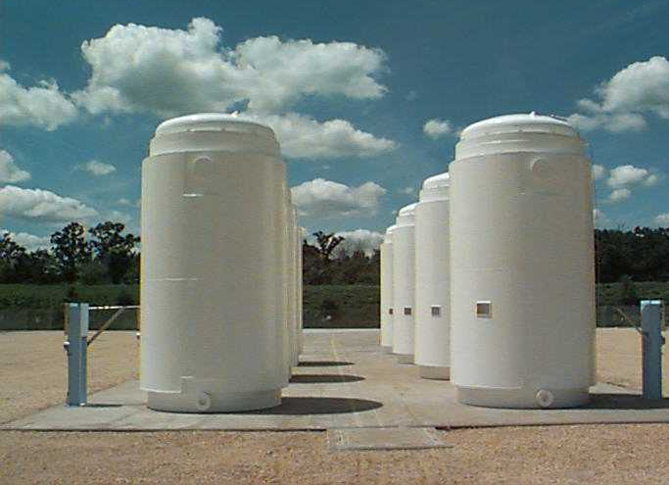
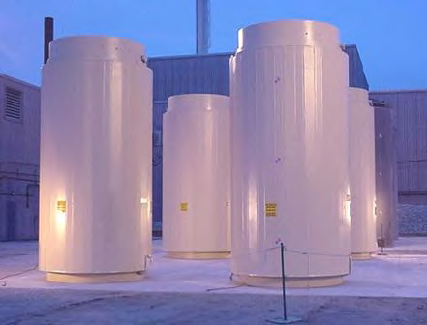
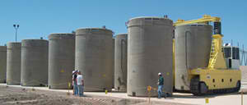
Commercial Dry Storage Inventory is Diverse and Growing
Inventory as of April 7, 2015
1,865 Welded Metal Canisters In Vented Concrete Overpacks
74,804 Assemblies,
88.6% of Dry
Transnuclear (37%)
Holtec (41%)
NAC (20%)
12 Welded Metal Canisters
in Transport Overpacks
866 Assemblies, 1.0% of Dry
Majority is in Large Welded Canisters
Current dry storage inventory is diverse
Trend toward higher capacities
189 Bare Fuel Casks
8,758 Assemblies, 10.4% of Dry
Transnuclear TN-32
Holtec Hi-Star 100
IAEA June 15-19, 2015

Slide 6
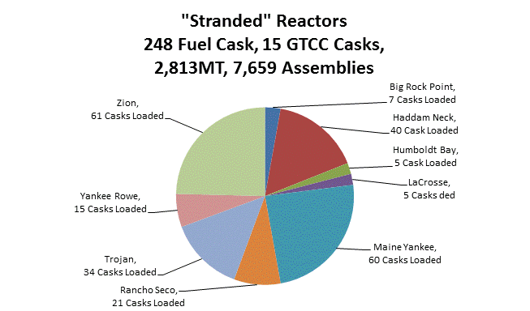
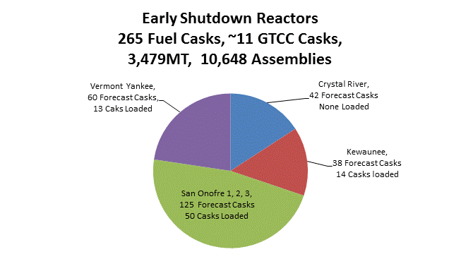
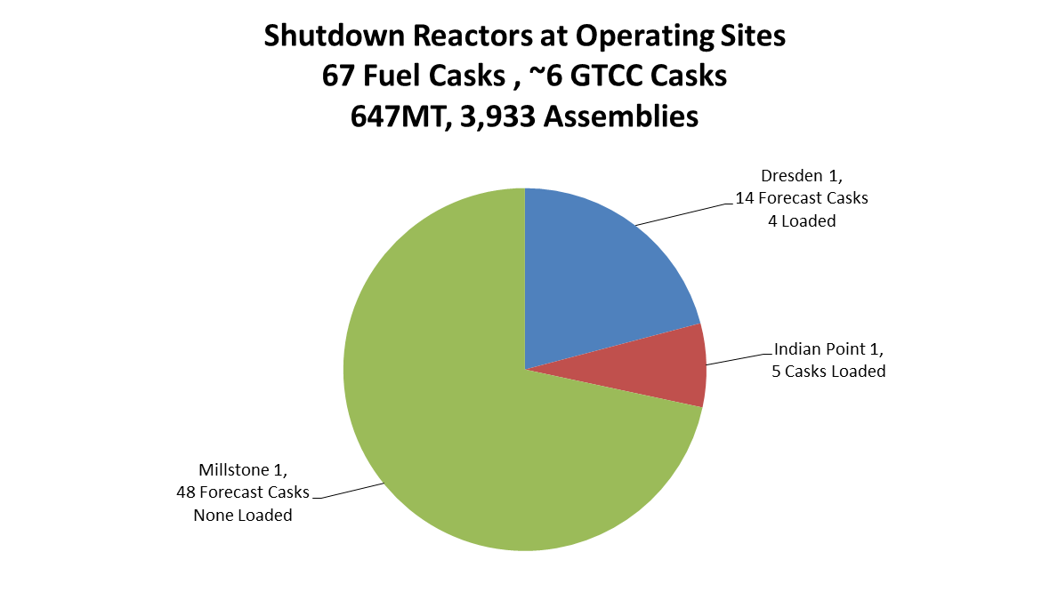
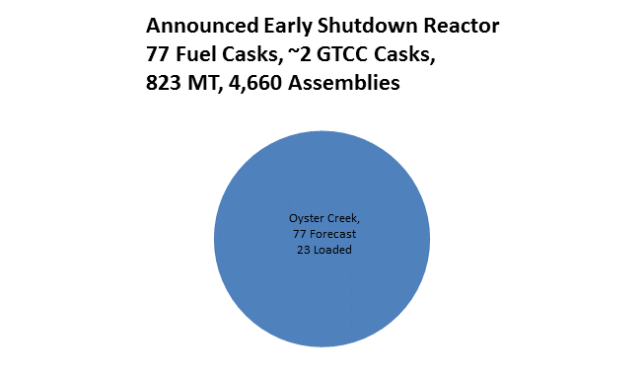
Shutdown Reactor Sites are Increasing in Number
Four Categories of Shutdown Reactor Fuel
Notes:
Could drop this slide

Slide 7
Shutdown Sites
Dual Purpose Canisters
Cask System | Canister Family | Canister | Transportation Cask | Total Canisters Generated in Reference Scenarioª
Fuel Solutions | W74 | W74T | TS125 | 7
HI-STORM 100 | MPC-32 (HI-STORM) | MPC-32 (HI-STORM) | HI-STAR 100 | 5
 | MPC-68 (HI-STORM) | MPC-68 (HI-STORM) | HI-STAR 100 | 70 Forecast, 13 loaded, remainder canister uncertain
 |  | MPC-68F (HI-STORM) | HI-STAR 100
 |  | MPC-68FF | Not Available
 |  | MPC-68M | Not Available
HI-STORM TranStor | MPC-24 (TranStor) | MPC-24E (TranStor) | HI-STAR 100 | 34, canister uncertain
 |  | MPC-24EF (TranStor) | HI-STAR 100
HI-STAR 100 | MPC-68 (HI-STAR) | MPC-68 (HI-STAR) | HI-STAR 100 | 4, canister uncertain
 |  | MPC-68F (HI-STAR) | HI-STAR 100
HI-STAR 100HB | MPC-HB | MPC-HB | HI-STAR 100HB | 5
Standardized NUHOMS | NUHOMS 32PT | NUHOMS 32PT-L100 | MP197 or MP197HB | 14, Canister uncertain
 |  | NUHOMS 32PT-L125 | MP197 or MP197HB
 |  | NUHOMS 32PT-S100 | MP197 or MP197HB
 |  | NUHOMS 32PT-S125 | MP197 or MP197HB
 | NUHOMS 32PTH1 | NUHOMS 32PTH1-L | MP197 or MP197HB | 42, None loaded canister uncertain
 |  | NUHOMS 32PTH1-M | MP197 or MP197HB
 |  | NUHOMS 32PTH1-S | MP197 or MP197HB
 | NUHOMS 61BT | NUHOMS 61BT | MP197 or MP197HB | 125 Forecast, 23 loaded, Remainder uncertain
 | NUHOMS 61BTH | NUHOMS 61BTH Type 1 | MP197HB
 |  | NUHOMS 61BTH Type 2 | MP197HB
 | NUHOMS FC-DSC | NUHOMS FC-DSC | MP187 | 18
 | NUHOMS FF-DSC | NUHOMS FF-DSC | MP187 | 1
 | NUHOMS FO-DSC | NUHOMS FO-DSC | MP187 | 2

Slide 8
Shutdown Sites
Dual Purpose Canisters (Con’t)
Cask System | Canister Family | Canister | Transportation Cask | Total Canisters Generated in Reference Scenarioª
Advanced NUHOMS | NUHOMS 24PT1 | NUHOMS 24PT1 | MP187 | 17
 | NUHOMS 24PT4 | NUHOMS 24PT4 | MP197HB | 33
UMAX | MPC-37 |  |  | 75
NAC-MPC | CY-MPC, 26 Assy | CY-MPC, 26 Assy | NAC-STC Transport Cask | 40
 | LACBWR | MPC-LACBWR | NAC-STC Transport Cask | 5
 | Yankee-MPC | Yankee-MPC | NAC-STC Transport Cask | 15
NAC-UMS | UMS-PWR | TSC-Class 1 | Universal Transport Cask | 60, Canister uncertain
 |  | TSC-Class 2 | Universal Transport Cask
 |  | TSC-Class 3 | Universal Transport Cask
NAC-MAGNASTOR | TSC PWR | TSC PWR | MAGNATRAN | 85 Forecast, 61 loaded
Total Potential Casks | 20 Canister Families | 33 Potential Canisters | 9 Transport Cask | 657 Fuel Casks 34 GTCC Casks

Slide 9
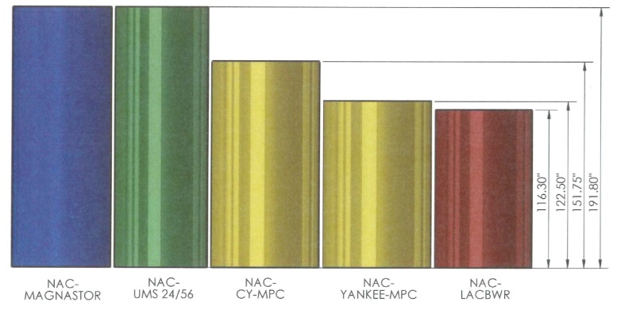
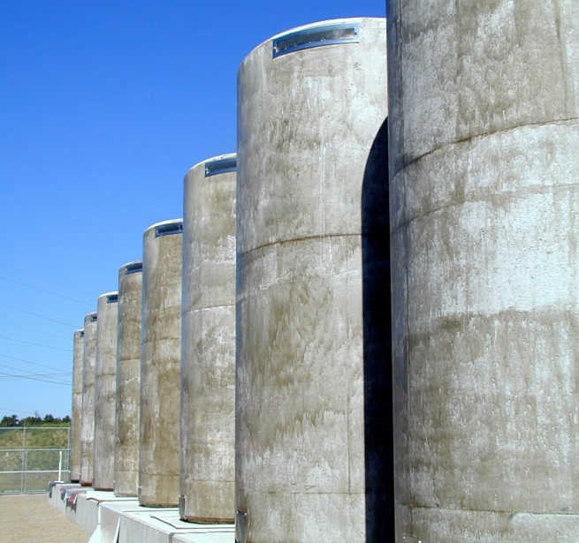
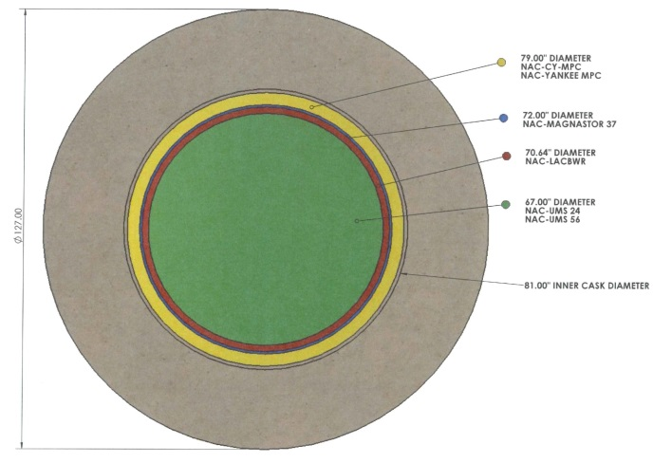
Example of Canister Diversity
NAC Diameters and Lengths Illustrated
NAC UMS System at Maine Yankee

Slide 10
Pilot Storage Facility Concept
5,000 to 10,000 MT capacity with a design receipt rate of 1,500 MT/year
  Accept dry storage canisters (DSC) from shutdown reactors, see next slide
  Accept Greater-Than-Class C Low Level Waste from decommissioned power reactors, and other approved contents in canisters
  Receive fuel in dual purpose canisters (DPC) in associated transportation casks
  Deployed in modules for storage capacity and additional functional capability
Fully developed facilities will include:
  Shielded cask-handling building for transfer of the canister from transportation casks to storage overpacks
  Storage pads with multiple vertical and horizontal storage overpack designs
  Infrastructure and balance of plant facilities
Designed to Meet:
  10CFR72
  10CFR73
  Associated Regulatory Guides (e.g. RG 3.60, 3.48 & 3.62)
  Guidance from NUREG – 1567 and 1927
IAEA June 15-19, 2015

Slide 11
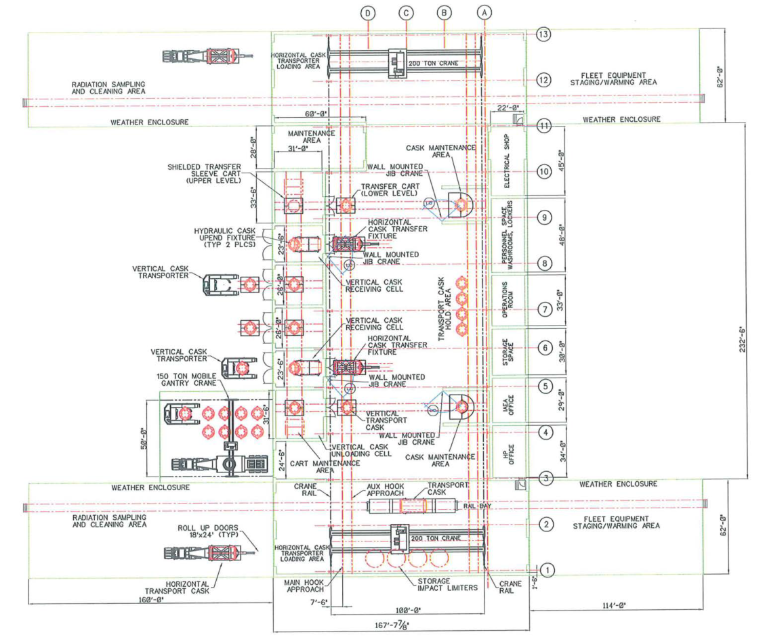
Canister Receipt Design Concept 1
Canister Transfer Building
Perform Post Transportation:
  Inspections,
  Radiological Surveys,
  Decontamination (if necessary)
  Security Receipt Inspections
Transfer Canister to New Overpack and
Relocate to Storage Pad
  Vertical Casks:
    Uprighted
    Transferred to Vertical Storage Overpack using
    Facility Cask
    Vertical Storage Cask Relocated to Pad
  Horizontal Casks:
    Loaded onto Transporter
    Relocated to Storage Pad using Transporter
    Transferred to HSM using Transport Cask
Existing Canisters are Placed into Storage w/o Opening
IAEA June 15-19, 2015

Slide 12
Canister Receipt Design Concept 2 & 3
Cask Handling Building with Remote Operations
  Higher Capital versus Concept 1
  Additional Complexity versus Concept 1
  Did NOT Provide Significant Dose Reduction versus Concept 1
Commercially Available Transfer Cask Used with:
  Mobile Cranes, no weather enclosure
  Installed Cranes in a weather enclosure
  Diversity of Canister Types is Challenging
  Highest Dose of the Alternatives Evaluated
  Method Being Considered for Early Operations
IAEA June 15-19, 2015

Slide 13
Storage Configuration Concept 1
Overpacks on a Pad
Pad Storage Using Currently Licensed Storage Overpacks
New Horizontal or Vertical Concrete Overpacks as required
  Most recent licensed overpack associated with each canister type,
  Limit to the extent possible storage overpack configurations
  Canisters which do not have a current commercial source for new storage casks must be identified and required license actions identified
  Considering Re-use of the Big Rock Point Fuel Solutions overpacks, segmented for transportation
Metal Storage/Transportation Overpacks can be Re-used
IAEA June 15-19, 2015

Slide 14
Pilot Conceptual Generic Layout
Two 5,000MT Storage Modules
IAEA June 15-19, 2015

Slide 15
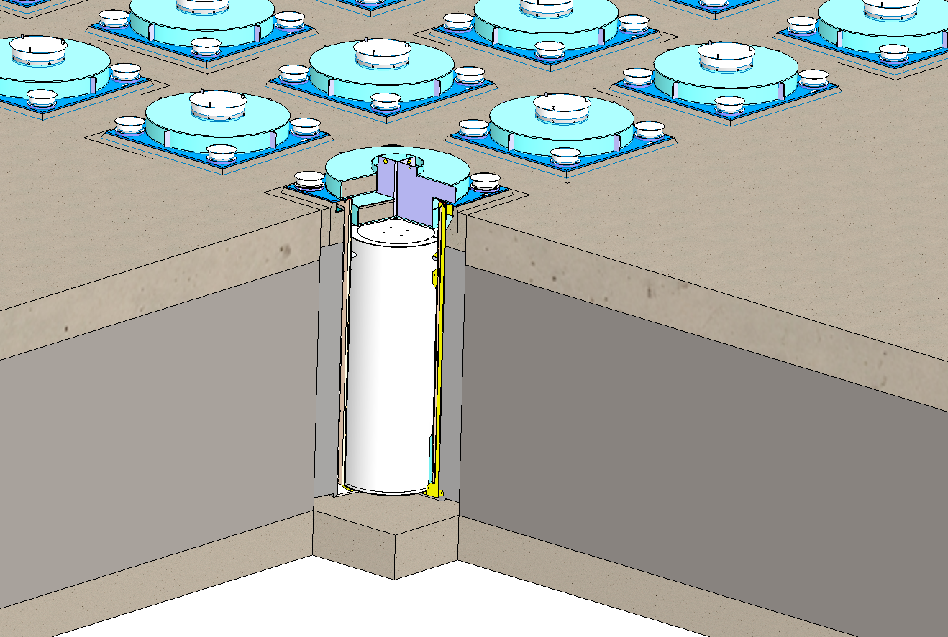
Storage Configuration Concept 2
Underground Silos
Underground Silo Storage
Similar to UMAX deployed at Callaway and announced for San Onofre
Reduced Security Requirements
Reduced Storage Area Dose
Licensing Challenges to Accept all Canister Types in a Vertical Storage Configuration
  Adaptors for the various canister sizes
  Fuel Orientation in currently horizontal configuration canisters
24,000 lb. Steel / Concrete Closure Lid
Reinforced Concrete Top Pad
Corrosion-Resistant Stainless Steel Spent Fuel Canister
Low Strength Concrete Monolith
Reinforced Concrete Base Mat
Corrosion-Resistant Stainless Steel Liner
IAEA June 15-19, 2015

Slide 16
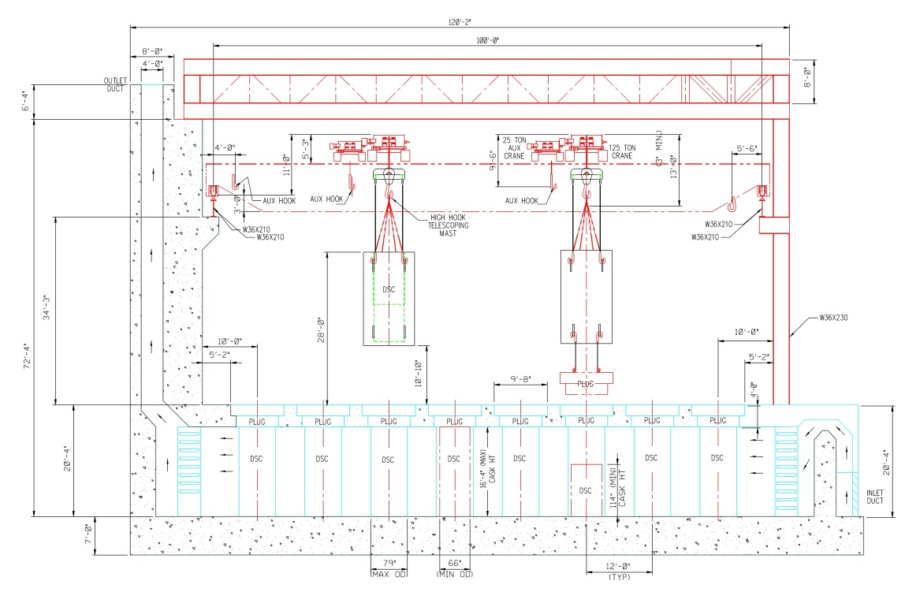
Storage Configuration Concept 3
Vault Configurations
Vertical Configuration
Similar to Ft. St. Vrain
Passive Air Cooled
  Decay Heat Limited
Licensing Challenges to Accept all Canister Types in a Vertical Storage Configuration
  Adaptors for the various canister sizes
  Fuel Orientation in currently horizontal configuration canisters
Horizontal Configuration
Licensing Challenges to Accept all Canister Types in a Horizontal Storage Configuration
  Adaptors for the various canister sizes
Access Not Available for Every Storage Position
Decay Heat Removal Extremely Challenging in a Passive Cooling Mode
IAEA June 15-19, 2015

Slide 17
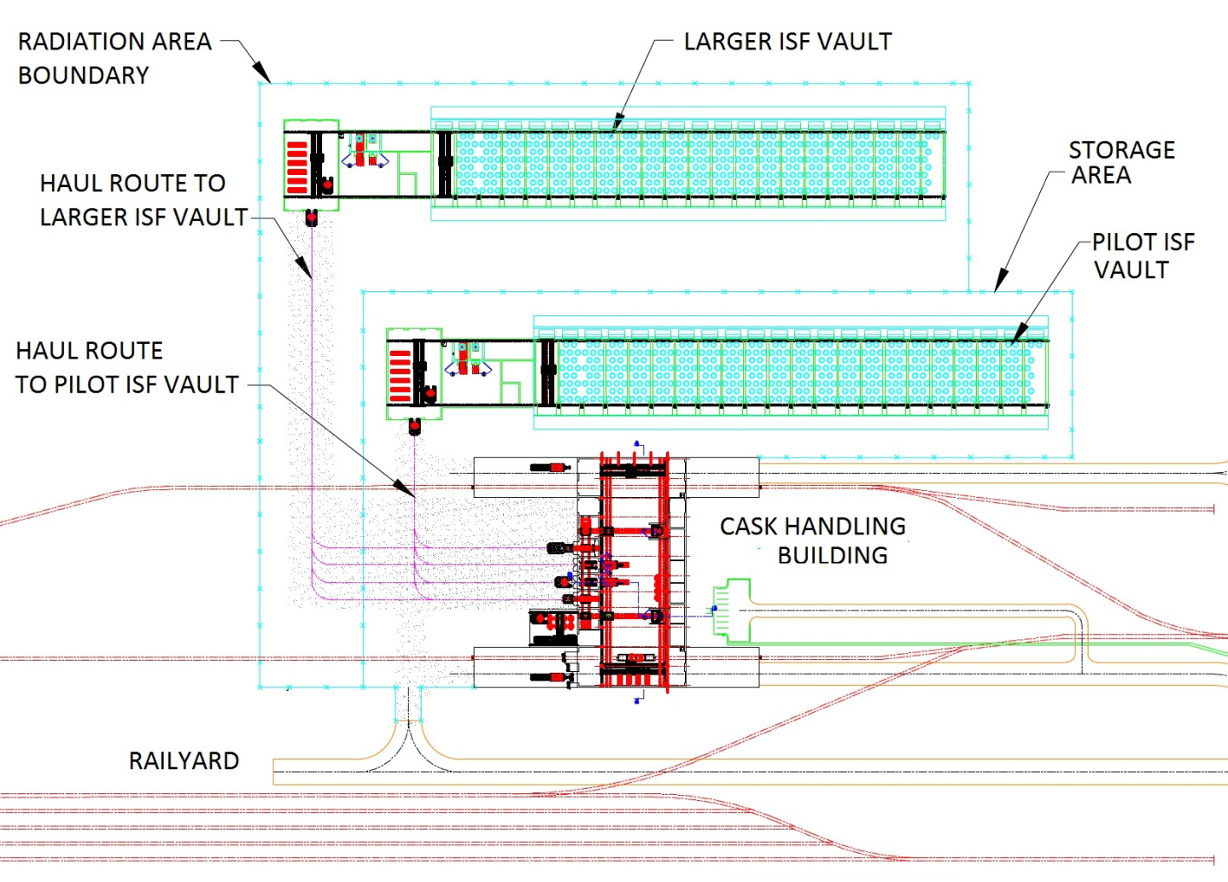
Vault Configuration Generic Layout
With Single Cask Handling Building
2 – 5,000MT Modules
IAEA June 15-19, 2015

Slide 18
Questions/Discussion
IAEA June 15-19, 2015

