Slide 1
Disposability of Loaded US Dual-Purpose Canisters from a Criticality Standpoint
Kaushik Banerjee, John M. Scaglione, and Justin B. Clarity
Oak Ridge National Laboratory
Used Fuel Disposition R&D Campaign
Contact: banerjeek@ornl.gov
IHLRWM
Charleston, SC, 12-16 April, 2015

Slide 2
Outline
Background
As-loaded criticality analysis for a repository performance period with fresh water and postulated basket degradation
As-loaded criticality analysis for a repository performance period with groundwater (chlorinated) and postulated basket degradation
Conclusion

Slide 3
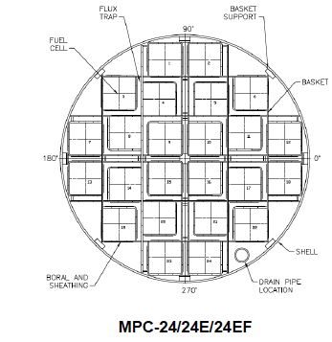
Used nuclear fuels (UNFs) are stored in a basket built as a honeycomb of cellular elements positioned within a canister
Fuel basket structure and canister are typically made of stainless steel
Coated carbon steel has also been used
Neutron absorber (such as Boral®) plates are attached to the basket cells
Neutron absorbers are comprised of a chemical form of the neutron absorber nuclide (such as B-10 in B₄C) and a matrix (such as Al or stainless steel) that holds the absorber nuclide
Canisters are typically dual-purpose canisters (DPCs) as they are designed for storage and transportation
The canister is placed in different overpacks for storage, transportation, and disposal (if they are to be disposed of)

Slide 4
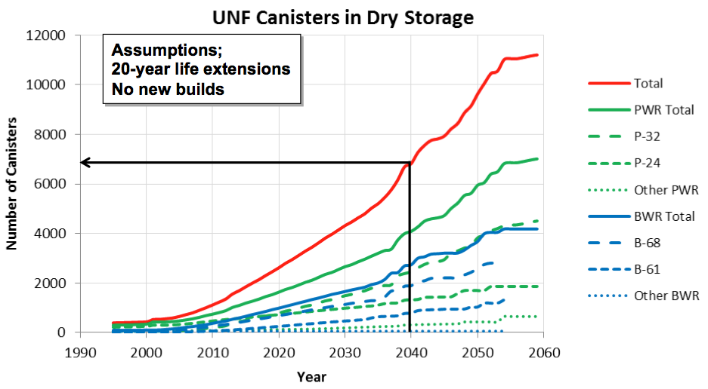
Used nuclear fuels will eventually be disposed of in a geological repository yet to be determined
Current used fuel disposition campaign research is focused on investigating the feasibility of direct disposal of existing canister systems (DPCs)
Why evaluate direct disposal of large DPCs?
Less cost
Less fuel handling
Less repackaging (facilities, operations, new canister hardware)
Lower worker dose
Less secondary waste (e.g., no separate disposal of existing DPC hulls)
Sometime before 2040 more than half of the commercial UNF in the U.S. will be stored in ~7,000 DPCs at power plants or decommissioned sites.

Slide 5
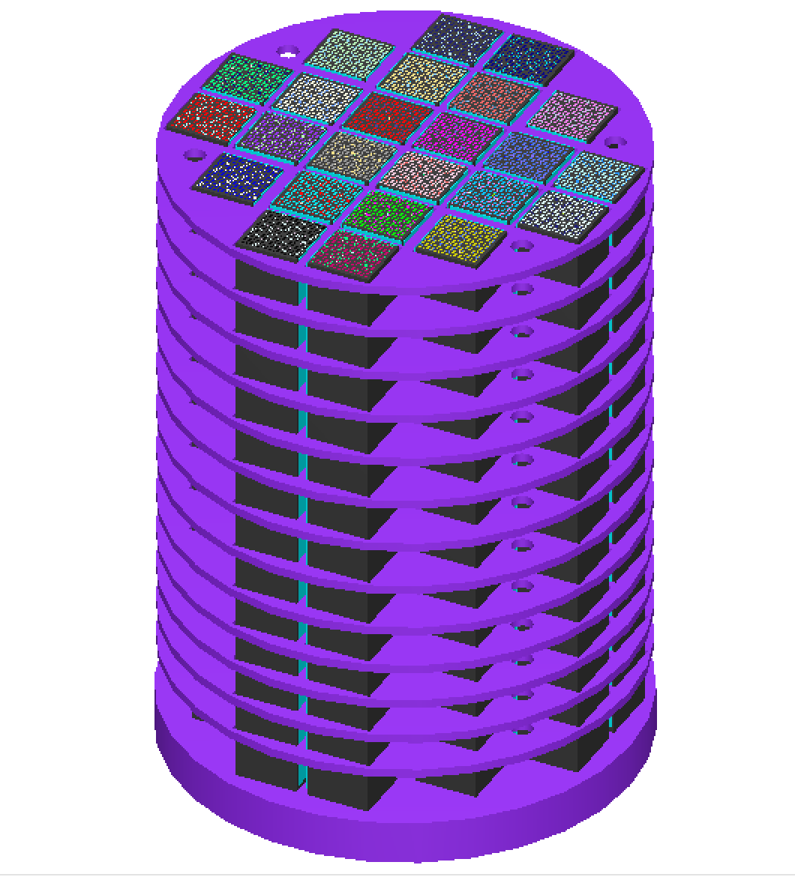
One of the principal challenges to direct disposal of DPCs is the potential for criticality over repository time frame
DPC criticality in a repository requires groundwater (also called moderator) infiltration and material and structural degradation
Criticality analysis process to support direct disposal of DPCs*
Two of the analysis steps identified in the criticality analysis process paper* are evaluated
Perform DPC model development to establish baseline (including key parameters that lead to criticality)
Inherent uncredited criticality margins in DPCs associated with as-loaded configurations are quantified
Groundwater analyses for different geologies
Various dissolved aqueous species are investigated to determine whether they can provide any reactivity suppression
*J. M. Scaglione et. al., “Criticality Analysis Process for Direct Disposal of Dual Purpose Canisters,” IHLRWM 2015.

Slide 6
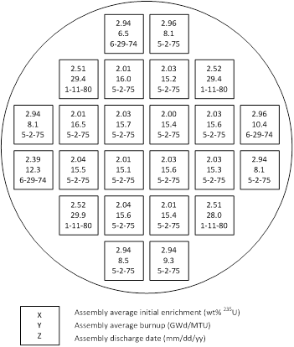
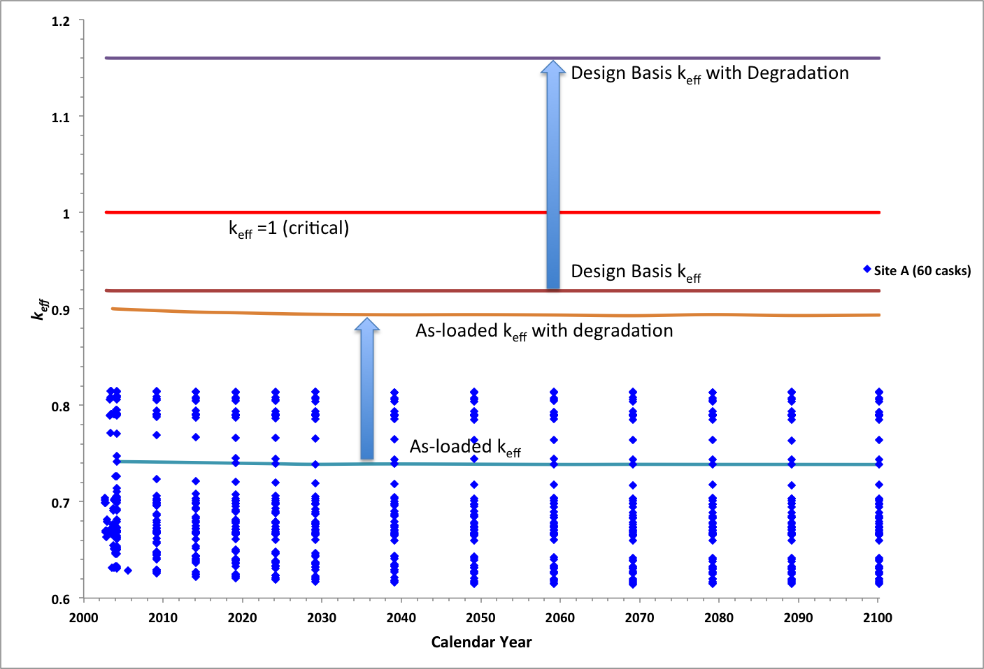
Uncredited criticality margins in DPC can offset reactivity increase from flooding and material degradation
Storage and transportation Certificates of Compliance are based on established bounding loading specifications using design-basis limits
Because of the diverse UNF inventory, it is not possible to load a DPC with UNF that represent exactly the design-basis limits, thereby providing some amount of unquantified, uncredited safety margin
The uncredited safety margin associated with actual loading is investigated to offset reactivity increases from flooding and associated basket material degradation

Slide 7
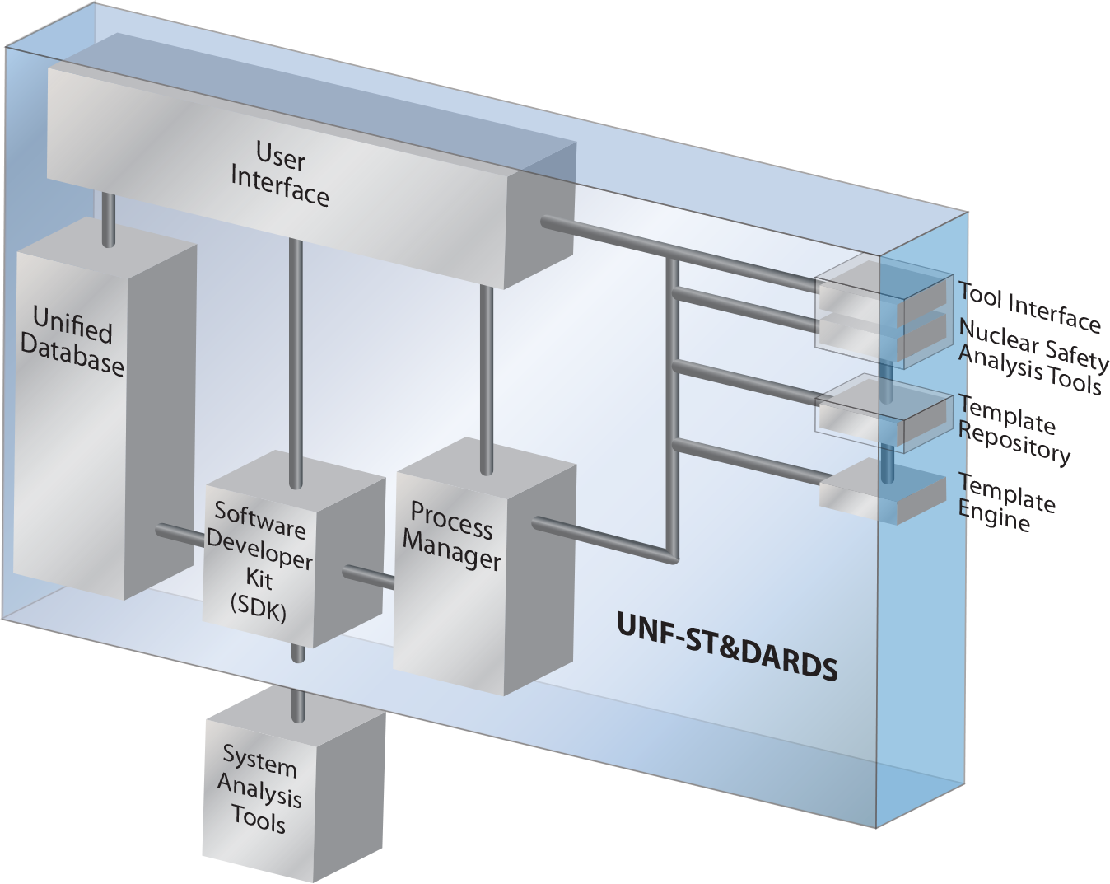
Used Nuclear Fuel- Storage, Transportation & Disposal Analysis Resource and Data System (UNF-ST&DARDS) is used for as-loaded analyses
UNF-ST&DARDS provides a comprehensive database and integrated analysis tools
ORNL’s SCALE code is used for criticality analyses
Principal set of isotopes (29) are used for criticality analyses
Pressurized water reactor (PWR) axial burnup profiles are used from NUREG/CR-6801
Uniform profile is used for the one boiling water reactor (BWR) site analyzed
Depletion calculations included the presence of burnable poison rod (PWR) and control blade (BWR) throughout the irradiation time

Slide 8
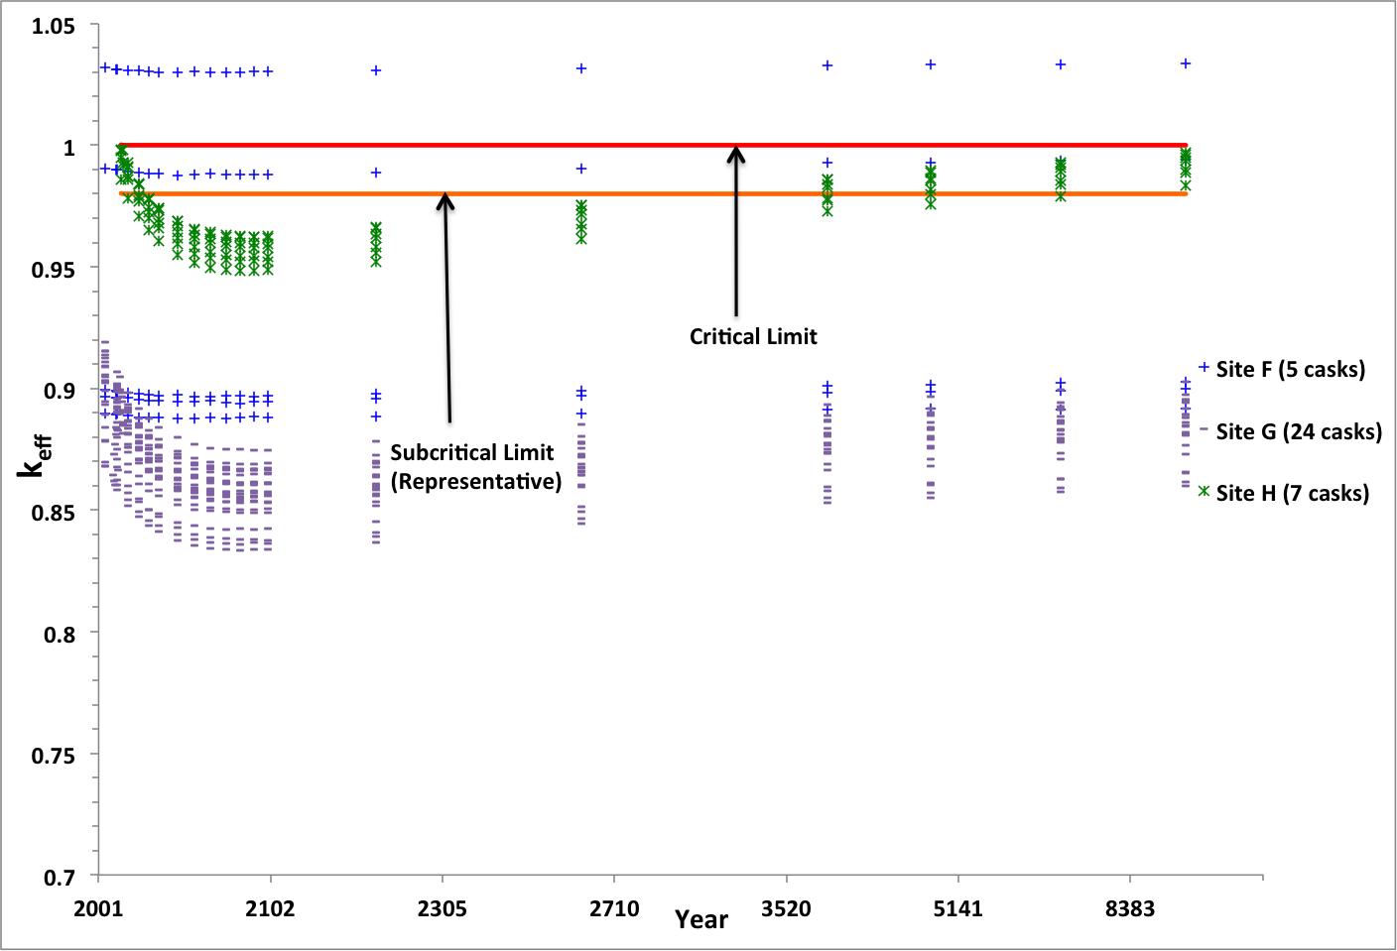
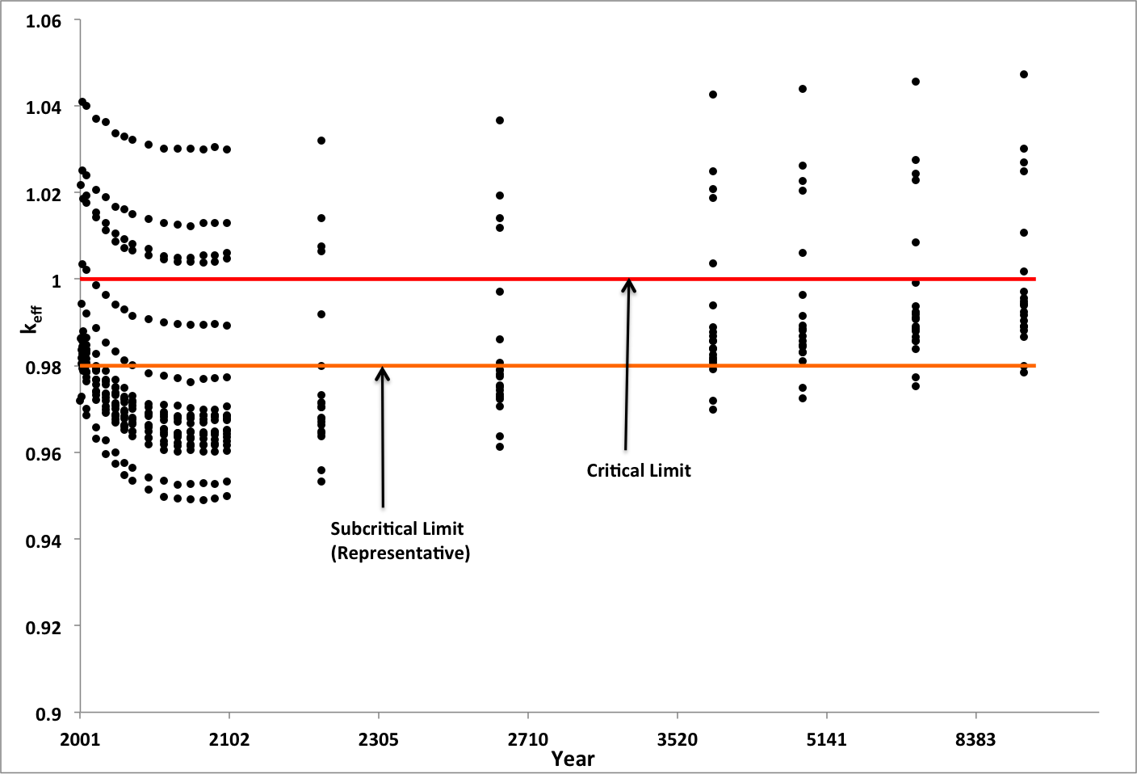
Criticality analyses are performed for loaded DPCs at eight sites using as-loaded configuration
215 loaded DPCs at eight sites are analyzed
Six DPC types including 24-assembly baskets (flux trap design) and 32-assembly basket
One BWR site analyzed
Two degradation scenarios are considered
Loss of neutron absorber panels (seven sites)
loss of carbon steel components and neutron absorber panels (one site)
Representative subcritical limit
k_{eff} <0.98 is used in this study as a representative acceptance criteria for as-loaded calculations
With loss of neutron absorber panels
With loss of neutron absorber panels
With loss of neutron absorber panels
and carbon steel components (Site C)

Slide 9
75% of analyzed DPCs are below the representative subcritical limit with as-loaded analysis

Slide 10
Geochemistry of the repository will determine the composition of groundwater
The dissolved aqueous species available in the groundwater widely vary depending on the geochemistry of the repository concepts under considerations (salt, crystalline rock, clay/shale, sedimentary rock, and hard rock)
The following dissolved species are commonly available in varying quantity in the repository concepts under consideration
Ca, Li, Na, Mg, K, Fe, Al, Si, Ba, B, Mn, Sr, Cl, S, Br, N, and F
The quantity of the dissolved species can vary from less than 1 mg/liter (for example, Li in Opalinus clay*) to more that 150,000 mg/liter (for example, Cl in a salt repository**)
*Y. Wang et. al., “Integrated Tool Development for Used Fuel Disposition Natural System Evaluation – Phase I Report,” Prepared for U.S. Department of Energy Used Fuel Disposition, FCRD-UFD-2012-000229 SAND2012-7073P, 2012.
**J. Winterle et. al., “Geological Disposal of High-Level Radioactive Waste in Salt Formation.” Center for Nuclear Waste Regulatory Analyses, San Antonio, Texas, March 2012.

Slide 11
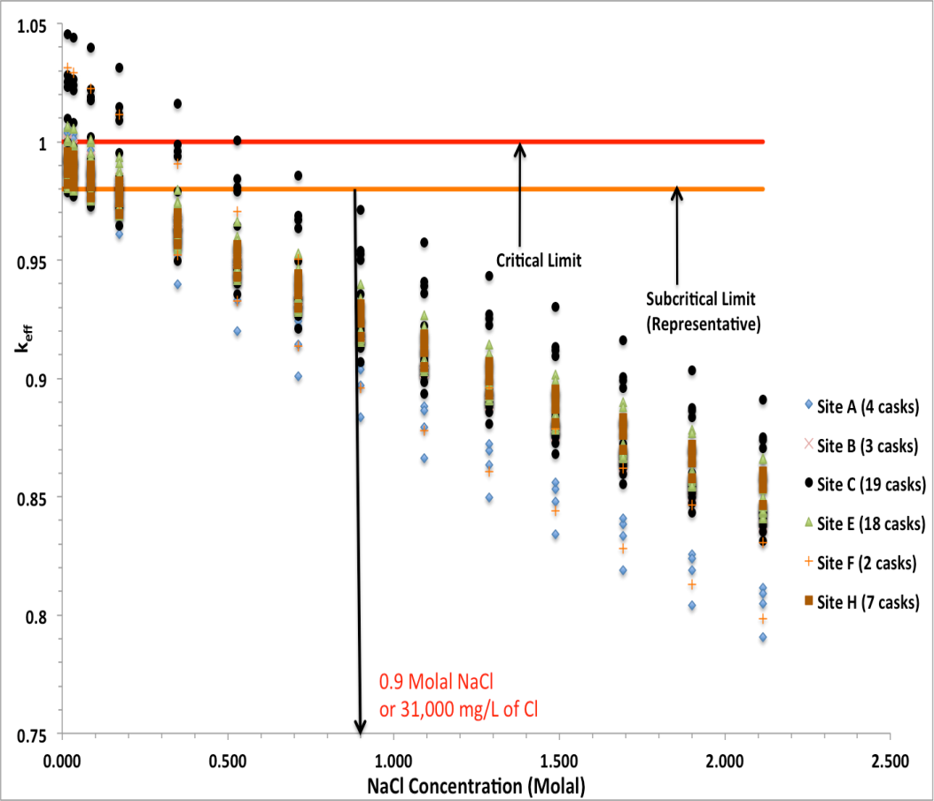
Only Cl is expected to be present in sufficient amounts to suppress reactivity in the geological media under consideration
In addition to salt repository concepts, Cl is also available (in moderate quantity) in clay*, granite* and crystalline rock**
The quantity of Cl varies between the geological media
Literature reviews show that Li and B may also be available in small quantity in some geological media*
Other commonly available dissolved aqueous species may not yield a significant neutron absorption effect, but together may provide a significant moderator displacement effect (not studied here)
*Y. Wang et. al., “Integrated Tool Development for Used Fuel Disposition Natural System Evaluation – Phase I Report,” Prepared for U.S. Department of Energy Used Fuel Disposition, FCRD-UFD-2012-000229 SAND2012-7073P, 2012.
**C.F. Jove Colon et. al. “Disposal Systems Evaluations and Tool Development – Engineered Barrier System (EBS) Evaluation,” Prepared for U.S. Department of Energy Used Fuel Disposition Campaign, SAND2010-8200, 2011.

Slide 12
DPC disposal criticality safety demonstration may require both canister-specific evaluations and credit for neutron absorbers present in the groundwater
Direct Disposal of DPCs has many potential benefits
Criticality is a challenge
If chlorine from the repository environment is in the groundwater, there may be substantial criticality benefits
It may be difficult to benchmark this analysis with current criticality experiments
Using actual as-loaded cask models (instead of design basis models), provides another significant criticality benefit
Additionally, criticality consequence analyses can be used to determine the impact of one or more criticality events on the repository performance

